Slide 1
Tactile ASL and Fingerspelling
Chapter 4.1.6

Slide 2
Overview
Research on how DB people use Sign Language has barely begun. Some DB people grew up deaf using fairly traditional ASL, while many others grew up using some variation of ASL and some grew up with English as a first language. This mixture is being influenced by adaptation to the tactile modality.

Slide 3
Language
What DB people use is being called Tactile ASL or TASL. It is at first, an adaptation of the varieties of ASL (visual ASL) to the tactile modality, but as it is used by DB people in their daily lives it is also evolving to suit the experience, beliefs, values and ultimately the World View of DB people (vs. Deaf people).

Slide 4
Language, cont.
Study of this evolution will inform our concepts of both language and culture (World Views).

Slide 5
TASL AND PHONOLOGY

Slide 6
Language and Modality or Channel
Visual ASL and other signed languages around the world have selected signs (and phonology) to suit the visual modality.
Spoken languages around the world have similarly selected words (and phonology) to suit the auditory modality.
Now TASL is gradually selecting signs (and phonology) to suit the tactual modality.

Slide 7
Signs Located on the Head
In visual ASL, signs made near the face are in the focal area of vision and thus can make minor distinctions that have meaning. For example the signs for ‘onion’ and ‘apple’ are only distinguished by a shift in location of 3-4” on the face.
Other sign pairs (e.g. ‘man/woman, brother/sister’) are similarly distinguished by such minimal differences in location.

Slide 8
Minimal Pairs: Spatial
These spatial distinctions are not clear tactually and thus the custom is to modify them slightly either in sign choice or in context. The sign chosen for ‘man’ for example is the one related to ‘boy’ but made with one firm movement.

Slide 9
Signs Located Near the Waist
In visual ASL signs made near the waist use more gross gestures and do not depend on an ability to perceive small differences in hand-shape (e.g. ‘pants, walk’).
These signs are made outside the ‘tunnel’ of good vision for DB people with tunnel vision and are not clear tactually.
Commonly, other semantically related signs or fingerspelling are used to substitute.

Slide 10
Answers vs. Awareness
DB people are only now forming stable communities within which to negotiate and shape their language, thus TASL is a very new variety of ASL.
For SSPs it is important to be aware of new ways of signing that you observe among DB people and to notice how you yourself can be more clear.

Slide 11
TASL & DESCRIPTIONS

Slide 12
Tactile Classifiers & Maps
Classifiers and describing space are especially different in TASL than in visual Sign Language.
You will, for example, sometimes need to use both hands to show relationships regardless of whether the DB person typically reads using only one hand.

Slide 13
Tactile Classifiers & Maps, cont.
In the next two slides the SSP reaches for the ‘other hand’ and then shows the relationship of the parts being considered.

Slide 14
The Clerk Describing the Object

Slide 15
Two Hands Describing the Fit

Slide 16
Maps
Other times, using the DB listener’s own hand as a base classifier or map will be the most clear. (See Discourse Part III: Orientation & Scale.)
In the next 2 slides the SSP describes the office kitchen, locating the door, sink, tables, and chairs, etc.

Slide 17
“The door we just came in…

Slide 18
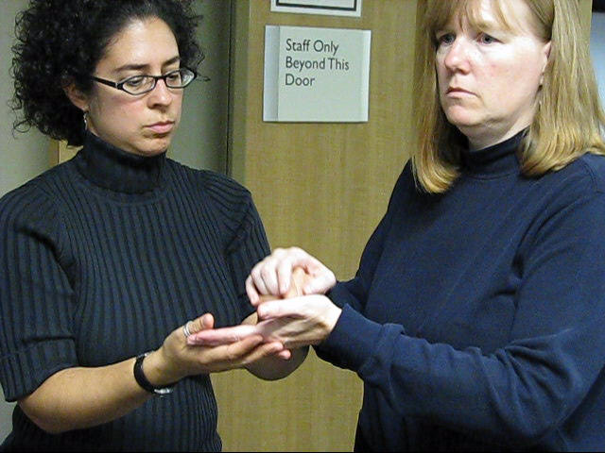
...is Here”

Slide 19
TASL: HAND POSITIONS

Slide 20
Fingerspelling Alone
A few DB people communicate receptively using only fingerspelling.
A few hard-of-hearing DB people use fingerspelling as backup when they cannot quite make out a word.
The position for reading fingerspelling in these instances will vary.

Slide 21
Reading TASL
In reading Sign Language the DB person may use one hand or two.
In using one hand, the DB person places their receptive hand on top of the signer’s dominant hand. Typically this will be two right-handed signers so the left-hand (receptive) of the DB person is on the right hand (dominant) of the signer.

Slide 22
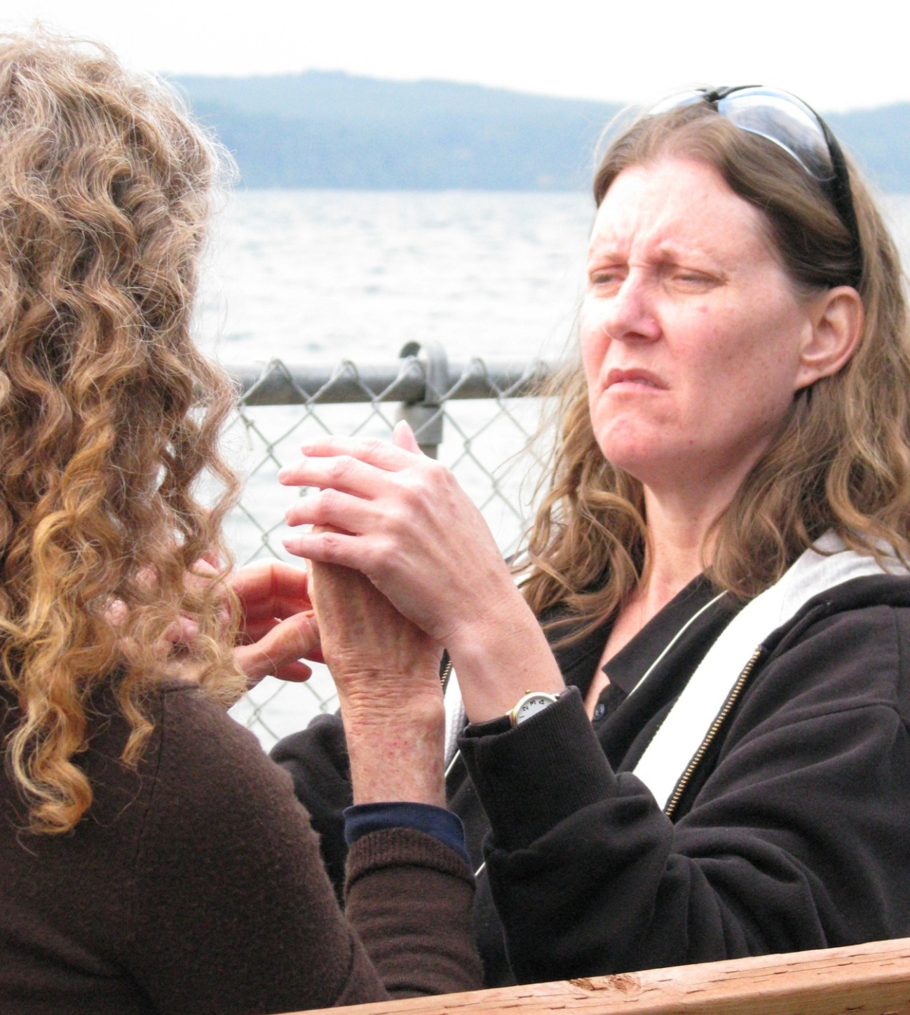

Slide 23
Elements of TASL
Elements of TASL include
Movement (including rhythm)
Tension (intensity)
Percussion (e.g. one hand striking another)
Location
Handshape

Slide 24
Hand on Hand
Where the DB person’s reading hand is placed on the signer’s need not be exact.
In general the DB person’s thumb and little finger do most of the work.

Slide 27
Two-Handed
Some DB people use both hands to read Sign Language. This may be because they are new at reading signs tactually, because the person signing to them is new at TASL, or from personal preference.
Be sure to sit close enough to get comfortable.

Slide 29
POSTIOINING

Slide 30
Positioning
While sitting, it is important to be close enough to be comfortable without twisting your back.
One common position is to sit with alternating legs.
Another is to sit close facing each other but with legs side-by-side. (See following slides.)

Slide 32
Here the DB woman is listening with one
hand, but the two are seated comfortably close to one another side-by-side.

Slide 33
TASL and Ergonomics
There is another PowerPoint presentation focused on ergonomics (how we best use our bodies in our work) but communication with DB people is different from two hearing people talking with each other or two deaf people talking with each other.
Be conscious of what your body is telling you and take the time to get comfortable.

Slide 34
Get on the Same Level
For extended discussions, get on the same level (both sitting or both standing) and get comfortable.

Slide 35
TASL: FINGERSPELLING AND NUMBERS

Slide 36
Reading Fingerspelling
In reading fingerspelling tactually, movement and rhythm are still important, but handshape takes on a greater importance.
The signer shifts position slightly so that hands are very slightly more palm to palm.
Rhythm is retained but fingerspelling is done somewhat more slowly.
Context is also important.

Slide 37
Fingerspelling & Context
In both sentences below ‘Carol’ is fingerspelled. The second sentence gives more context:
Carol will come at noon.
The SSP named Carol will come at noon.
Of course, there are other ways of giving context. The point is that context helps in reading fingerspelling.

Slide 38
Numbers
One of the difficulties with reading numbers is that there is much less context and little or no rhythm. Numbers depend almost entirely on handshape which is more difficult to read tactually.
Many DB people prefer to have numbers printed in their palm at least some of the time.

Slide 39
Conclusion
ASL evolved as a natural language to suit the visual modality or channel. Reading ASL tactually can be a little like lipreading a language you already know.
As deaf-blind people form communities and talk with one another regularly, TASL is shifting to suit the tactile modality, changing the way some signs are made and inventing others to express their experience.

Slide 40
Conclusion, cont.
As an SSP you will be aware of touch in all its forms and how it is used by and among DB people to communicate both verbally and non-verbally.

