Slide 1
Low Vision Part II
Chapter 4.1.1

Slide 2
Overview
Now that you have had some experience with using the simulators, this presentation provides:
  An introduction to poor acuity (blurry central vision)
  Some special considerations regarding vision and the environment
  Implications for SSPs in working with DB people who have poor vision

Slide 3
POOR ACUITY

Slide 4
Blurry Vision
Some DB people do not have tunnel vision.
Macular degeneration and diabetic retinopathy, among other things, cause blindness that impairs central vision making it difficult to see detail.
This makes it difficult to recognize objects and people.
It also makes it difficult to read print.

Slide 5

Blurry Vision – Poor Acuity

Slide 6
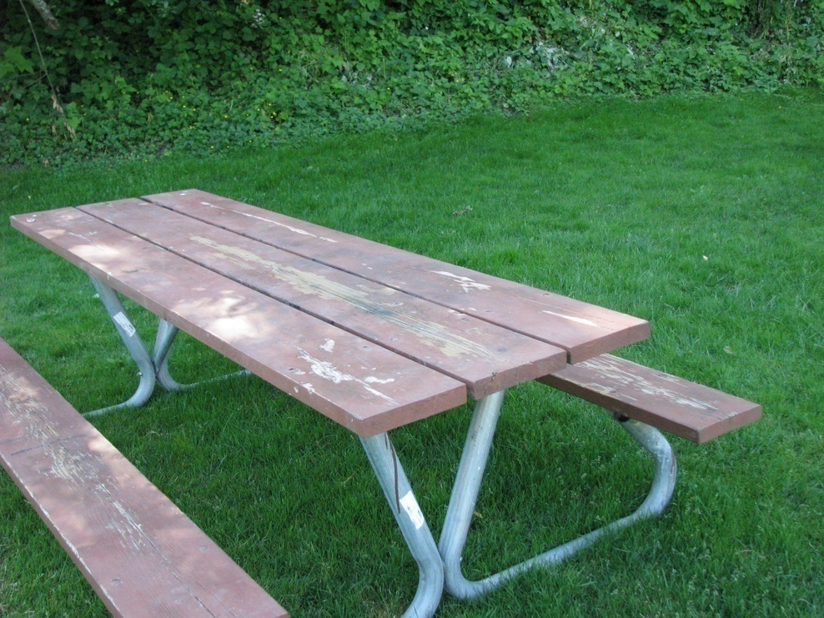
It’s a picnic bench

Slide 7
Close Vision
Blurry vision is sometimes called ‘close vision’. This is because when acuity is poor the person will need to stand close to see signing.
Slowing your signing, especially when fingerspelling, helps.
Some people with very blurry or close vision do better using tactile signing.

Slide 8
POOR VISION AND
THE ENVIRONMENT

Slide 9
Locating...
With poor vision it is difficult to scan to locate objects or people. SSPs help by pointing them out.
If you are showing the DB person an object, get close.
Touch is often very helpful.

Slide 10
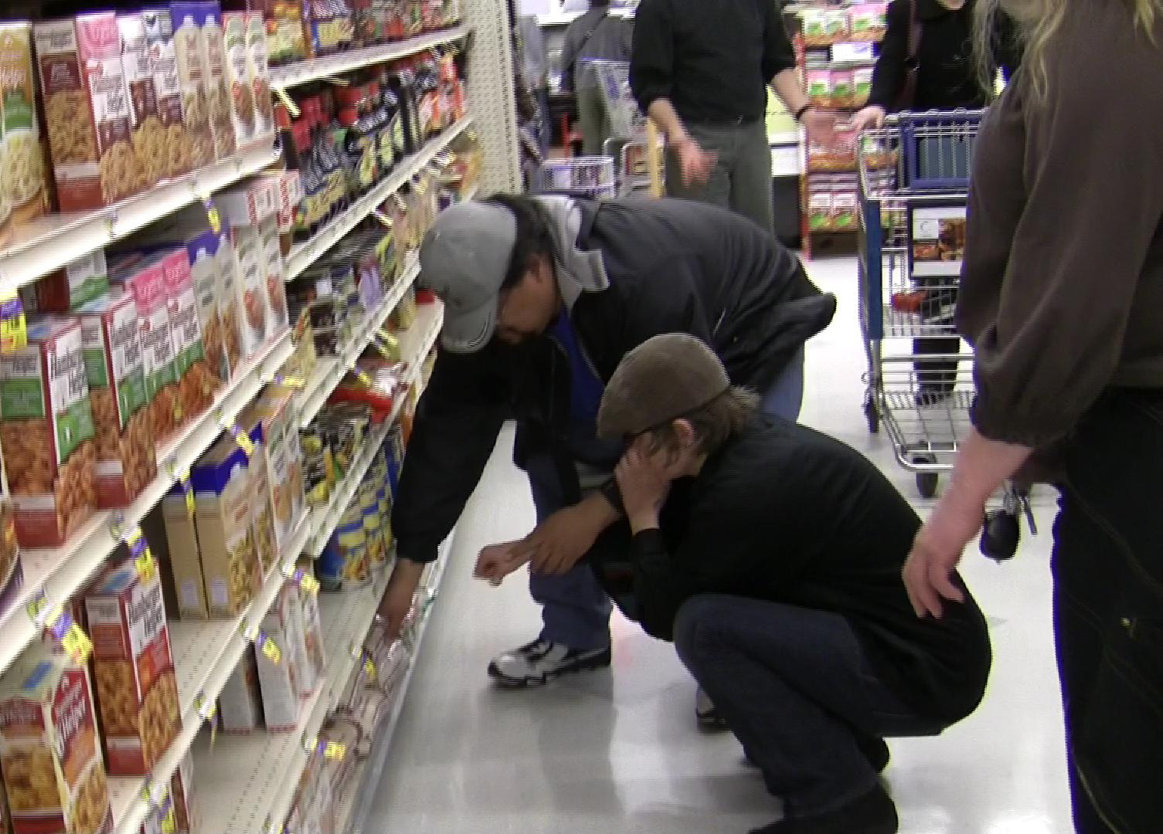
“Yes, that’s it”

Slide 11
Edges and Contrast
A DB person who does not usually use a guide or a cane but has poor vision may miss seeing steps or unexpected objects in the way.
An SSP would make sure they notice such dangers.

Slide 12
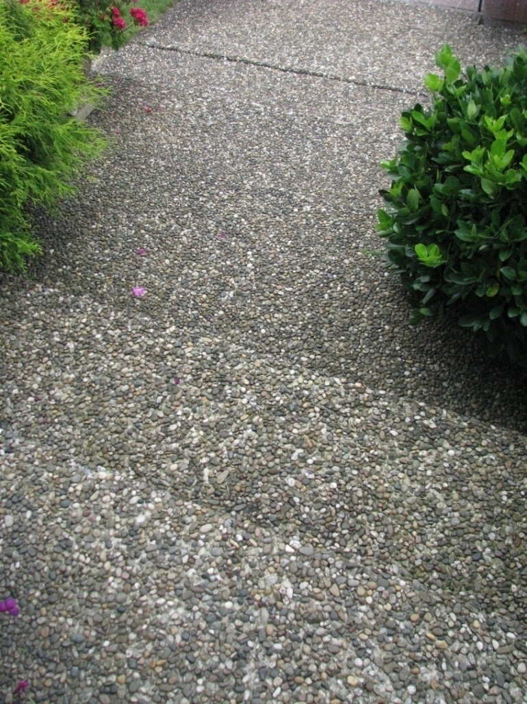
Steps
See the edges?

Slide 13
LIGHT AND COMMUNICATION

Slide 14
Lighting
For people with low vision (either tunnel vision or blurry vision), lighting is very important. To make the best use of what lighting is available, consider the following:
  Level of light
  Glare
  Direction of light

Slide 15
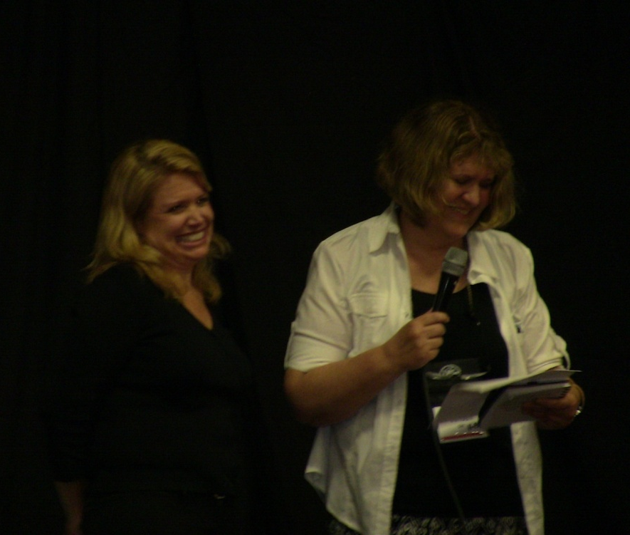
Dim Lighting
In dim lighting there is lack of color as well as lack of detail.

Slide 16

Dim Light + Tunnel Vision

Slide 17
Light, Glare and the SSP
The previous slides showed low or dim light. If you are communicating with a person who has problems with lighting, take time to move into a place and position where the lighting is optimal.

Slide 18
Glare
Snow and bright sun on the water can create glare that we are all familiar with.
Our eyes, however, are not as sensitive as those of people with poor vision.
Windows, white tablecloths, white shirt collars, and sleeve cuffs are common offenders.
As an SSP, be aware of lighting in all its forms.

Slide 19
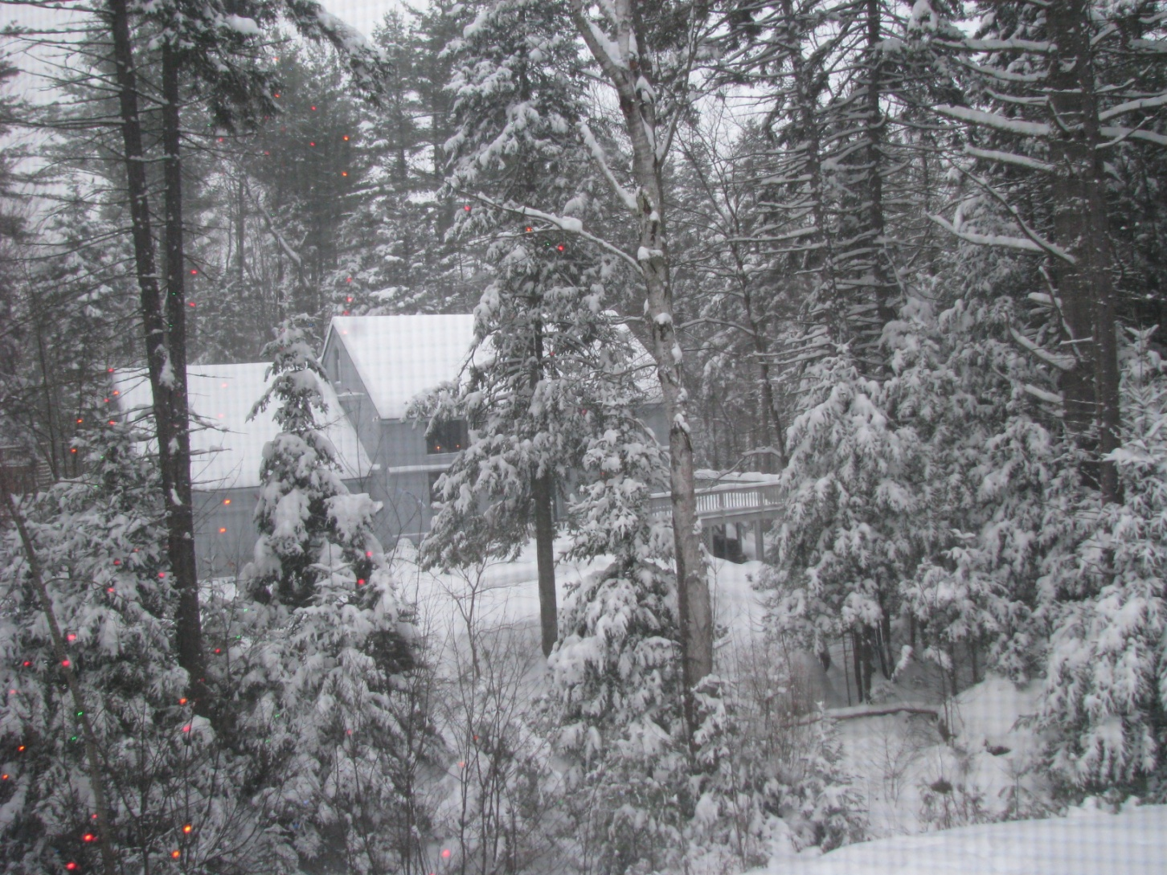
Glare

Slide 20
Glare, cont.
Overhead light (including from the sun) often creates glare as does light in the visual field.
Most people with low vision wear caps or hats with bills, or sunglasses that block glare from the sun or overhead light (even when indoors).

Slide 21
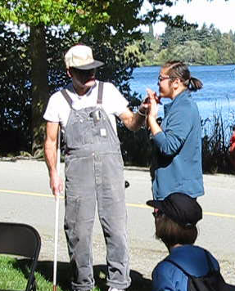
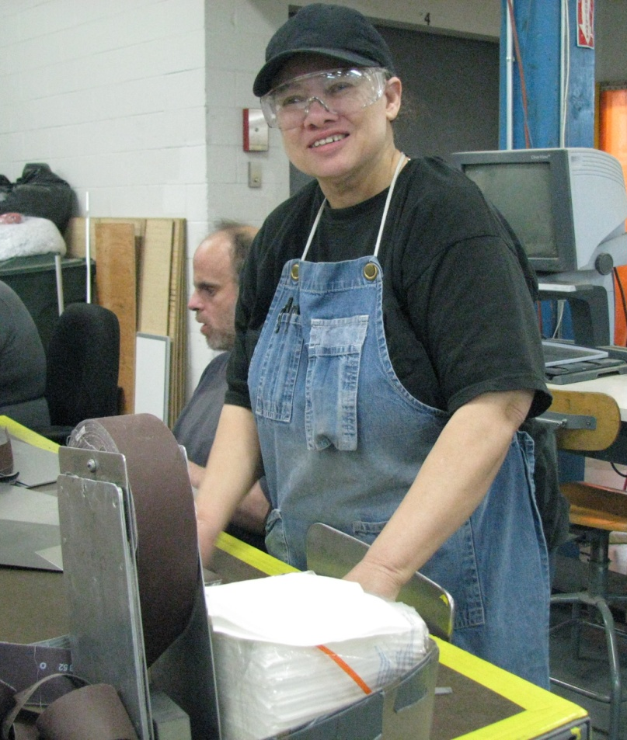

Slide 22
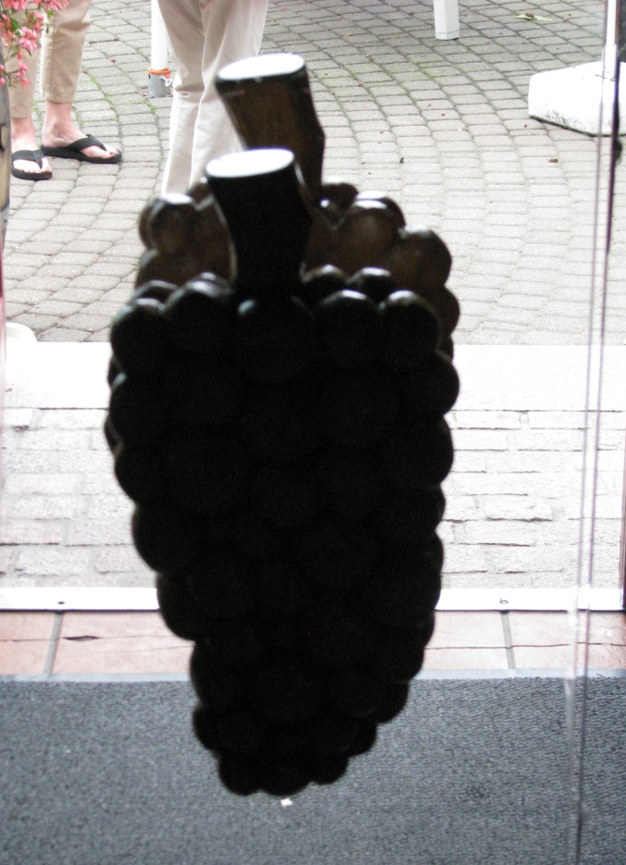
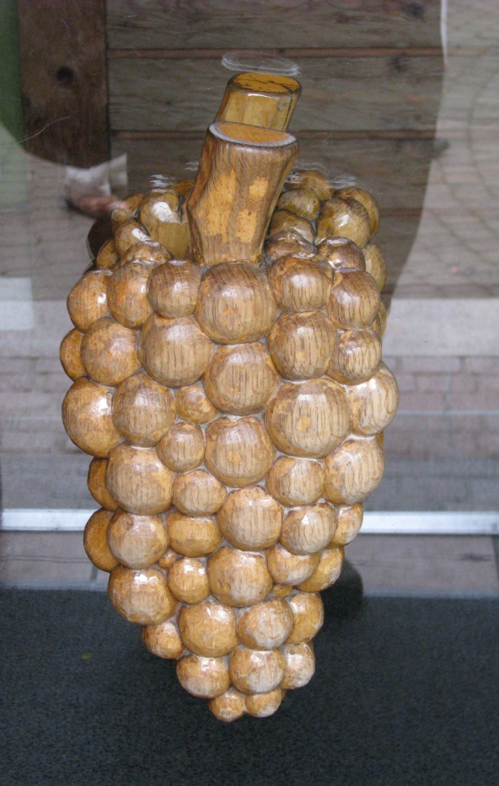
Direction of Light
Back Lit Front Lit

Slide 23
Light & Direction
The light should not be shining in your eyes, of course, but it is especially important that the light not be shining in the eyes of the DB person.
The woman in the next slide is having to look into the light – not good.

Slide 24
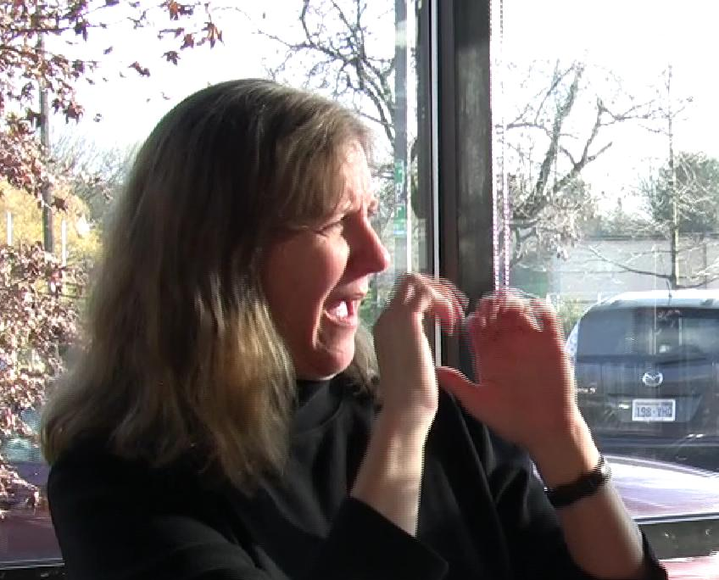

Slide 25
Adjustment Time
It also takes the person with poor vision longer to adjust to changes in light, especially going from bright to dim light, or vice versa.
This means when you enter a building, you will need to pause a few minutes for the DB person to adjust to the new lighting situation.

Slide 26
SSPs and Clothes
Wear plain, contrasting shirts and blouses (tops) so your signing is clear.
White clothes make it easy to spot the person but difficult to read their signs.
Dark colors absorb the light and prevent glare.
Remove shiny jewelry, especially earrings

Slide 27
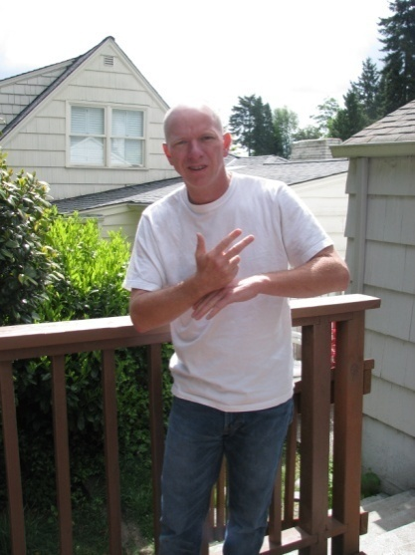
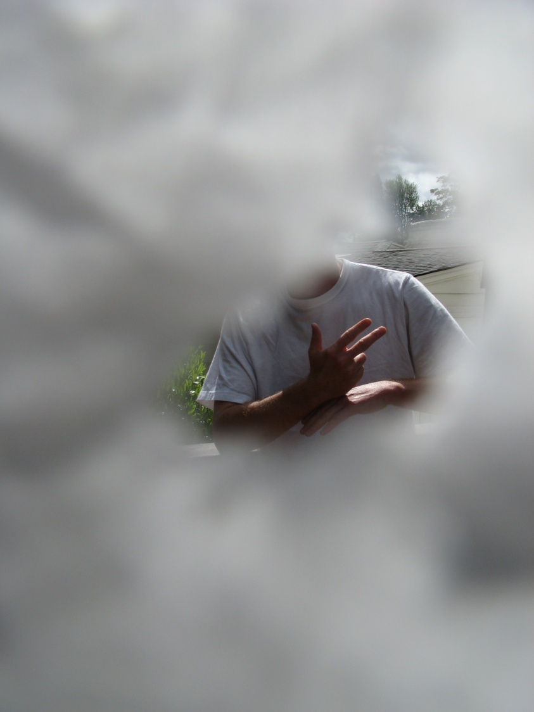
Bad Example
Here the pale signer is wearing white. The sun is behind him. Add tunnel vision and it becomes very difficult to follow his signs.

Slide 28
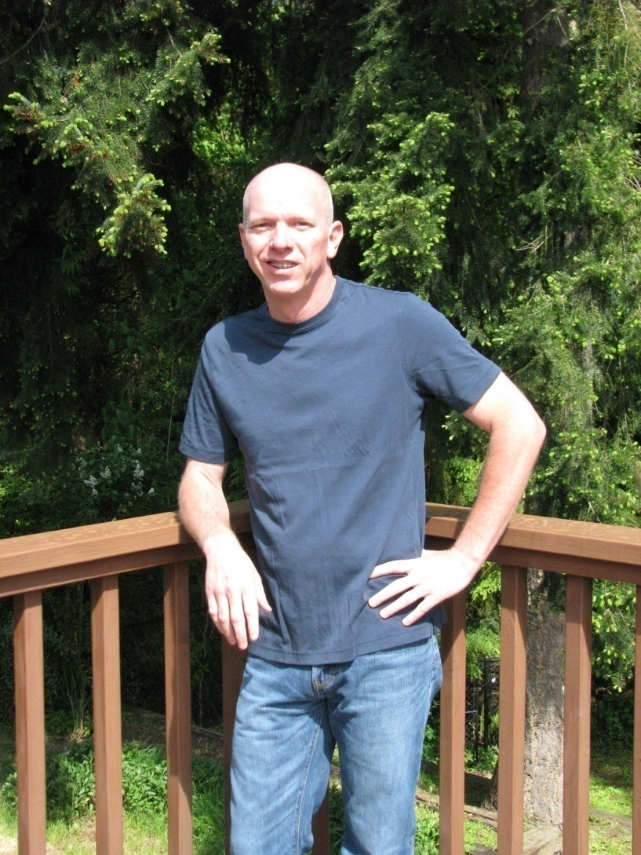
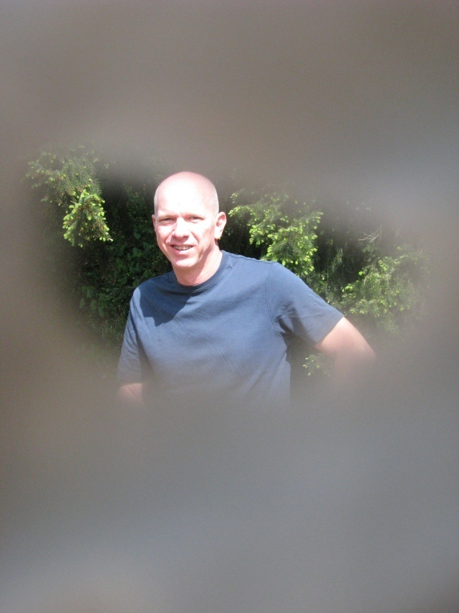
Much Better

Slide 29
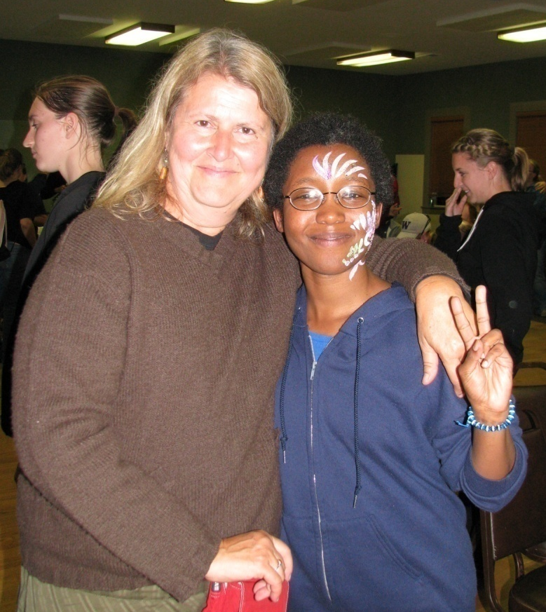
Clothes with Good Contrast – Low Glare

Slide 30
PRINT

Slide 31
Applying the Same Principles
The same rules (by now very familiar to you) apply to print.
    Good contrast (including bold print)
    Low glare

Slide 32
Computer Print
You will notice that all the power points in this curriculum have a dark background (not white) and light lettering. This makes for optimum contrast and minimum glare.
For paper, buff color makes a good choice since it is low-glare.
Felt-tip pens are also bolder and hence easier to see. A pencil is not good at all.

Slide 33
Simulation
Try the blurry vision or poor acuity simulators.
As you begin work as an SSP it is beneficial to use simulators from time to time.
Do this with your colleagues. Give yourselves specific assignments or tasks. Discuss your experiences with each other. You will gain new insights.

Slide 34
Conclusion
When a person has poor vision, a little change in the environment or from day to day may make a big difference. Even a headache can put someone ‘over the edge’.
Over time, the vision of people who are deaf-blind will typically continue to change.
Be alert to such changes.

Slide 35
Conclusion, cont.
Practice consciously so that these adjustments to your communicating will become natural to you and you will automatically choose appropriate clothing, where to position yourself, as well as notice what is most helpful and efficient while respecting the autonomy of the DB person.

