Slide 1
Guiding Part V: More Beyond the Basics
Chapter 4.1.5

Slide 2
Overview
We have covered the basic skills of guiding DB people, however there are a few more things to learn:
Getting seated
Handing the DB person an object
Serving food
When the DB person has a guide dog
Paying the bill

Slide 3
GETTING SEATED

Slide 4
Guiding To a Chair
By now you have noticed the pattern that DB people do things by themselves with information from the SSP-Guide. Here it is the same.
The easiest way to inform a DB person where the chair is and how it is oriented is to guide their hand to the back of the chair.

Slide 5
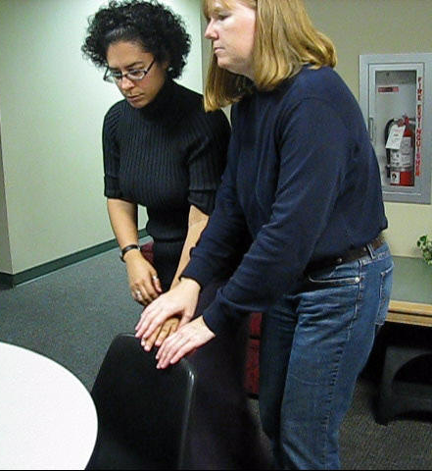

Slide 6
Chair at a Table
If the chair is at a table it might be helpful to indicate the table as well.
Notice in the next slide that the DB woman is keeping her left hand on the chair-back for orientation as she follows the guide’s hand to the table.

Slide 7
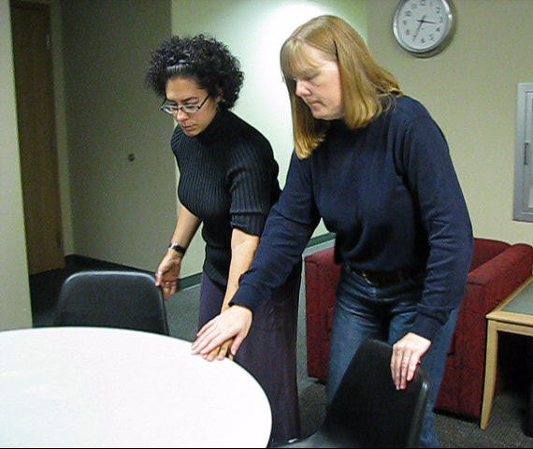

Slide 8
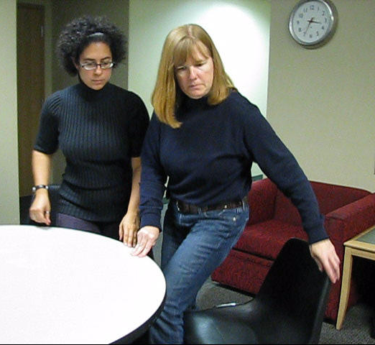

Slide 9
Guiding To a Couch or Low Chair
Sometimes the chair has no back or it is awkward to reach it.
Touching the arm of the chair (or in the case of a stool, the seat) will also work.
Again, the SSP-guide guides the DB person’s hand to the chair. The DB woman then explores it to get oriented before sitting down.

Slide 10
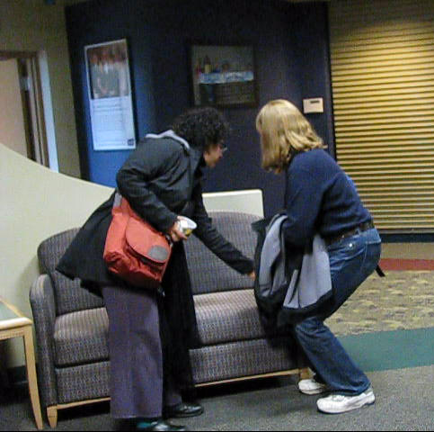

Slide 11
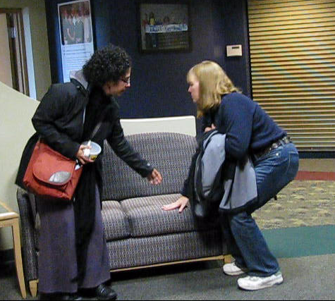

Slide 12
Entering Booths
The principle for entering booths is the same: the SSP-guide informs the DB person it is a booth and then guides their hand to the table and back of the booth.
The DB person then explores the table/booth and slides in on their own.

Slide 13
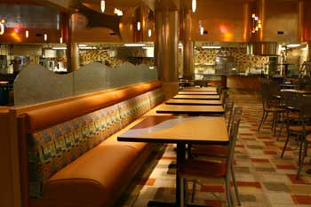
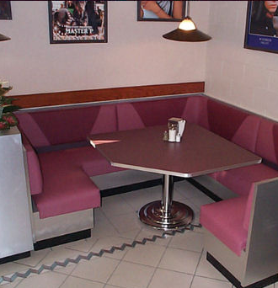

Slide 14
Booth Variations
In the previous examples of booths there are significant variations. In the left picture the booth is only on one side. In the one in the center, there is a little step up. In the right picture it is a corner booth. Be sure to mention these details so the DB person can enter smoothly.

Slide 15
Seating
You will want to arrange yourselves so that communication is the most comfortable.
Consider lighting (not facing windows) and the ability to use speech, visual Sign Language or tactile Sign Language. This may mean sitting on the same side.

Slide 16
INTERACTING WITH OBJECTS

Slide 17
Handing Objects to the DB Person
Typically the DB person will know you are going to hand them something (e.g. a drink). Depending on how easily it will spill, how unusual the object is, etc. you may want to hold the object in one hand and guide their hand to it with the other.

Slide 18
A Cup of Water
In the next series of slides the DB woman has asked for a drink of water. The SSP gets a cup of water, and as she returns to the table and passes behind the DB woman, she sweeps her hand across her back. This enables the DB woman to know where the SSP is, and she is able to smoothly reach up for the drink.

Slide 19
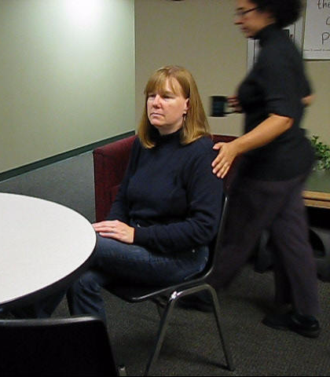

Slide 20
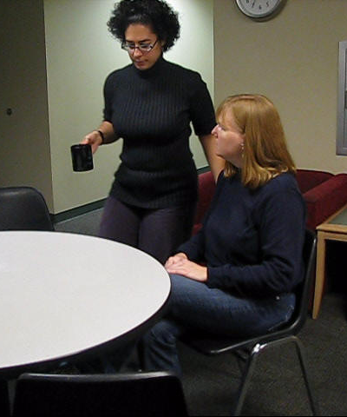

Slide 22
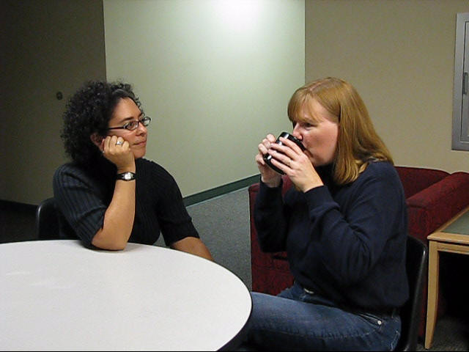

Slide 23
Objects
Communicate first when handing an object to the deaf-blind person if they are not expecting it (e.g. asking them to hold your coat while you search for your keys).
Styrofoam is so light as to be unstable. It is not a good choice for serving food, but if it is all there is, be aware that Styrofoam and some other disposable serving products are easier to spill.

Slide 24
GUIDE DOGS

Slide 25
Team
Typically the DB person will put their dog on a leash (not the harness) so that the dog will be ‘off duty’ and you will be the active guide.
Other DB people prefer to use both.

Slide 26
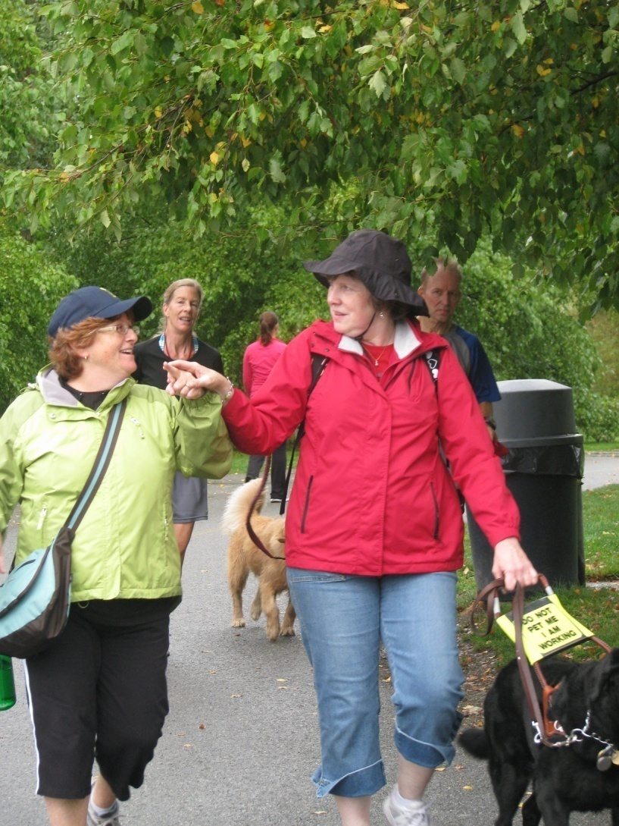
Guide Dogs on Harness

Slide 27
Dog on Leash (off duty)

Slide 28
Dogs
Working dogs are still dogs.
If you’re not comfortable with dogs, work it out.
If you are comfortable with dogs, make sure dog hair will not be an issue on your clothes or in your car.
Front seat? Back seat? Rub dry first?

Slide 30
Equipment
Of course, the DB person is responsible for watering, feeding, and toileting their dog. If this is an issue, discuss it.

Slide 31
Working Dogs
Working dogs are permitted in public places that they would not otherwise be permitted, such as restaurants. This is covered by the ADA and state law.
Guide dogs are trained to stay out of pathways by getting under chairs and tables.

Slide 32
Support
The DB person may travel independently to and from a familiar place where you will meet to begin your SSP duties.
Nevertheless, you will want to be clear as to exactly where you will meet (e.g. at or inside the front door) and the DB person may need help finding the exit after the assignment.

Slide 33
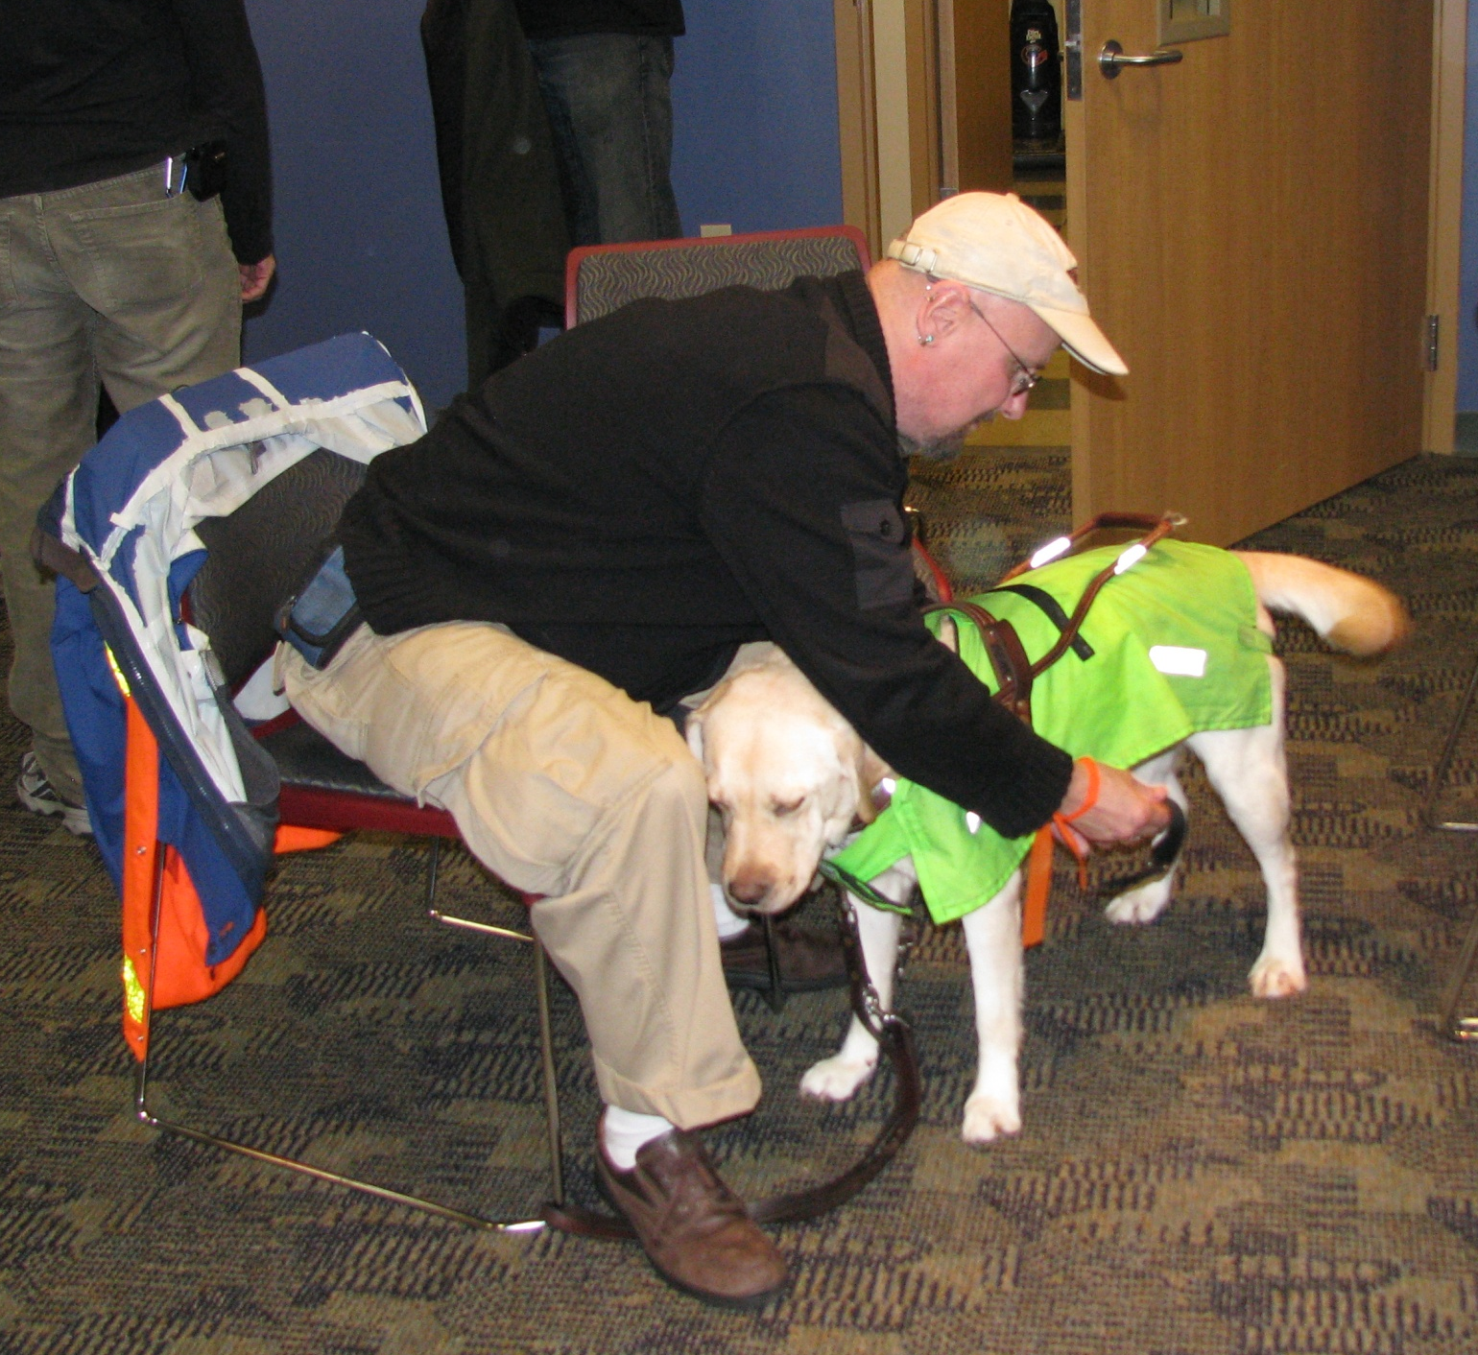

Slide 34
PAYING THE BILL

Slide 35
Money
Whether you are being the SSP for a shopping trip, a banking trip or stopping at a café or restaurant with friends, the DB person handles their own money.
This includes payment by cash, credit cards or using a credit/debit card and a machine.

Slide 36
Steps
In the following slides, the DB woman is paying for the meal using her credit card.
The SSP informs her that the check has arrived.
The DB woman then asks for a read-out of the bill.

Slide 37
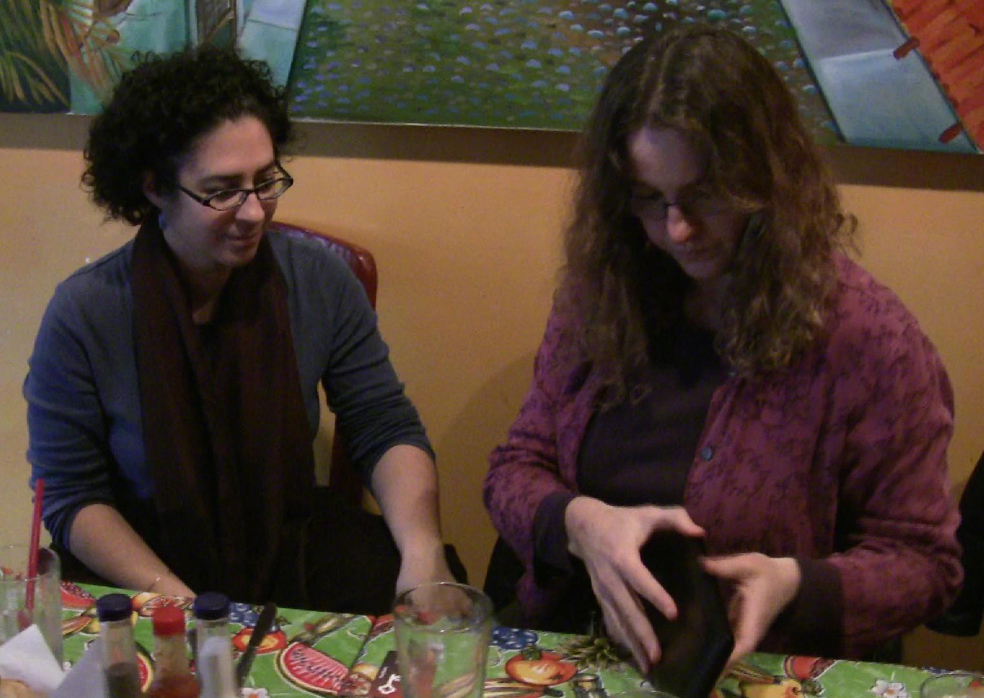

Slide 38
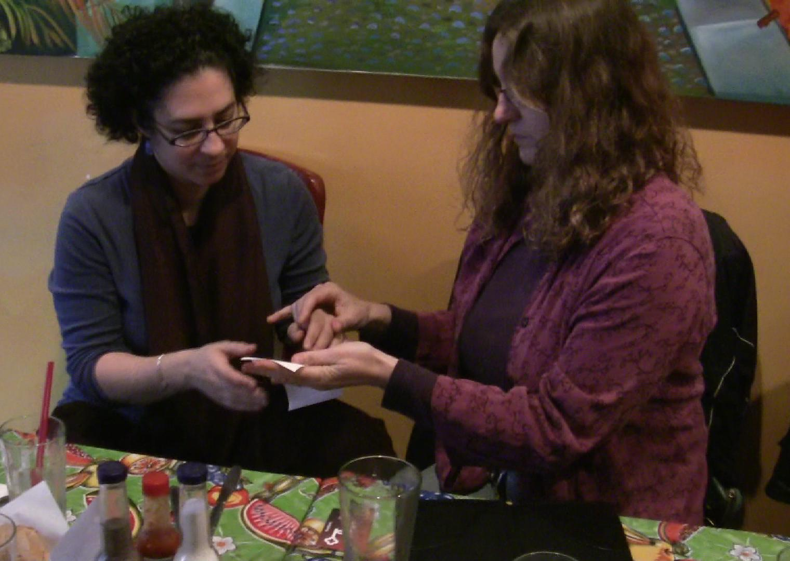

Slide 39
Checking
The DB woman then confirms each item purchased, the amount and the total, asking for clarification if necessary.
The SSP re-reads the bill to make sure she has read it correctly.

Slide 40
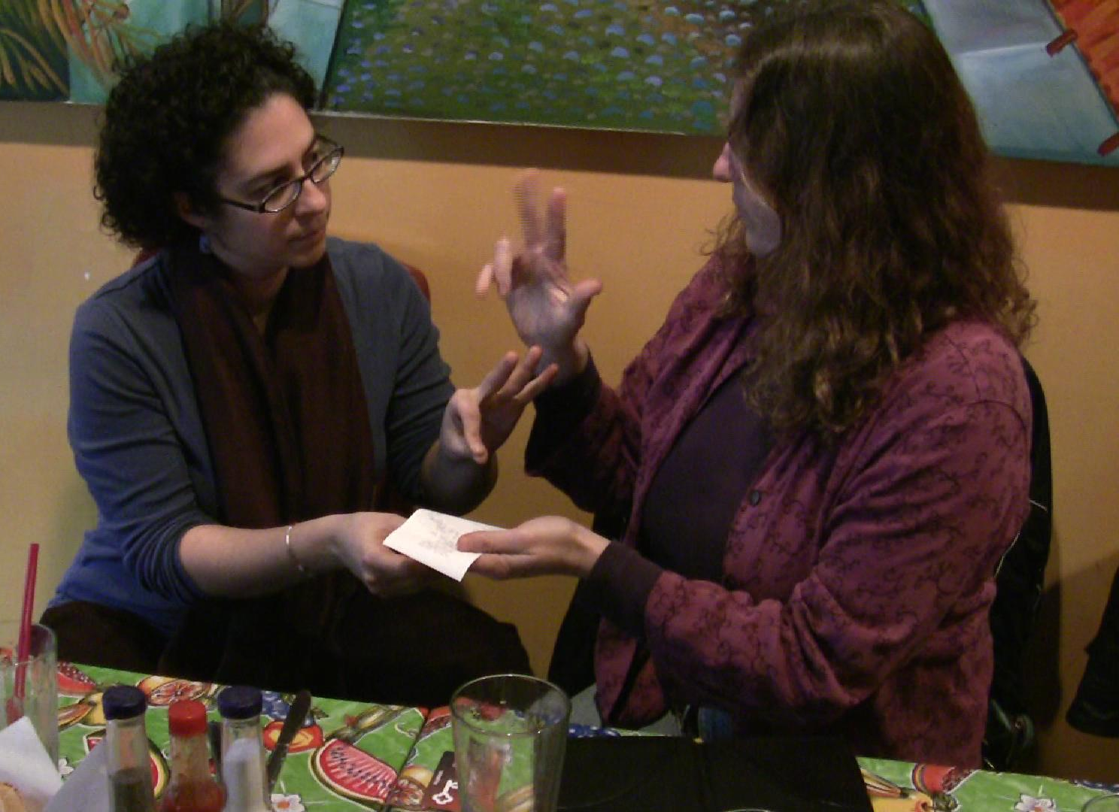

Slide 41
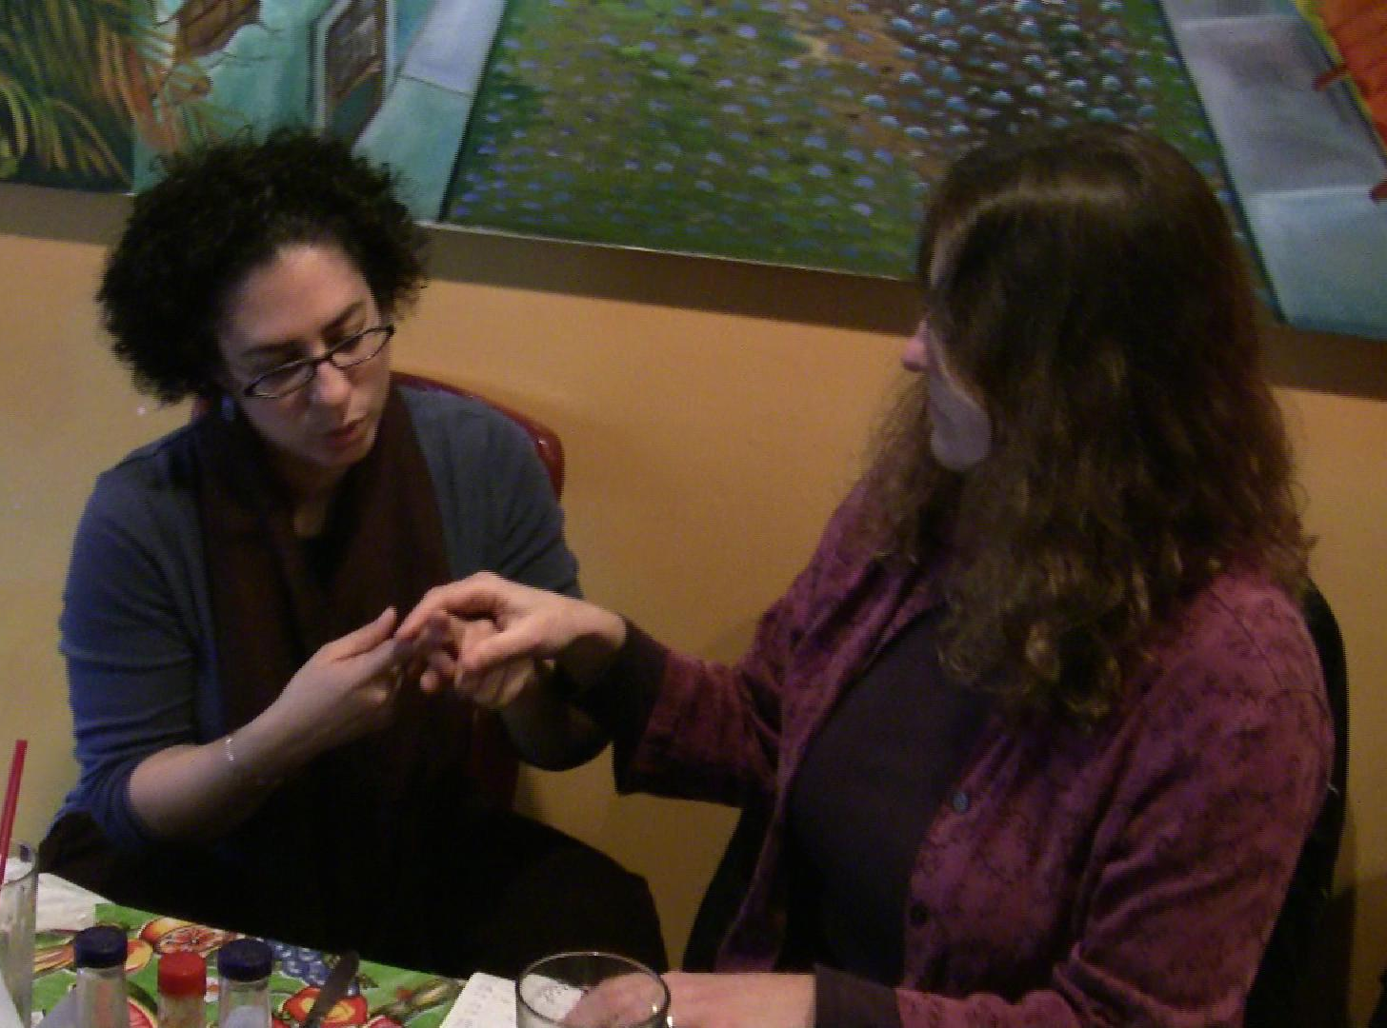

Slide 42
Signing
The DB woman is satisfied that the check is accurate and places her credit card in the holder to be taken by the wait-person.
Again, the SSP need not handle the credit card at all.

Slide 43
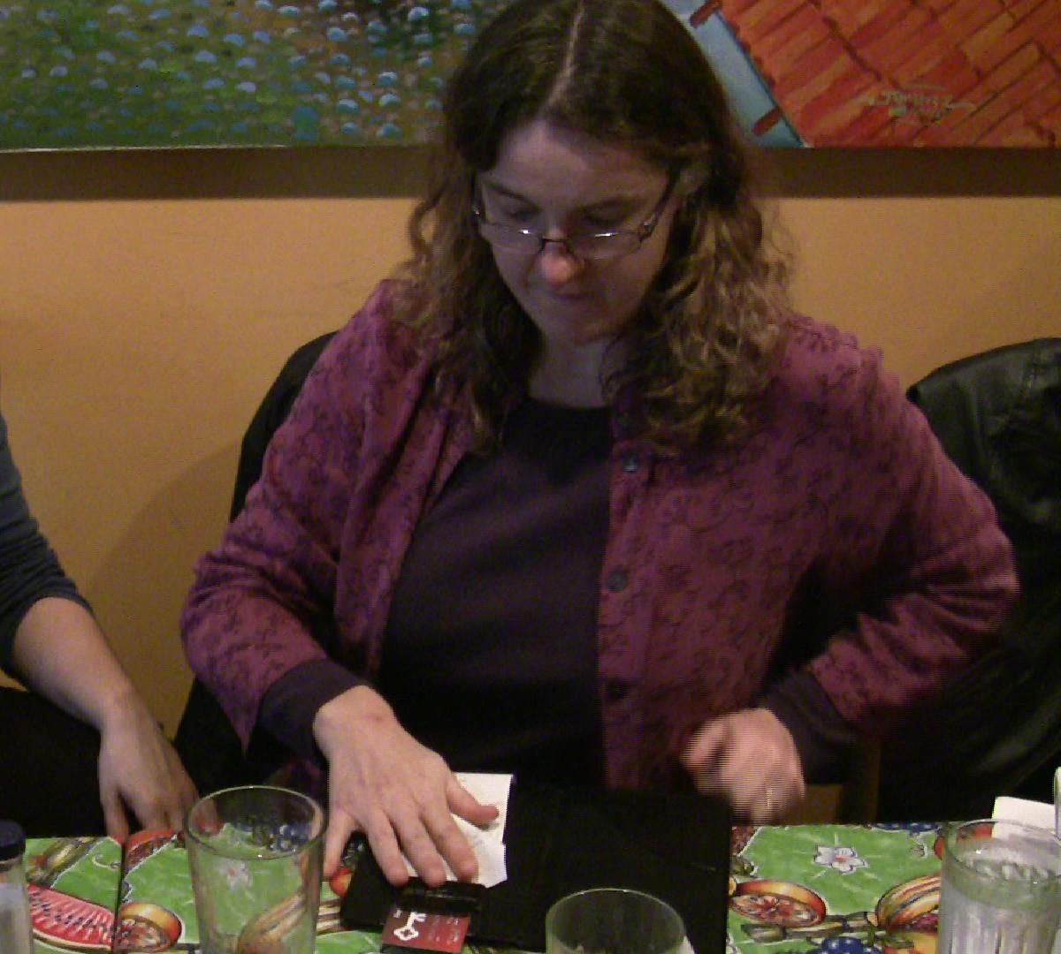

Slide 44
Signing
When the bill returns with the printed receipt, ready to be signed, the credit card can become a marker for the signature line.
The SSP places the credit card under the signature line and guides the DB woman’s hand to the correct place.

Slide 45
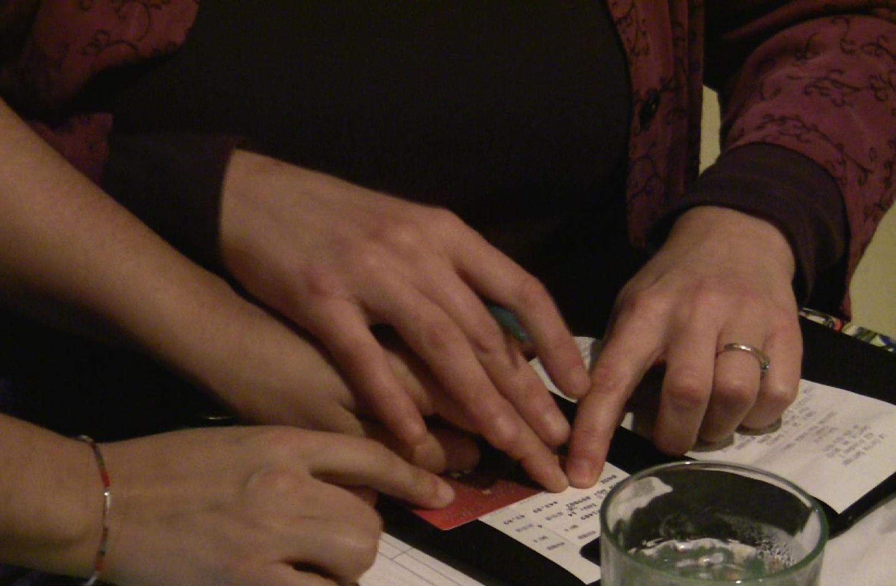

Slide 46
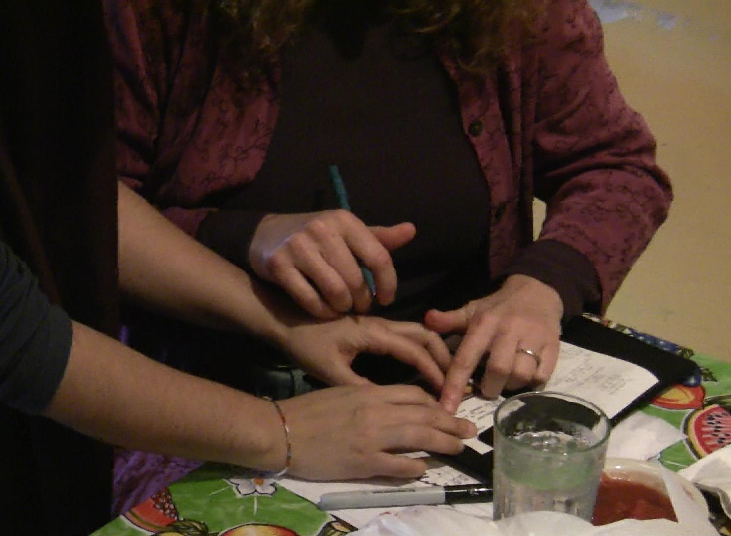

Slide 47
Tip and Total
The DB woman herself enters the total, tip and her own signature.
Some DB people prefer the SSP to do the actual writing of numbers.
The principle is that the DB person is fully informed and in control of the process.
When finished, the DB woman gathers the receipt and her credit card herself.

Slide 49
Beware Pressures
As mentioned in the presentation on Ethics, Role and Power there are outside pressures on the SSP (and DB person) to conform to the patterns and expectations of non-DB people – in this case perhaps to hurry or just let the SSP take care of the payment.
On the contrary, the SSP must be comfortable with DB time and pace.

Slide 50
Dependence vs. Autonomy
Many DB people have not had an opportunity (the respect from others) to manage their own affairs. They have “gone along to get along” and let others tell them what to do and how to manage their lives.
The fact that this is common does not make it good.

Slide 51
DB People’s Response
A few DB people have resisted control by non-DB people and insisted on their own authority.
A few DB people actually prefer being taken care of and do not want to assert their abilities.

Slide 52
Most…
Most DB people live between these two polarities. They have submitted to the pressure to take what services are offered without protest or comment, because they lack support, resources and real choices.
When DB people do resist there is often push-back.

Slide 53
Dismissing Leadership
Indeed, dismissive comments are made about this model of SSP (and guiding) in which the DB person takes the lead and do for themselves. Comments are made that only ‘special’ DB people can operate this way.
Such comments should be understood for what they are: oppressive.

Slide 54
Change
This model is a model for positive change.
It will take time for SSPs to be trained as well as for programs regularly paying for SSP services to be established.
Guiding and offering SSP service with respect is a good place to begin.

Slide 55
Conclusion
Once you have mastered the basic guiding skills, these extra skills just make sense. The basic principles are important throughout:
The SSP gives the DB person cues and the DB person takes it from there.
The SSP-Guide does not manipulate, move or handle the DB person, their objects, dogs or money.

Slide 56
Conclusion, cont.
When there are disagreements or conflicts, they should be discussed, with both the SSP and DB person airing their concerns.

