Slide 1
Guiding Part VI: Recreational Outings
Bonus

Slide 2
The Terrain
Recreational outings may include going to a swimming pool or out on a hike.
Here the SSP-guide must be careful to watch the terrain; perhaps establishing signals or cues to communicate efficiently about changes or things to be aware of.

Slide 3
Preparation
You should be dressed appropriately for the activity.
Remember to be sure your footwear supports you well and that your hands are free.
Is a walking stick a good idea for your hike?

Slide 4
Preparation, cont.
Would it be best to have two SSPs for each person?
If animals are involved, any allergies?

Slide 5
Balance

Slide 6
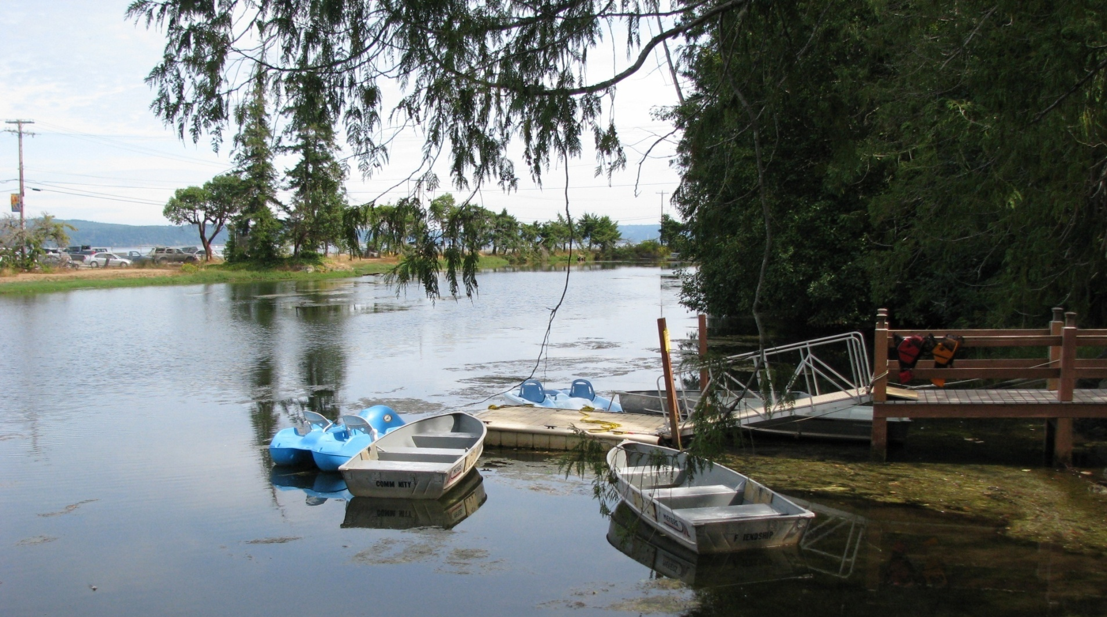
Getting into and out of boats.

Slide 7
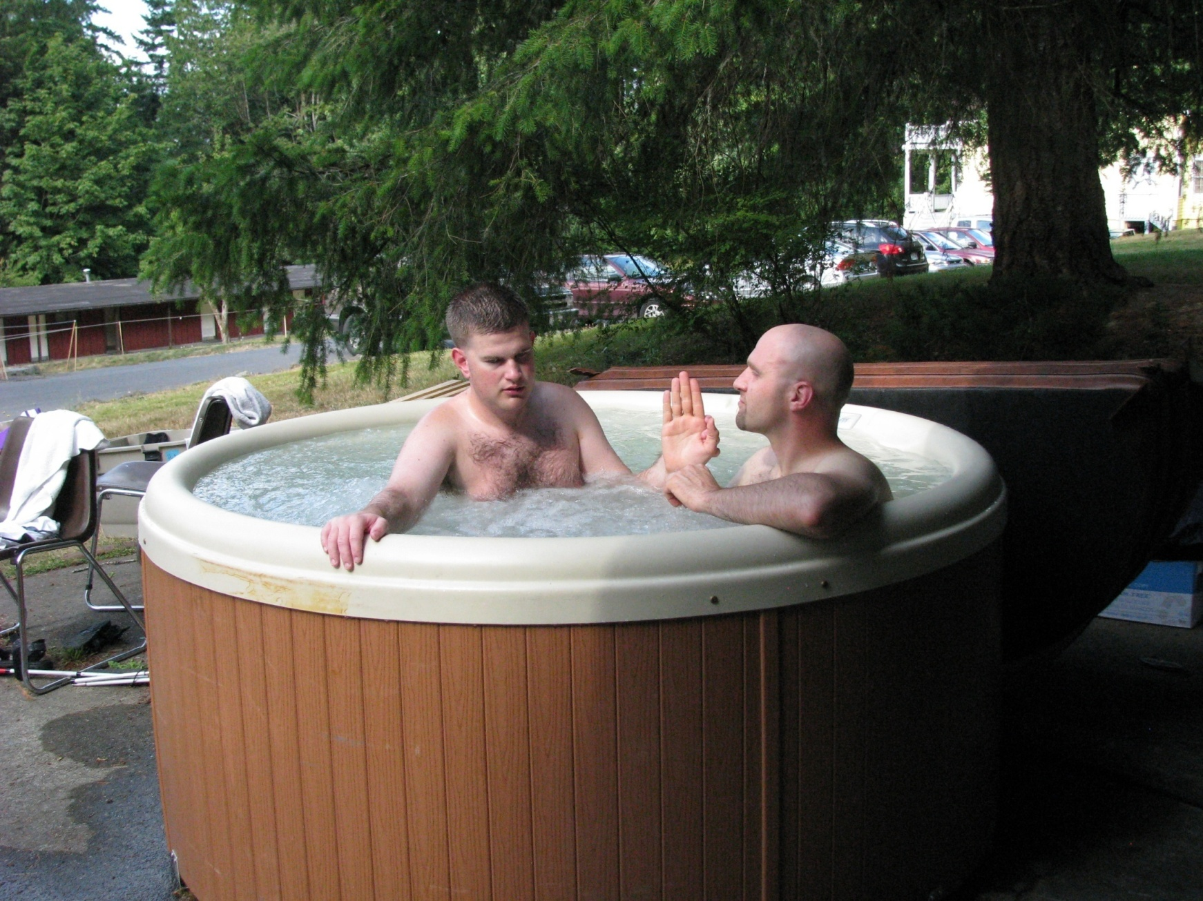

Slide 8
Remember the Principles:
Take your time.
Communicate.
The DB person needs the information and then they move themselves.
Where balance is an issue, as on stairs, holding the railing is often a DB person’s preference.

Slide 9
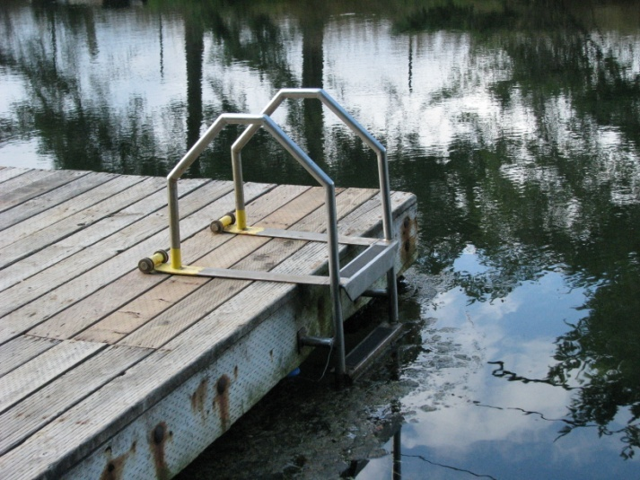

Slide 10
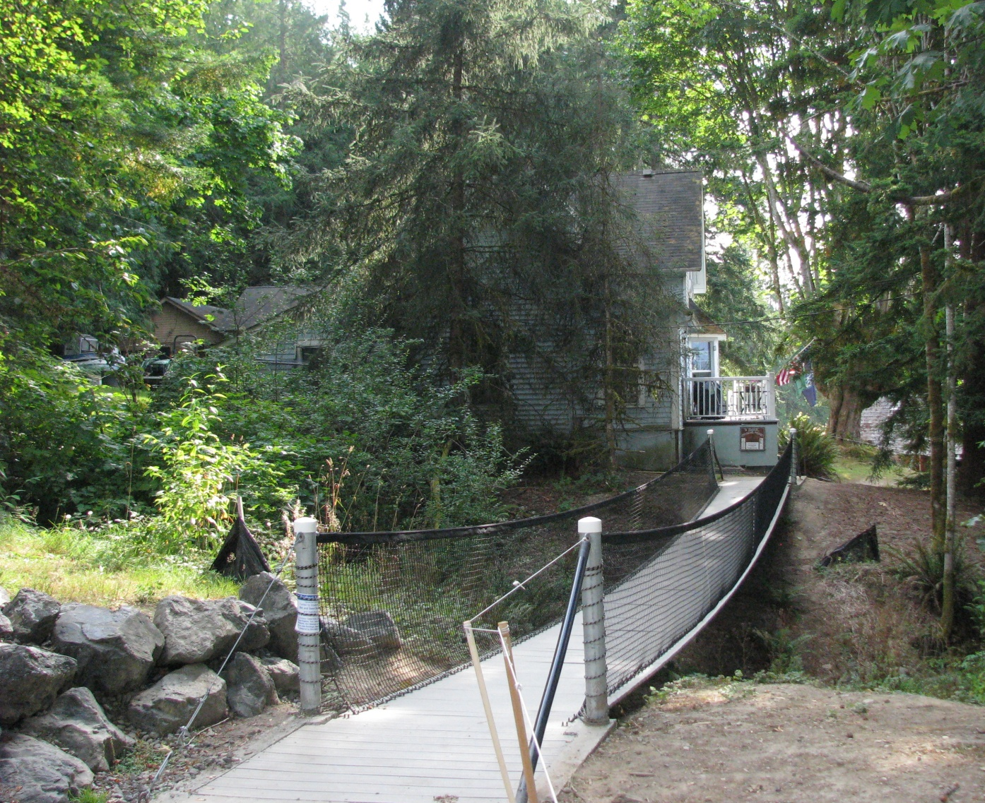
A Bouncy Bridge - Fun

Slide 11
No Rail
In the previous picture, the bouncy bridge had hand-rails. In the next slide the bouncy foot-bridge to the swimming deck does not have any rails. Talk with the DB person to see their preference. One way is to stand in a line and the DB person place both hands on both shoulders for better balance.

Slide 12
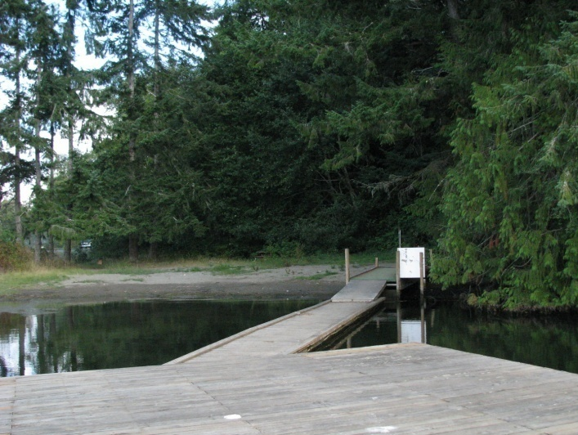

Slide 13
Snow
Snow can be slippery but that’s part of the fun. If you’re prepared it should be fine and if you fall, it should be soft, right?

Slide 14
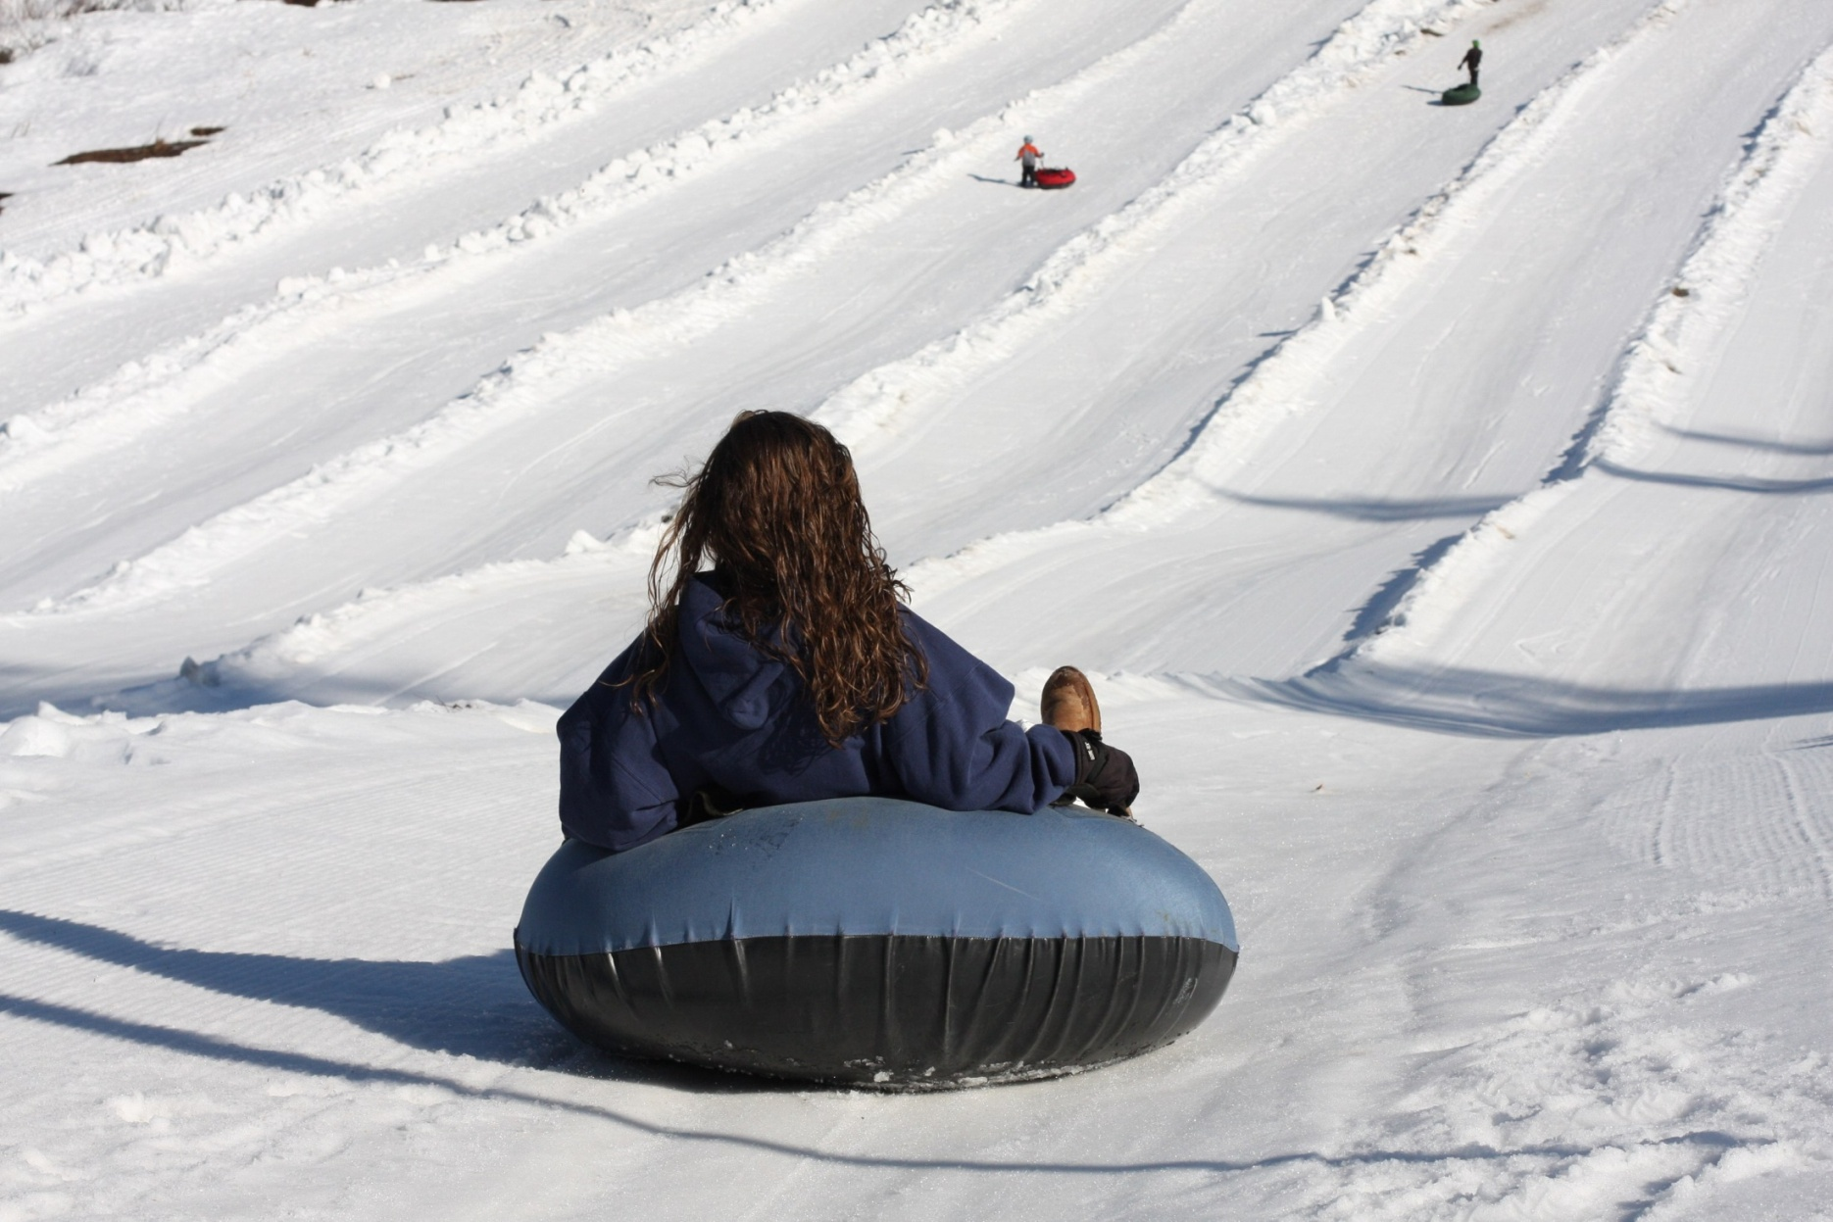

Slide 15
Exercise
One mistake people make is thinking of DB people as fragile. Of course, information is key. A person can’t walk ‘blindly’ into the void. However, with information, being active is as essential for DB people as it is for the rest of us.
Hiking, swimming, riding bikes and so forth should be accessible for DB people too.

Slide 16
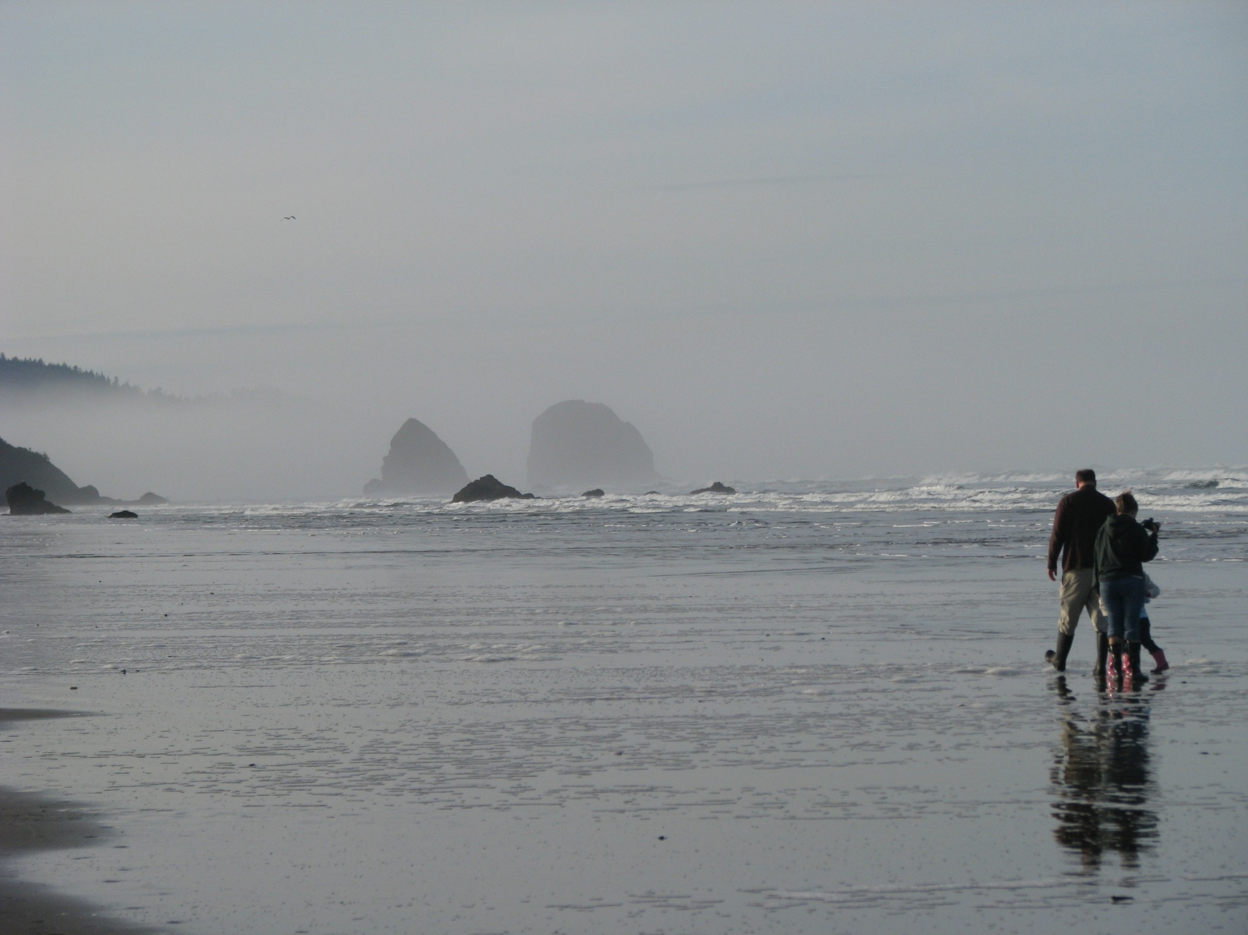

Slide 18
Variety
Festivals are fun. They can be a pleasant experience (things to touch, and to eat) and people to talk with. They can be educational too.
How are some of the crafts made? What is popular now? Who are the exhibitors and why are they there? How many festivals are there in your area?

Slide 19
Plan
Set up a recreation committee and plan fun things. It will help new SSPs see how experienced SSPs work and learn while having fun. It helps build community.
Be creative and think of new things. Of course you’ll have old favorites but don’t get stuck having a pot luck dinner month after month.

Slide 20
Broaden Your Contacts
You will be surprised at the things there are to do, and how many people will be happy to help support you, give you ideas and even offer their equipment at a reduced price.

Slide 21
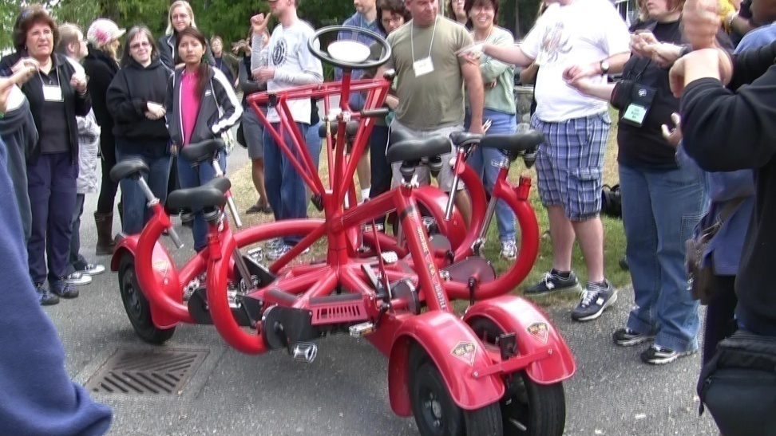
A “conference bike” that seats 6 people, one driver, all pedal.

Slide 22
Showing the Bike
In the next slides, we see the SSP show a DB person a conference bike, explaining how it works. Others mount and off they go.

Slide 23
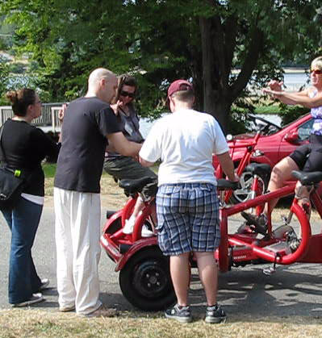

Slide 24
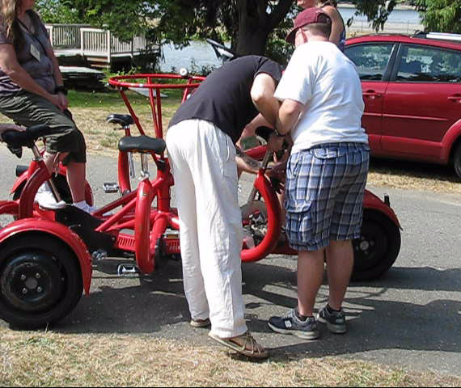

Slide 25
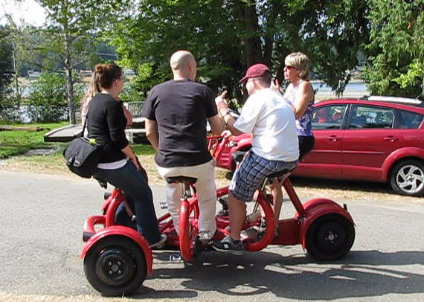
One more person and we’re ready.

Slide 26
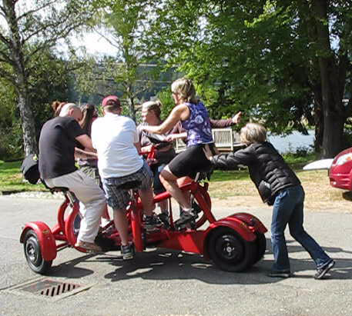

Slide 27
Fluency
Guiding, like any skill, takes practice and with practice becomes smooth and virtually unconscious.
As with any skill, it is important to avoid developing bad habits such as moving the DB person’s hand instead of guiding it, or proceeding without communicating clearly.

Slide 28
Multi-Tasking
In the next slide, the SSP listens to the DB person, checks out the food being served and gestures to the DB man to move forward a few steps in the line.

Slide 30
Conclusion
SSP-guiding for recreational activities will present multiple opportunities to enjoy being together as well as providing access.

Slide 31
Conclusion, cont.
It will also present new guiding challenges as is impossible to accurately predict everything that will come up – but following the principles of taking your time and communicating clearly, it will work.

