Slide 1
Guiding Part I: SSP & Sighted Guide: Two Functions in One Role
Chapter 4.1.5

Slide 2
Overview
Working as an SSP includes the task of ‘sighted guide’, including its techniques.
This series of power-point presentations on “Guiding” illustrates and explains these techniques.

Slide 3
Overview, cont.
The SSP-guide’s role, however, is much more than simply being a ‘sighted-guide’. The SSP continuously provides information verbally that helps orient the DB person to the surroundings.
Guiding Part I focuses on this on-going verbal orientation as the SSP guides the DB person through the environment.

Slide 4
‘Sighted-Guide’
It is two people moving through the environment smoothly with one person’s sight providing visual information to both.
The guide signals pauses, turns, steps and so on through movements of her/his body.
The SSP-Guide works with the DB person to become a ‘mobility & orientation’ team.

Slide 5
SSP-Guide
For blind-hearing people ‘sighted guide’ is not a professional role but rather a helping hand (elbow) provided by a person who knows how to do so safely.
The SSP-Guide is skilled at these techniques but additionally offers information about the environment through which the SSP and DB person are travelling.

Slide 6
SSP-Guide, cont.
This information is for both safety in travelling and adds to the general wealth of knowledge of the DB person.

Slide 7
For Example
While shopping the SSP both:
Guides the DB person through the aisles of a store smoothly and comfortably, communicating turns, aisles and so on non-verbally, and
Provides other information verbally such as what is on sale, new fashion trends, and what other people are wearing and doing.

Slide 8
Priorities
If it is a hurried trip with much to accomplish, less time is spent providing information that is unrelated to the immediate task.
Even in hurried trips, the SSP will relay what the clerk is doing while checking out, how many other customers are waiting in line ahead of them, etc.

Slide 9
Priorities, cont.
When the trip is not hurried, extra information would be included.

Slide 10
BEING ORIENTED

Slide 11
Guiding ≠ Walking
Guiding is not simply walking while the DB person holds on.
Other power points and lessons talk about verbal ways of providing information, what kinds of information, and so on.
Here, we focus on using your body to communicate, supplemented by verbal information.

Slide 12
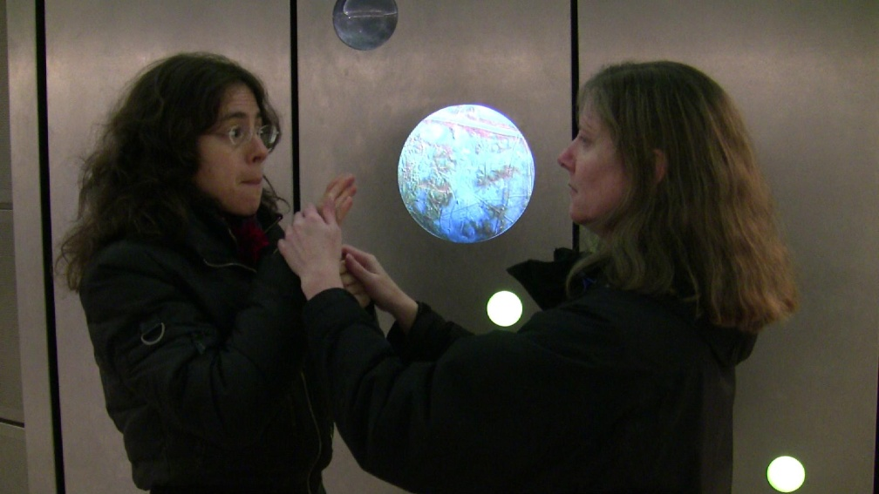
Orientation
While they are waiting for the light rail, the SSP describes some of the art in the station.

Slide 13
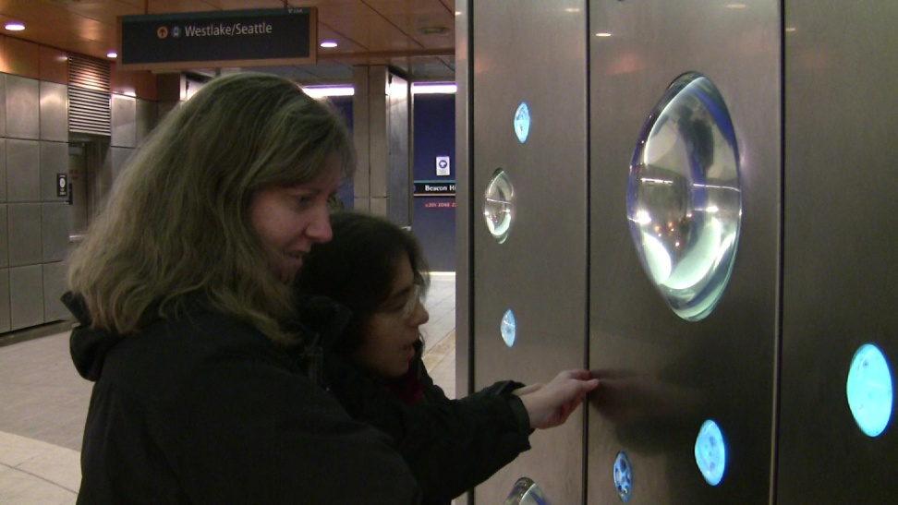

Slide 14
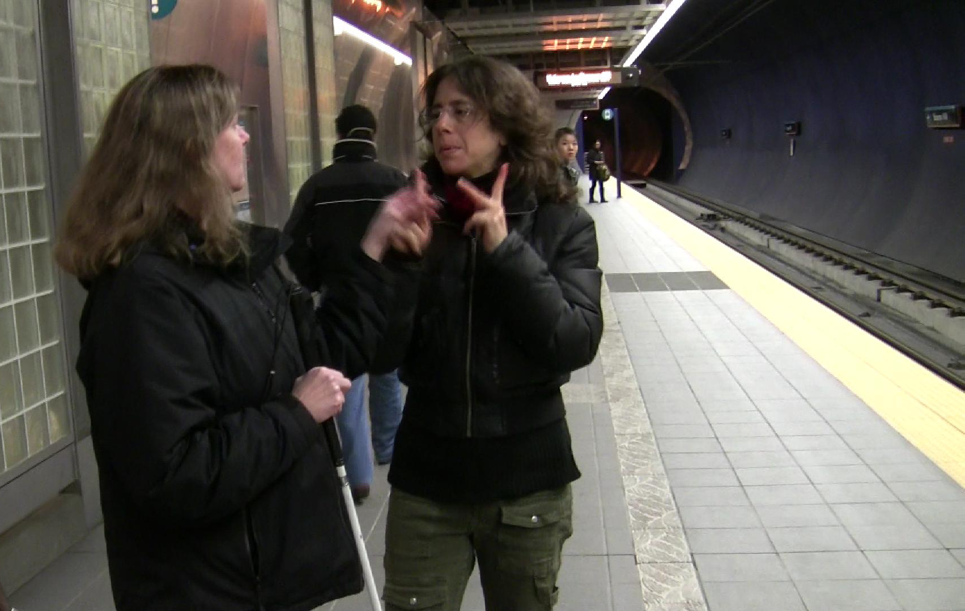
Before the train arrives, the SSP relates that there are about 20 other people waiting and a uniformed security officer is passing by. All this is orientation to the space.

Slide 15
Anticipation
“Now the train is coming.”

Slide 16
Orientation
Knowing how many people are in the area – that the SSP is paying attention and informing her – allows the DB person to feel both informed and safe. Knowledge is a form of power.
Knowing that the train is coming allows the DB person to anticipate the next movements and not feel ‘surprised’.

Slide 17
The Train is Here

Slide 18
The Train is Here, cont.
Above the SSP uses the “look-at” sign to both indicate what she is doing, and the direction.
As the train pulls up, the SSP reports that the train is pretty full and that there are only a few people getting off at this station.

Slide 19
Getting Ready to Board
The deaf-blind woman is oriented to the space and what is happening and readies her cane to move forward.
The man passing (next slide) says “Good morning” and the SSP interprets the comment.

Slide 20
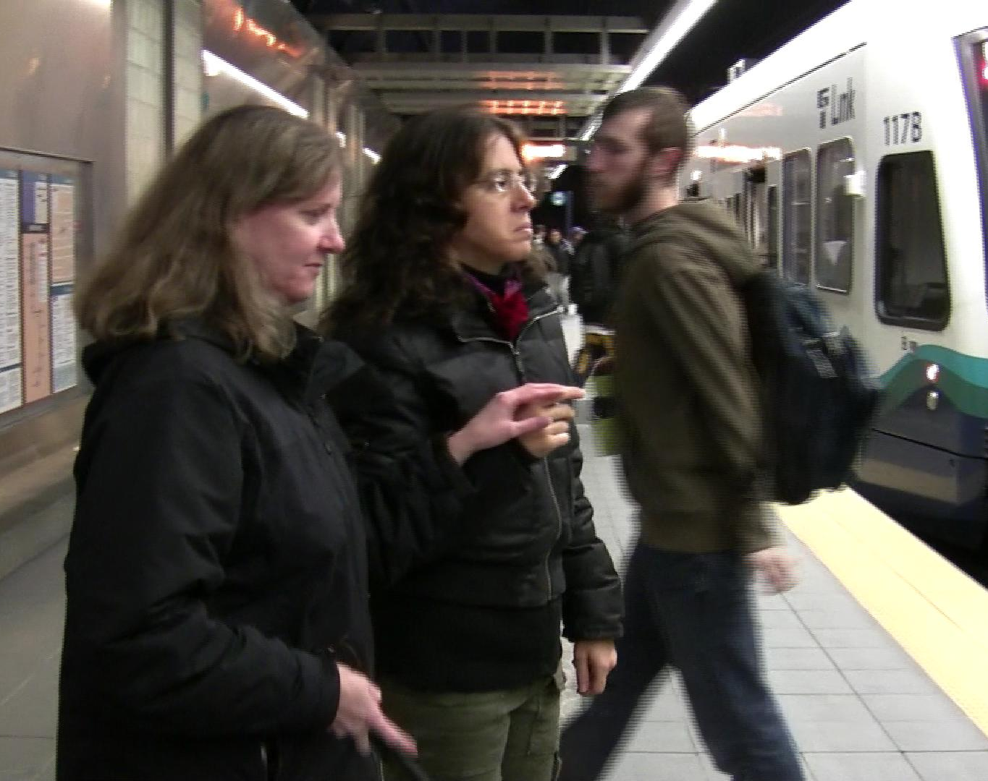

Slide 21
The SSP Orients Herself
As they go through the train doors in the next slide, the SSP:
looks at the path, and
uses her left arm to locate the side of the door.
The DB person uses her cane and vision on the path.

Slide 22
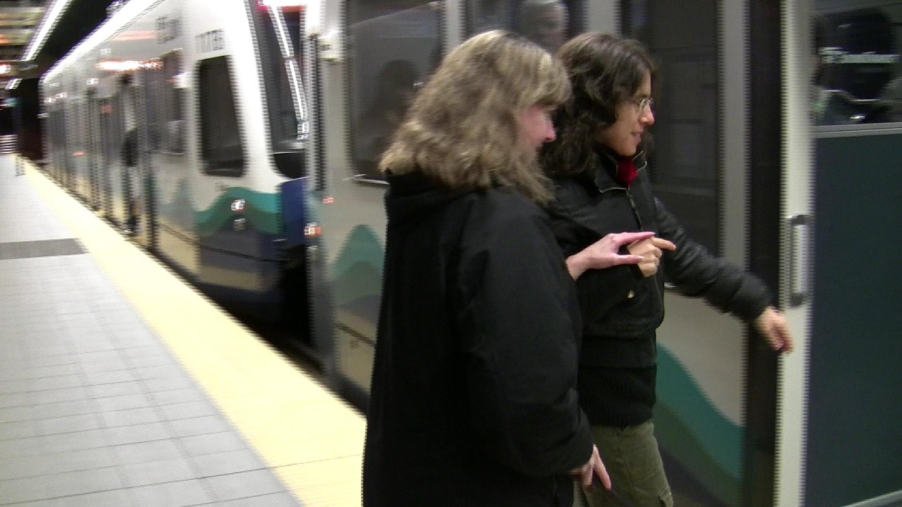

Slide 23
Where to sit?
Once inside the train, the SSP describes the available seating so the DB person can decide where to sit.

Slide 24
Pausing to Communicate
Here the SSP has pauses to give the hard-of-hearing deaf-blind man verbal information so he can choose where he would like to sit.
Choices are based on information.

Slide 25
Pausing to Communicate, cont.
Choices are based on information.

Slide 26
Decisions
When a DB person is unsure (or indecisive) this is because they do not have enough information.
This is a cue to provide more information.

Slide 27
SSP GUIDING IS TEAM WORK

Slide 28
Communication is Two-Way
In the previous series Nancy specifically asked her SSP to give her information in advance about the train arriving, etc. (changes in the environment) and to use a calm, unhurried pace.
Jenne, at a trip to the mall, told her SSP to keep an eye out for sales while shopping.

Slide 29
Communication is Two-Way, cont.
At the Deaf Expo, she explained to her SSP that she wanted to connect with the people there more than know what is in the exhibits or for sale.

Slide 30
Two-Way Communication
Also at the Deaf Expo Jelica instructed her SSP to casually look for “J,” and as she is doing so, to briefly inform her of the booths they are passing. If Jelica then wants more detail, she will ask.
This two-way communication helps the SSP do a better job.

Slide 31
Practice
Some DB people are experienced in using an SSP.
With training and support DB people can become confident and more articulate and give clear direction to the SSP.
SSPs should be open and accepting of such guidance from DB people.

Slide 32
No Directions?
If the DB person does not give directions it could be for a number of reasons:
They are not aware of the options (not enough information)
They have not had an opportunity to give directions to an SSP before

Slide 33
No Directions?, cont.
They have not had an opportunity to give directions to an SSP before
They have very limited world experience
They only have enough SSP hours to do the bare essentials which are pretty routine

Slide 34
Instruction for DB People
The curriculum includes instruction for DB people on:
how to use an SSP
the importance of touch for information

Slide 35
Instruction for DB People, cont.
the benefit of making plans and being assertive
ways to help the SSP provide better information
For DB people who are new at using SSPs, review the points made in this series of power points on SSP-Guides (including techniques).

Slide 36
Knowing How
It’s important to recognize that the DB person is working too.
DB people who are skilled at using a guide will stay slightly behind the guide.

Slide 37
Canes
Here Paul uses his cane to gain information.
He locates the first step while his guide indicates the handrail on the right.
Together they navigate the stairs.

Slide 38
Hands
Here Jenne seeks information from the handrail, and her cane as well as from the SSP-Guide.

Slide 39
More Teamwork
DB people must focus to use an SSP-Guide well. They may use the angle of the road felt through their feet, and the amount of time traveled to further orient themselves.
When there is a community DB people can share these tips and techniques.
This curriculum can be a source as well.

Slide 40
Social Information
While DB people can navigate the informal environment independently, the SSP-Guide
Makes it more safe and more efficient, but
Critically provides social information (who is there, what they are wearing, what they are doing) to link the DB person to society as well as to things.

Slide 41
Conclusion
Work as an SSP-Guide is challenging and requires the ability to multi-task.
It will take time to learn the skills of sighted-guide. Start there. Once you are comfortable moving safely through the environment, remember to add orientation information.
Once you have absorbed the information in the Guiding series of power points, return to this one for review.

