Slide 1
Glossary: Some Illustrations
Chapter 2

Slide 2
Assistive Listening Device

Slide 3
The FM Kit

Slide 4
Blind, Partially Sighted, or Visually Impaired
Poor Acuity (blurry vision)

Slide 5
Blind, Partially Sighted, or Visually Impaired, cont.
Reduced Field (tunnel vision)

Slide 6
Copy Interpreter
The ‘copy interpreter’ stands/sits in the front, next to the person leading the discussion and copies what participants say so other participants do not need to turn their heads to see what is said.

Slide 7
Copy Interpreter, cont.
When the participants should look at the copy signer, the instructor indicates that.
When the copy signer is finished and the participants should look back to the instructor, the copy signer indicates that.

Slide 8
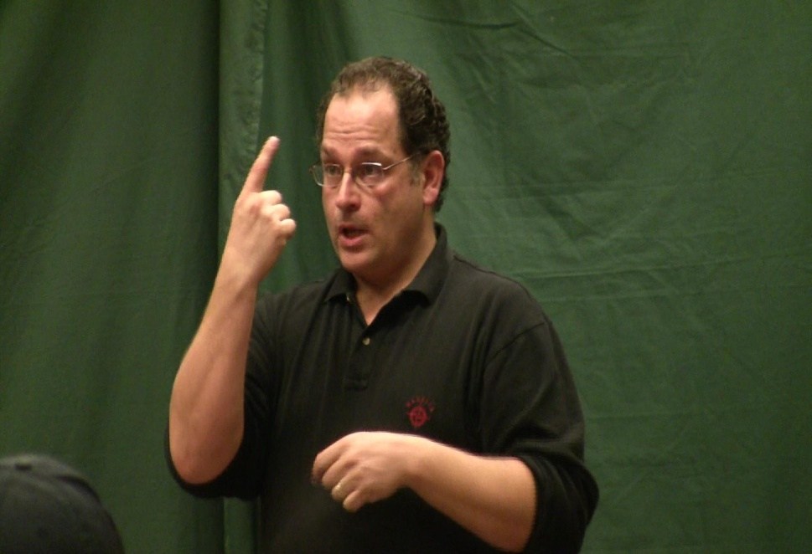
1) Instructor calls for questions.

Slide 9
2) Instructor waits for copy signer to finish

Slide 10
3) Copy signer finishes; indicates participants should look to instructor again.

Slide 11
Communication Facilitator

Slide 12
Large Print
Regular Print
Large Print
Note:
Font style (Arial)
Point size (16)
Bolded (not Arial Bold)
Writing with a black felt-tip pen or marker

Slide 13
Large Print, cont.

Slide 14
Tactile - Tactual
Tactile Map
Tactual – signing

Slide 15
Deaf-Blind Communicator

Slide 16
Video Phone (VP)
Any device connected to the Internet with a high speed connection and a camera. Includes desk-top computers, laptop computers, tablets (iPads) and smart phones.

Slide 17
Video Phone (VP), cont.

Slide 18
Video Relay Service (VRS)
Three-way relayed call from a deaf person through an interpreter to a non-signer (hearing person).

