Slide 1
Discourse Part VII: DB Community Discourse Practices & Manners
Chapter 4.3.6

Slide 2
Overview
This presentation is a brief overview of the conversational discourse practices of the Core DB Community.
Specifically:
Use of touch
Greetings, leave-taking
Initiating and yielding turns

Slide 3
Touch
Central to the DB experience is touch, and is also central to the discourse. It is used with vision and hearing to explore the environment and for communication.
In the next slide the DB woman checks the fruit.
In the following one, the DB man uses his hands to ‘frame’ the signer’s hands.

Slide 4
Inspecting the Bananas Tactually

Slide 5
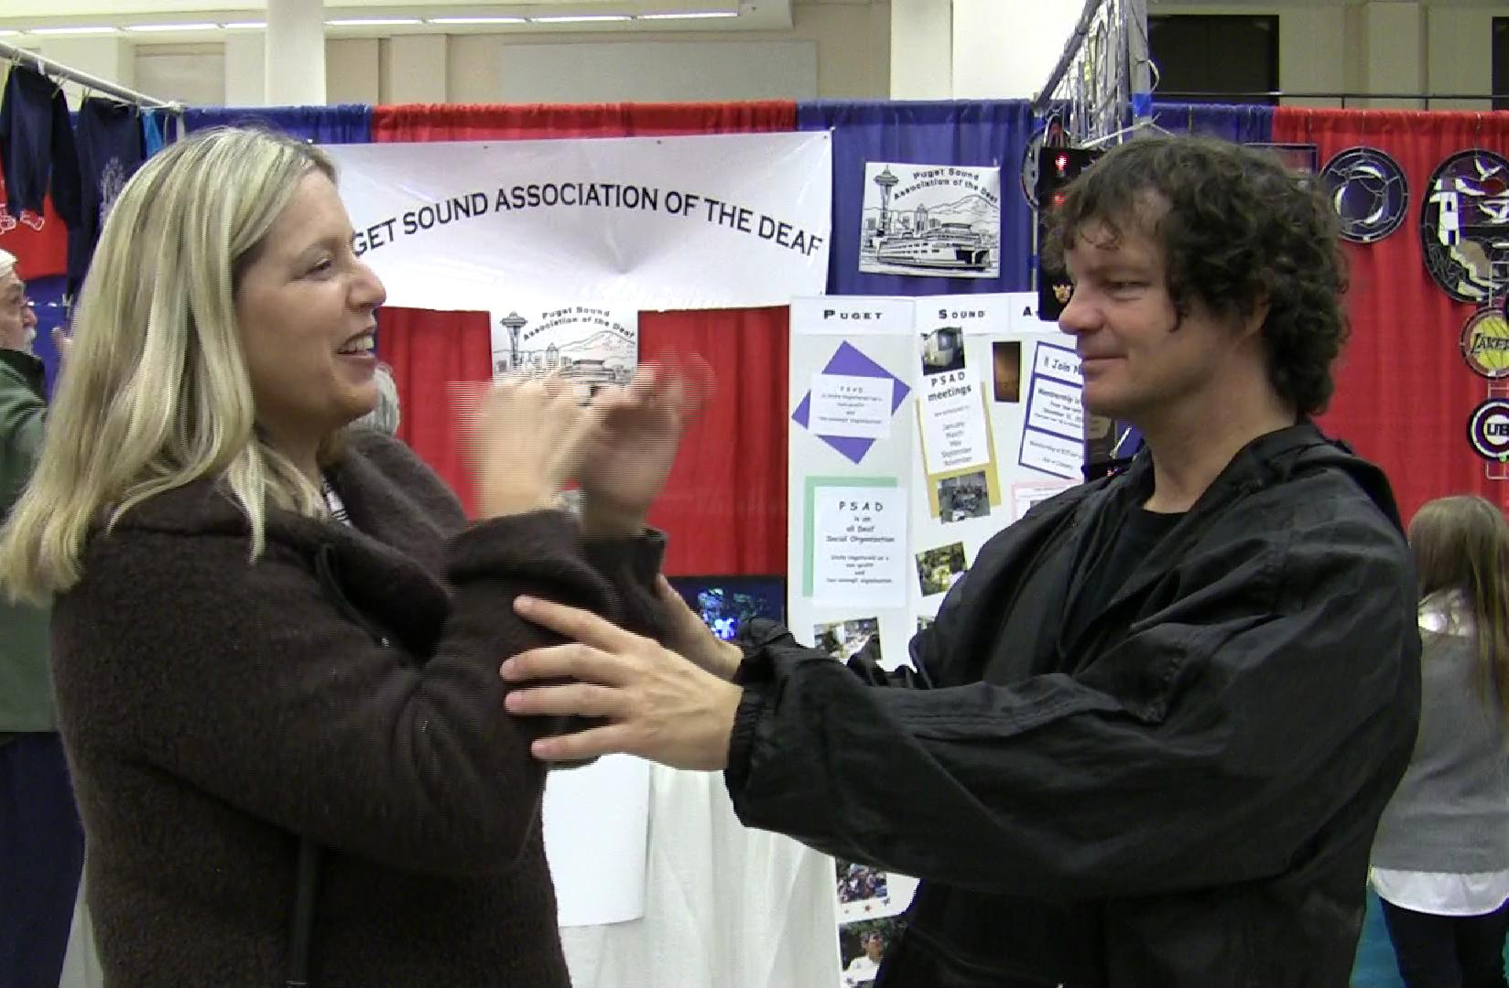

Slide 6
Greetings and Leave Taking
Greetings and leave taking among acquaintances are often done with a hug.
Greetings, much like hand-shakes, are brief but also give one a sense of the person being greeted.

Slide 7
Hugging
The practice likely comes from the Deaf Community where Usher I people have experienced similar greetings.
Hugs among friends are often tighter, closer and longer.
On the other hand, some DB people (especially if not part of a DB Community) may either be less comfortable hugging or misinterpret them.

Slide 8
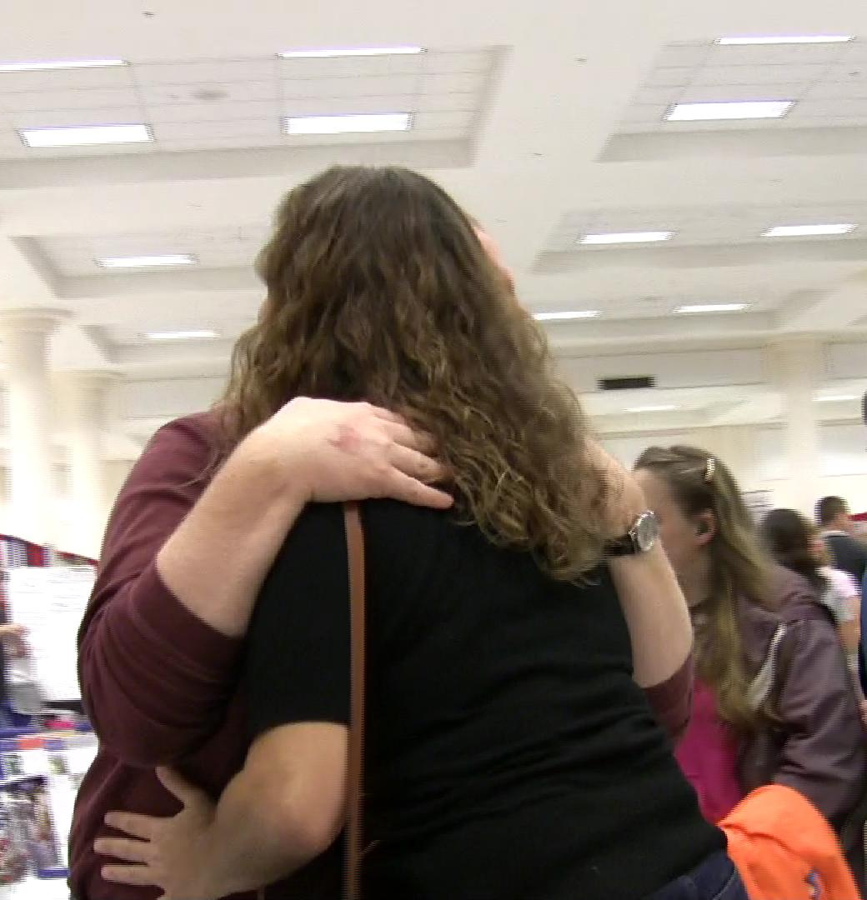

Slide 9
APPROACHING

Slide 10
Initiating
If you meet a DB person at their home, and they greet you at the door, they will use their vision/hearing to identify you or put out their listening hand for you to identify yourself.
If they are waiting for you inside, approach and gently touch them on the shoulder and wait for them to locate you (either visually or moving their hand down to yours).

Slide 11
Shoulder
Don’t touch and withdraw your hand. Wait until the DB person locates you either tactually or visually.
In the next slide the DB person is expecting the SSP (to return with some water). The SSP touches the DB woman’s shoulder as she approaches.

Slide 12
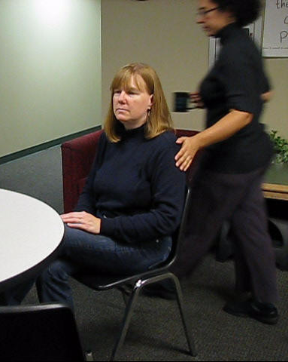

Slide 13
Maintaining Contact

Slide 14
Who?
Don’t forget to identify yourself.
Even if you are the only person there, it is reassuring.
If there are several people present, identify yourself each time.

Slide 15
It’s Heather

Slide 16
TURN-TAKING

Slide 17
Getting Attention
With a hard-of-hearing DB person, you may both touch their shoulder/arm and use their name.
For a deaf DB person, the appropriate places to touch are the limbs: shoulder, upper arm, forearm, under the hand, or knee.
The best place will depend on how you are positioned physically.

Slide 18
Getting Attention, cont.
In the next slide the DB woman with glasses has tunnel vision. The SSP across from her is trying to get her attention but she is looking down. So, the other sighted woman touches her arm for attention and indicates the SSP who wants to talk.

Slide 19
Touching the Elbow

Slide 20
Touching the Arm
In the next slide, the two men are chatting across a table and the woman wants to interrupt, but it is not urgent.
She gently touches the upper arm of the DB man whose attention she wants.

Slide 21
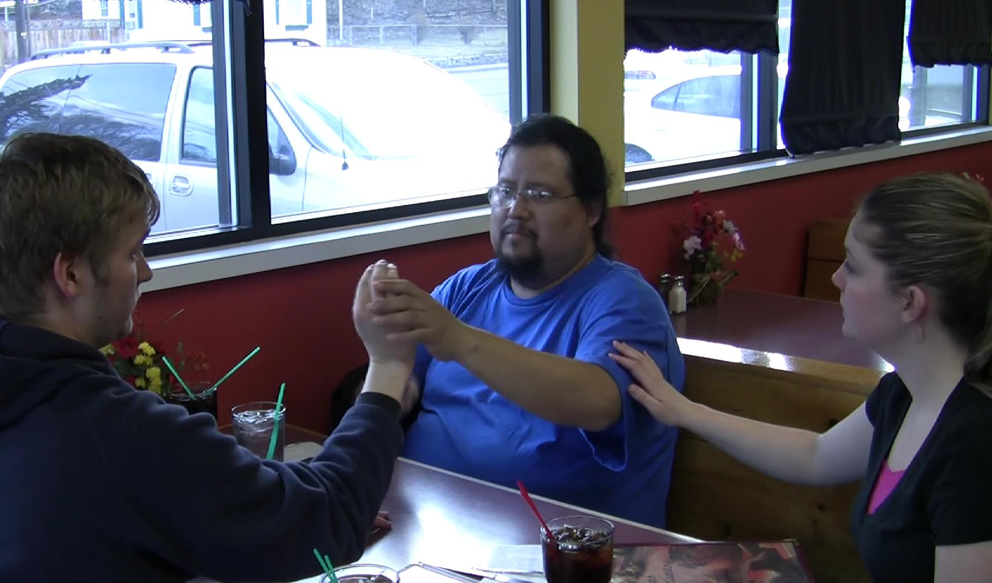

Slide 22
Pause
All exchanges have pauses while people think for a moment.
In the next slide the DB man is pausing to think what else he wants to let the SSP know before they leave for the store.
He and the SSP comfortably stay in touch during the pause.

Slide 23
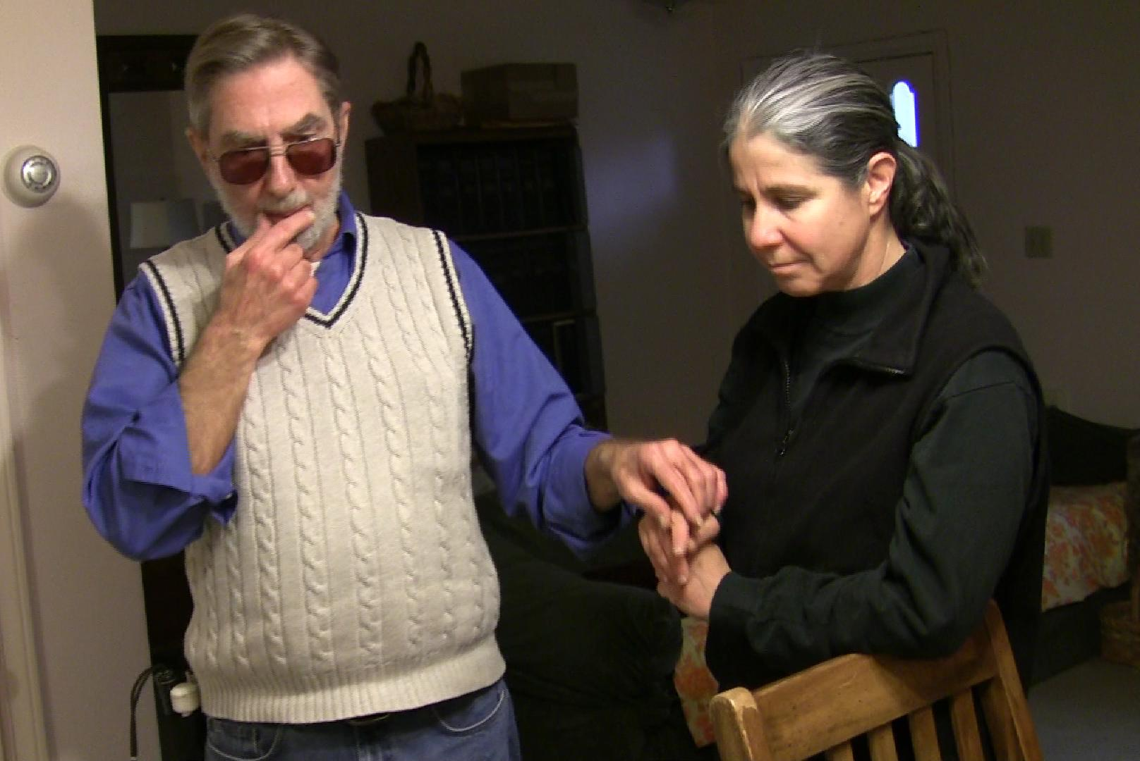

Slide 24
When You Want to Interrupt
You can slip your hand underneath theirs for a more urgent interruption, or put your hand on their shoulder to indicate you’d like to join the conversation.
In the next slide, the sighted SSP and DB woman with red hair are discussing a schedule. The 3rd person approaching executes a brief, urgent interruption by briefly by slipping her hand under theirs.

Slide 25
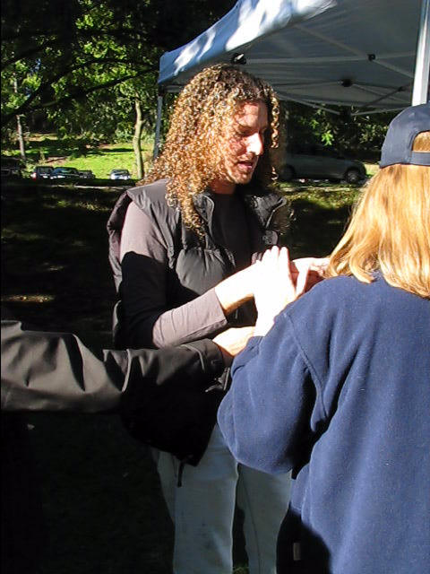

Slide 26
Yielding a Turn
When the DB person using tactile signing has not been receiving tactile back-channeling, they will hold their signing hand up and put their receptive hand out for a response.
When they yield a turn, they lower their signing hand (as in the upcoming slide) and reach to listen.

Slide 27
Yielding a Turn, cont.
In the next slide, the woman in the middle yields the turn to the woman on her left by moving the DB man’s listening hand to her.

Slide 29
Yielding a Turn, cont.
When 3 people are talking together using pro-tactile (all staying in touch), turn-taking is faster, easier and more fluid.
The important thing is to remember to sign with both hands (as dominant hands) at the same time. It takes some practice but is entirely do-able.

Slide 30
3-Way

Slide 31
PASSIVE LISTENING

Slide 32
Staying in Touch: Passive Listening
Other presentations in this set of materials illustrate tactual back-channeling, i.e. responding while listening.
Passive listening, with no particular response, is indicated by a light, constant touch. It is the equivalent of ‘an attentive listening face’.

Slide 33
(Tactile) Passive Listening
It is polite to indicate your presence by placing your hand on the DB person.
In the next slide the man is making an announcement. The DB woman on his right, wearing black pants, is looking at an interpreter in the front row, but staying in touch with him to indicate she is listening. The woman on her right, in white pants, (her SSP) is also staying in touch.

Slide 34
Listening, Being Present

Slide 35
Leave-Taking
If you need to leave for a few moments (e.g. to use the restroom) let the DB person know.
Make sure you say Goodbye when you are leaving.
Leave taking often concludes with a somewhat formal hug.

Slide 36
Conclusion
Pay attention to how the DB person responds and adjust your techniques.
Don’t rely on vision or hearing alone to communicate.
Remember both hearing and vision vary with the environment and change very gradually over time.

