Slide 1
Discourse Part I: Figure / Ground
Chapter 4.2.7

Slide 2
Overview
When we look at a picture we see both the foreground or the focus of the picture (often people) but also the background or context in which they are located.
This presentation explores how we see and how we talk about what we see in a way that establishes both the focal point and the background or context.

Slide 3
Definition
Figure / Ground is the term used to distinguish what we are paying attention to or focusing on (the figure) as opposed to the background (ground).
Have you ever taken pictures of your friends or an interesting object and later noticed something in the background that you did not see at the time? This is what figure/ground is about.

Slide 4
Example

Slide 5
What did You See?
The two women at a dinner table are the ‘figure’.
In the background we can see that the meal is finished. Even though there are only two women in the picture, there are two arms (one on each side) and there were five plates.

Slide 6
What did You See?, cont.
Depending on how long you look and your particular interests you may notice the wine, the crystal used, the china cabinet, the back of an antique chair and so on. This is all ‘ground’.

Slide 7
People & Things
People are usually the figure and things are usually the background, but not always. If you do not know the people and are looking for a particular object, then the object (and things that look like it) will be the focus or the ‘figure’.
In other words, what you are most interested in, what you focus on, is the ‘figure’.
This concept is important in how you describe what you see to DB people.

Slide 8
Figure/Ground & Discourse
Of course you will report what the DB person has told you they are interested in (a person or object they are looking for).
But there are other things you will notice along the way, such as things on sale in the store, people with a very unusual manner of dress, or something unexpected that you think will be of particular interest to the DB person (more on this in another presentation).

Slide 9
Setting a Scene and Discourse
The organization of your report (how you organize it) will indicate what you think is important (the figure) and what you think is just background.
Each language (ASL/English) has its own way of highlighting the ‘figure’.
As you learn to report what you see, you will need to get in the habit of thinking about why you are reporting it.

Slide 10
Discourse Markers
In module 3.6 (Chapter 4) you will see a presentation on how to mark different kinds of discourse in ASL, including signs such as “let-you-know” for background information or “warning-aviso” for foreground information.
For now, think about the different kinds of information you gather visually and how you use each type (figure/ground) of information.

Slide 11
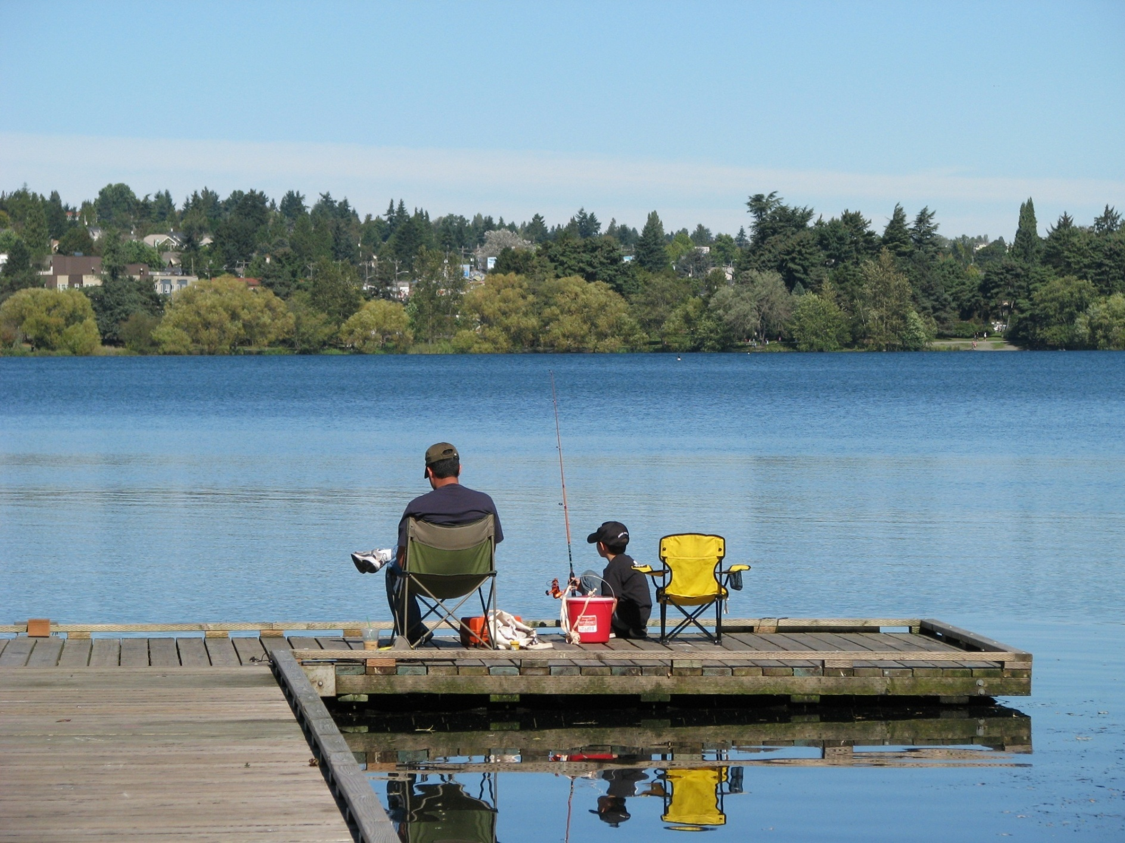

Slide 12
Man and Boy
To simply note that a man and a boy are fishing is not enough. Where are they fishing? From a boat? With poles or nets? Are they catching anything?
Why is it interesting? Because it is in a city park? Because we wish we were doing that? Because it reminds us of pleasant father-son memories or stories?
How would you verbally paint a picture?

Slide 13
Ground
Ground is not the focus but it is also important.
The background gives us a sense of place. It helps us be oriented.
It establishes the frame within which we look at particular elements.
Newspaper reports, for example, always have a “dateline” (time and place).

Slide 14
CONTEXT

Slide 15
Context as Ground: Who are they? Where are they? What are they doing?

Slide 16
Answer
They’re at a small town fair. The woman who is seated with the lime-green wrap is getting a temporary hair dye, just for fun.
What other things would you think are emblematic of a small town fair?
How would you categorize them? How would they be arranged? For example, see the next slide.

Slide 17
Lots of Booths, Crafts for Sale

Slide 18
Scenes
The following slides provide some photos to practice with.
Imagine that each slide is at a particular event as identified at the top.
What would you want to report (and why)?
How would you distinguish the figure and the ground?
Which ground would you report (and why)?

Slide 19
Extended Family Get Together

Slide 20
Family Get Together
Why do extended families get together? What do you hope to have experienced and how would an SSP facilitate that?
As you view the next slides, ask yourself similar questions – what should someone hope to get from this experience and how can the SSP facilitate that?

Slide 21
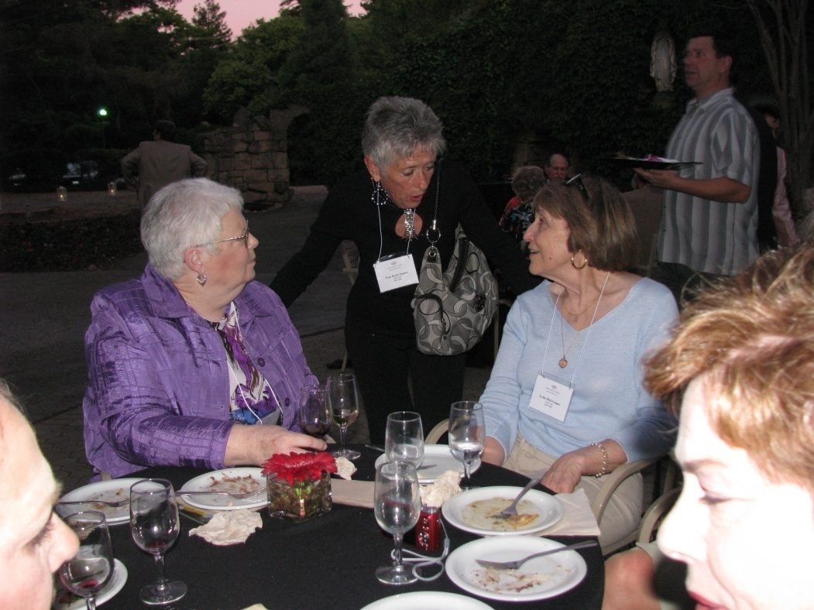
Social Time at a Conference

Slide 22
Winter Festival

Slide 23
Dedication of a new Auditorium

Slide 24
Event
How does each event influence what you notice?
Social time at a conference might be a time to engage with others there but it might also be a time to observe the social dynamics of others (who is talking with whom, the tone, etc.).
Festival: the focus might be the music, the food, the costumes or activities depending on the DB person.

Slide 25
Conclusion
This is just one part of the larger topic ‘Visual Information’: focus within a larger context.
Once you have gone through all three presentations, consider how they fit together to inform how you talk about what you see.

