Slide 1
Discourse Part III: Orientation, Scale and Sense of Place
Chapter 4.3.1

Slide 2
Orientation
Being oriented to time, place and the social environment means knowing what kind of place you are in, who is there, what they are doing, and the pace of what is happening.
To say you are “in a restaurant” or “in a hotel” is a good start in a top-down description but needs detail.

Slide 3
Orientation, cont.
Space, light, color, and style are some of the visual elements that give a sense of place.

Slide 4
Orientation as Sense of Place
Orientation – knowing where you are – is complex. First, yes, knowing you are in a restaurant (the DB person can probably smell the food) but what kind of decor? What distinguishes the Manhattan bar & grill from the San Diego bar and grill? Why do we care?

Slide 5
Orientation as Experience Interpreted
It is impossible to describe a scene completely in every detail.
Choose the details that convey the tone.
The DB person will have their own experience of the place. Our role is to provide visual information that is useful and interesting.

Slide 6
What Characterizes This Place?
What characterizes this particular place visually?
It will be a combination of an overall impression and particular chosen details. What strikes you? Light, clutter, energy, the age/style, the presence of nature or…?
Compare & contrast to other familiar places.

Slide 7
Small Town USA
One small town was described by an SSP as “brown”. The buildings were relatively colorless, non-descript and lackluster.
Further detail indicated storefront after storefront displaying signs saying “Going out of business,” “Sale,” or “Everything marked down.” The overall sense was of a dying town.

Slide 8
Sense of Place
‘Sense’ of place is quite literally our perceptions based in our senses. Check out these next slides to see what you get visually.
Also consider what kind of impression a DB person with no sight might get. What might they feel, smell or hear?
How would this fit with what you see?

Slide 9
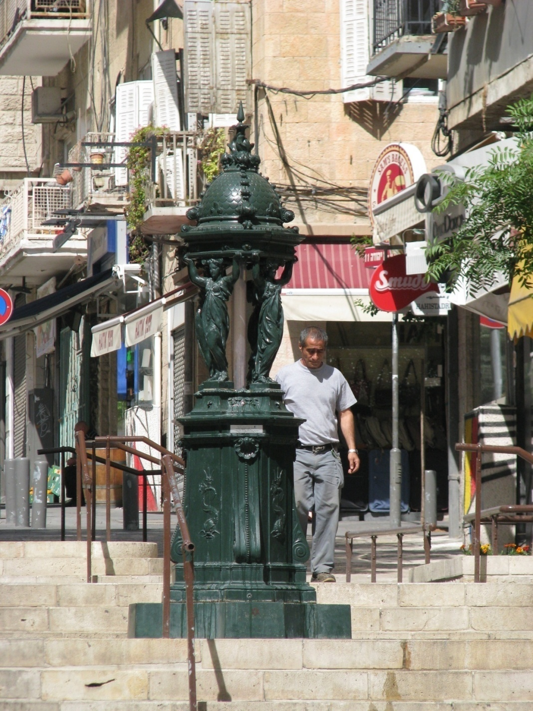

Slide 10
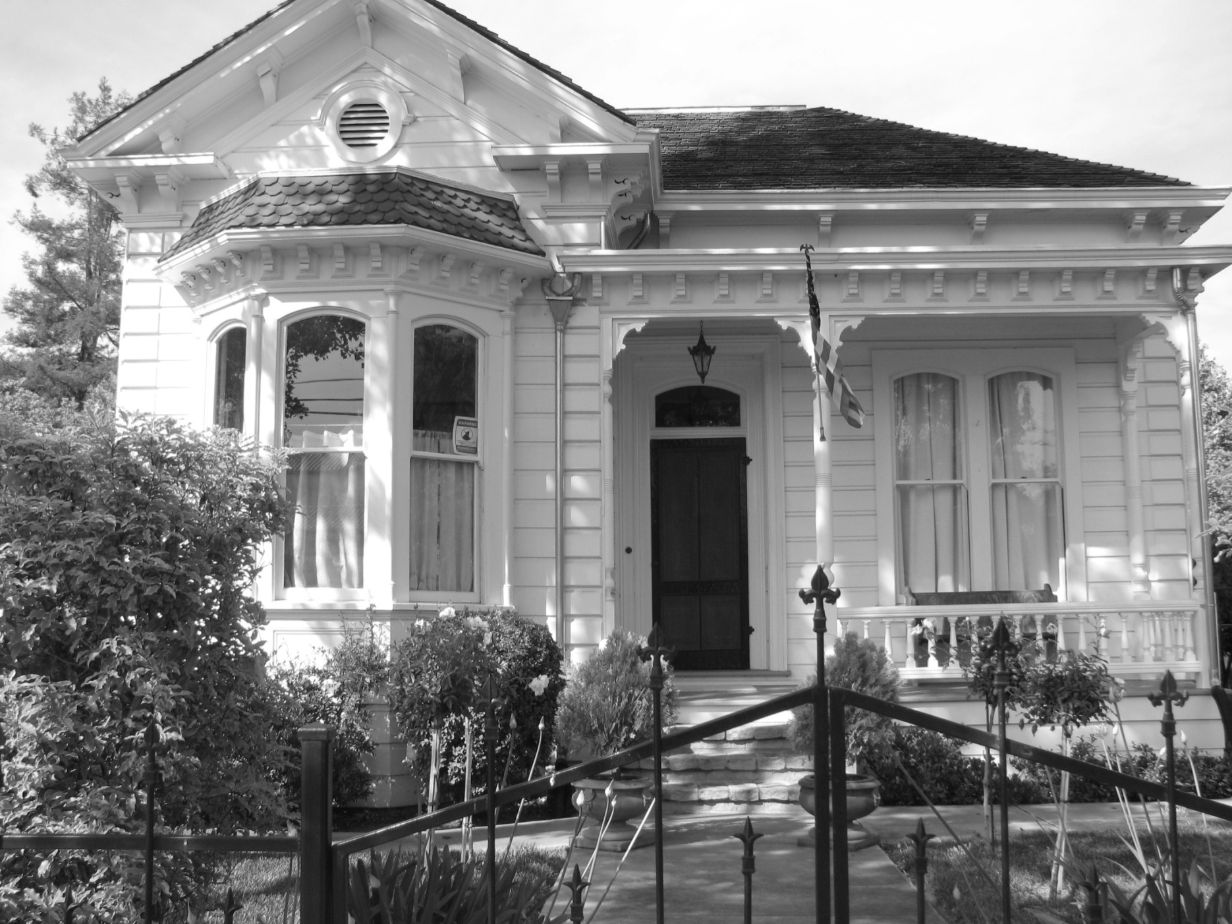

Slide 11
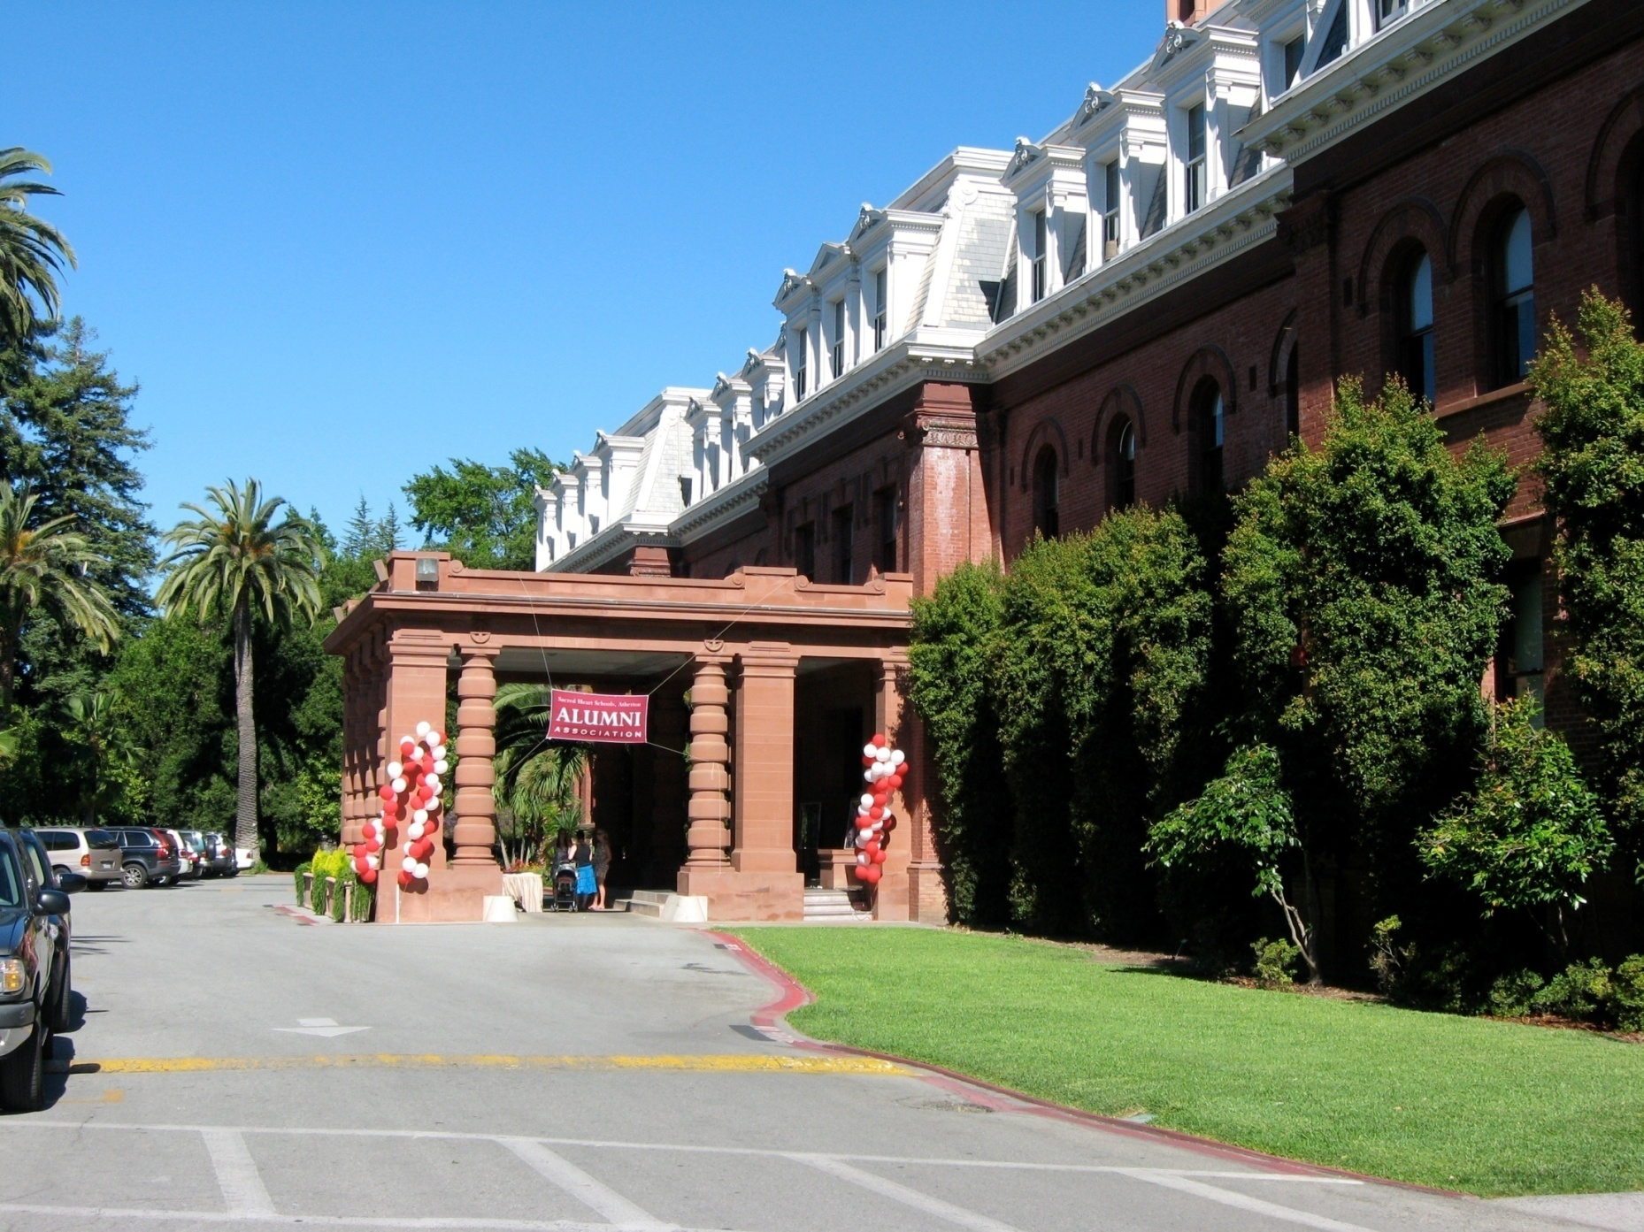

Slide 12
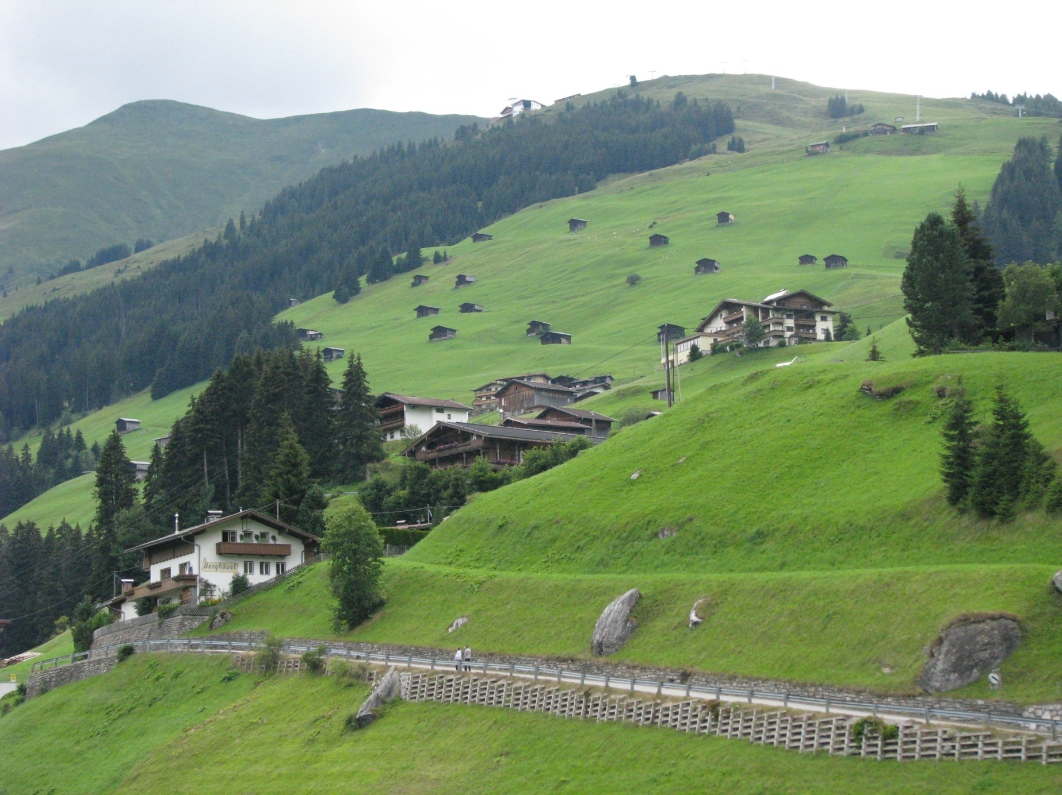

Slide 13
DEAF-BLIND Sense of Place
A DB person also has a sense of place based on temperature, air quality and movement, information through their cane, and things they touch as well as what they see/hear imperfectly.
Their ‘sense’ is different from yours so sharing impressions builds a more complete picture for you both.

Slide 14
Scanning
As you move through a space you scan quickly.
Walking down the street you might report: News stand, drug store, pizza place, shoe store, etc.
This gives the DB person a sense of the type of area you are walking through and also the location of places they may want to visit later.

Slide 15
Practice Pictures
Following are a few practice pictures.

Slide 16
Descriptions
Now, practice efficiently giving a sense of place for each of the above scenes.
Consider figure/ground – what is the focal point of each picture?
Use the top-down approach giving an overall framework (impression) and then focusing in on significant details.
Be aware of what makes each unique.

Slide 17
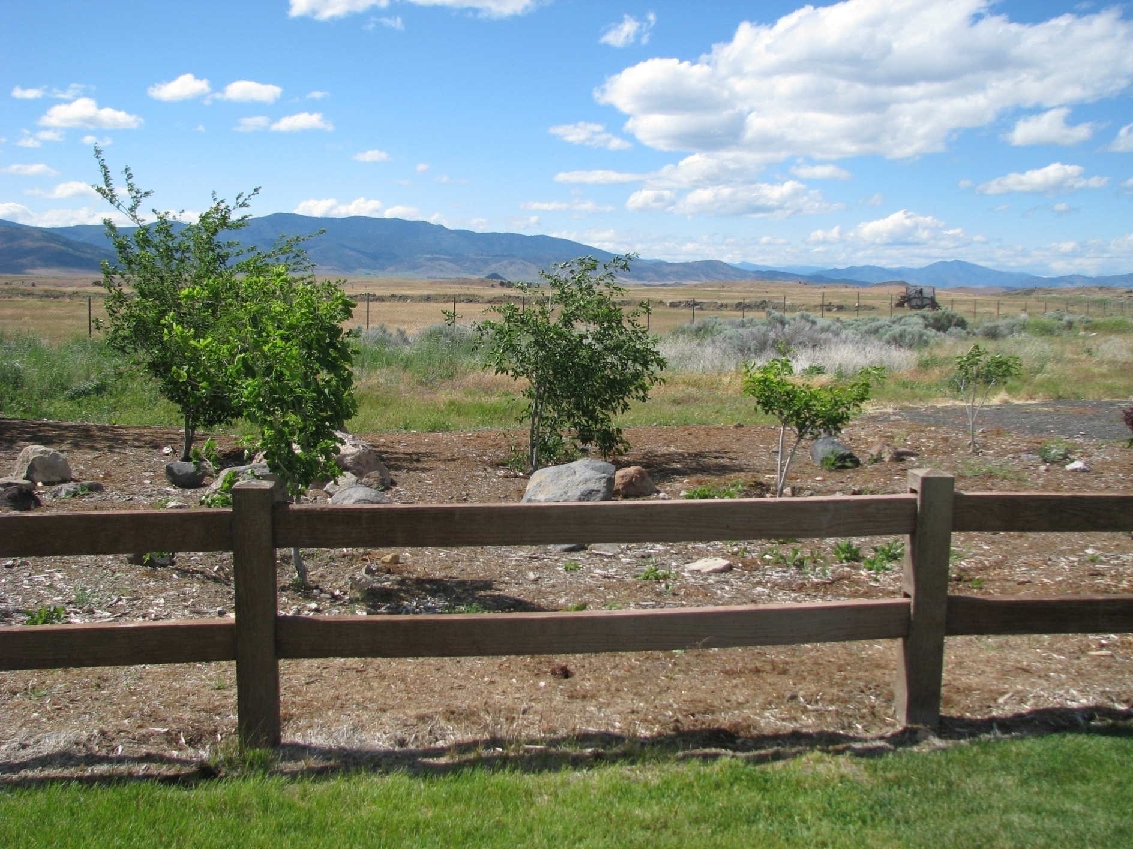

Slide 18
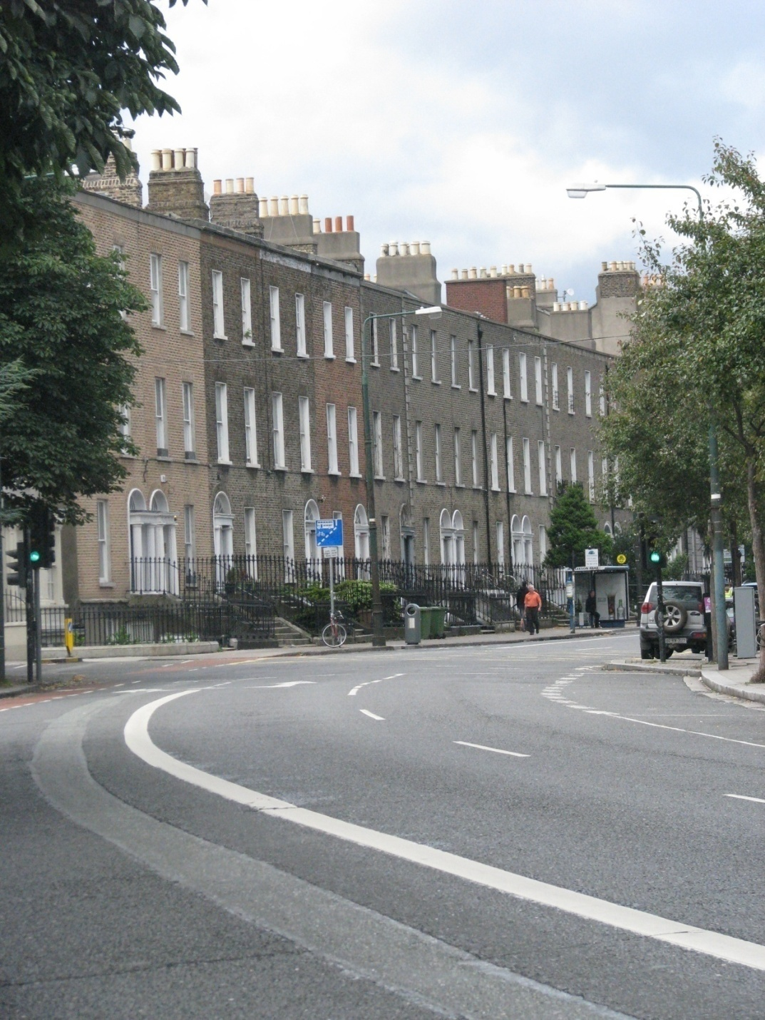

Slide 19
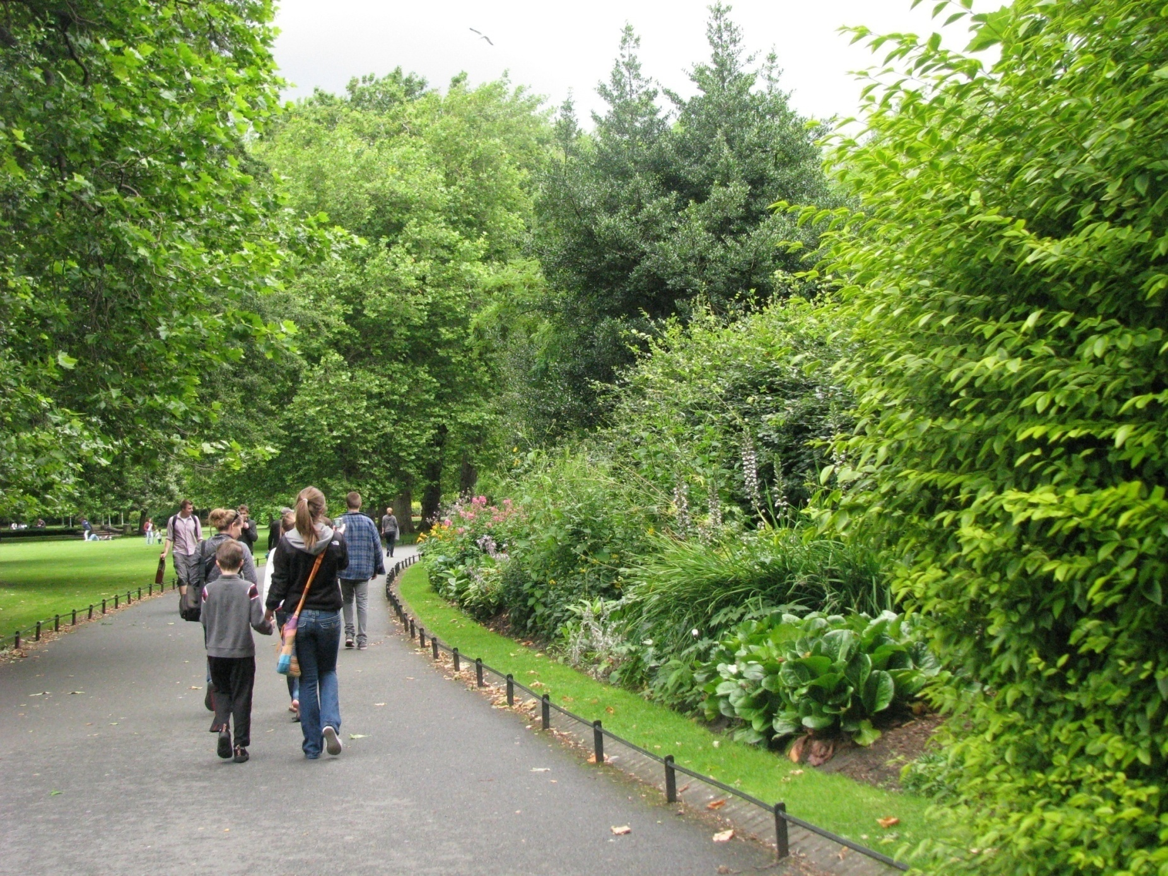

Slide 20
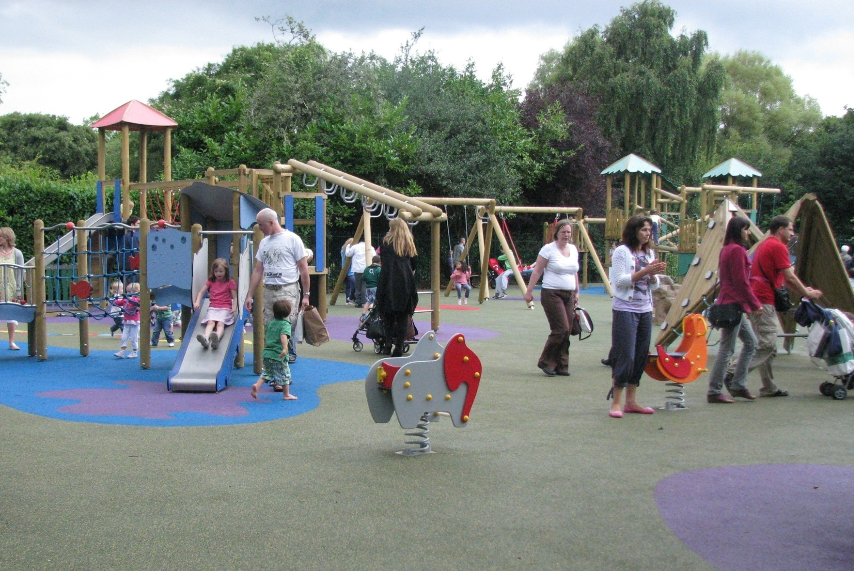

Slide 21
Elements of Place
The elements of space that we see include:
nature, buildings, people as well as the characteristics described previously (light, space, age, etc.)
Consider what would be informative to touch.
Depending on the purpose of the outing and the time available, touch should be a part of the experience.

Slide 22
SPACE & LOCATION

Slide 23
Shape
ASL Classifiers help identify size and shape which is a part of scale, but ASL classifiers can be difficult to read tactually.
Tactile classifiers are made on the body of the DB person. Signing “climbed the tree and sat on the lowest branch” is clear visually but to be clear tactually the DB person’s arm becomes the tree that is climbed (see video).

Slide 24
Size
Similarly, ASL classifiers indicate relative size. English uses numbers (e.g. 12 feet long, 60 stories tall) and both can be useful.
Relative size indicators such as “big,” “many,” or “small” often require context that is not shared. When you say there are many people at the party, do you mean 12 or 50? Be more specific.

Slide 25
Location
Similarly, pointing to ‘over there’ is not clear. Do we mean “3 feet in that direction” or “30 feet in that direction”? If I turn slightly (and can’t see) ‘over there’ gets lost.

Slide 26
Location, cont.
Tactile maps on the hand are more clear. The boundaries of the space (e.g. a room or area in a department store) are outlined by the boundaries of the hand. Locations can be marked on the hand relative to one another.

Slide 27
Visual Descriptions: Putting it Together
So far we have presented a little bit of theory regarding how we use our vision. Consider now how the concept of ‘figure/ground’ fits with the idea of orientation.
Consider too how the approach of a ‘top-down’ description fits with the idea of orientation as overall impression and significant details.

