Slide 1
DB People and Autonomy
Chapter 4.1.4

Slide 2
Overview
This presentation explores the elements of autonomy (for DB people) and how it relates to SSPs:
Autonomy vs. independence
Advocacy
Access
Services
Community
Jobs

Slide 3
Autonomy vs. Independence
All of us depend on services: grocery stores, road and highway maintenance, fire departments and so on.
We also depend on others for information: TV, the internet and other media
Given these dependencies and their constraints, we are free to make our own choices as to what to buy, how to travel etc.
Notes:
Add period to second bullet?

Slide 4
Making One’s Own Decisions
Through the use of:
Transportation
Interpreters
VRS & Communication Facilitators (CF)
Support Service Providers (SSPs)
Technology
Jobs

Slide 5
Lack of Services = Dependence
Dependence develops when access is not available (no interpreters, SSPs, communication facilitators or appropriate transportation and mobility systems).
There are often not enough teachers of Braille or Orientation & Mobility who specialize in working with DB people.
Many towns & some cities do not have reliable bus or light rail service.

Slide 6
Catching Up
Some deaf-blind people have been isolated for many years and will need to catch up on information before they can make choices.
They may have had to depend on busy family members who did not have time or the skill to provide much information.
They may thus have developed habits of “going along to get along” and not requesting more information.

Slide 7
ADVOCACY

Slide 8
Advocacy, Access & Services
Advocacy, access and services create a stable community. Services without advocacy becomes a stagnant system in which ‘clients’ are ‘served’ but citizens do not participate. Advocacy without access or services is advocacy without success.
An important part of access is a support system including communication and transportation services.

Slide 9
Organizations are Key
The American Association of the Deaf-Blind, a national organization of, by and for Deaf-Blind People. Some states or areas have local organizations, for example:
The Washington State Deaf-Blind Citizens
Minnesota Deaf-Blind Association
Deaf-Blind Association of Connecticut
Metro-Washington Association of the Deaf-Blind

Slide 10
Organizations
Organizations such as the Washington State Deaf-Blind Citizens (WSDBC) provide an opportunity for DB people to exchange information, practice leadership, set goals, and work together.
Start with social events and don’t get bogged down in writing By-Laws or other formal issues.

Slide 11
ACCESS

Slide 12
Autonomy and Access
Advocacy for DB people is part of the larger movement for people with disabilities, a movement for universal access.
Universal design aims to accommodate people of all ages and physical abilities.
For DB people, the focus is on communication (in both formal and informal settings) and transportation.

Slide 13
Qualified Interpreters

Slide 14
Support Service Providers (SSPs)

Slide 15
Transportation

Slide 16
Riding the Metro Bus
Debbie Sommer (next slide) holds her bus kit folded to the number of the bus she wants to ride.

Slide 17
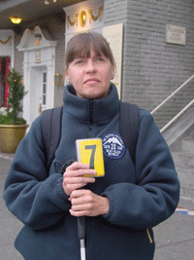
Riding the Metro Bus, cont.
The yellow background indicates she is deaf as well as blind.
Photo credit Seattle Lighthouse for the Blind, Horizons newsletter, Spring 2006

Slide 18
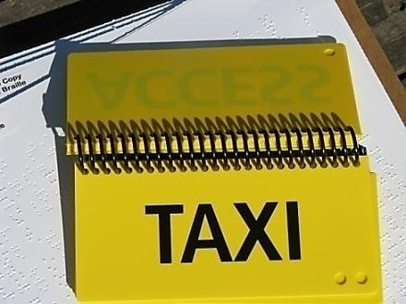
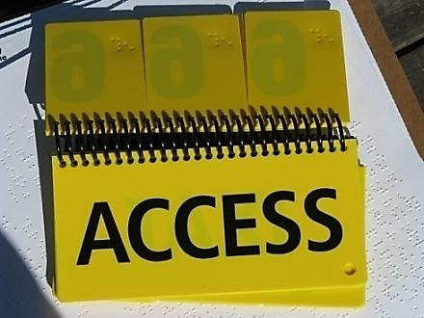
“Bus Kit”
The numbers in the bus kit are printed in bold and embossed in Braille so Ms. Sommer can feel the numbers to choose the correct one.
Bus driver notes the card, stops, gets out of the bus and guides the DB person onto the bus and to a seat.

Slide 19
Equipment & Instruction

Slide 20
SERVICES

Slide 21
Services
SSPs
Interpreters
Transportation
Braille teachers
Orientation & Mobility Teachers (specialists with DB people)
Advocates
Case managers

Slide 22
Professional Allies
Advocates know systems, rules and who makes which decisions.
Advocates know the law and how to talk to people in the various bureaucracies.
The law is there – advocates make sure it is applied.

Slide 23
Case Managers
A single deaf-blind individual must often deal with a number of agencies, many of whom know nothing about what it means to be deaf-blind.
Once advocacy has made it clear that access is a right, a case manager can help with coordination of these many services and with referral.

Slide 24
Job Placement Specialists
Good job placement specialists will look at the individual DB person and listen to the kinds of work they want to do and are qualified to do, then use creativity and persuasion to find an appropriate position.

Slide 25
Advocacy, Access & Services
Advocacy, access and services create a stable community. Services without advocacy becomes a stagnant system in which ‘clients’ are ‘served’ but citizens do not participate. Advocacy without access or services is advocacy without success.
An important part of access is a support system including communication and transportation services.

Slide 26
Self-Advocacy
Self-advocacy depends on good communication access.
It requires a knowledge of the system.
It also takes non-DB people to listen.
This includes SSPs and interpreters who work with DB people and who listen to what it is the DB person wants, and follows through.
SSPs and interpreters open channels of communication.

Slide 27
COMMUNITY

Slide 28
Participating in Community
“Participating in Community” is two-fold:
Having a community of peers with whom to share experiences, discuss problems and solutions, and
Being able to participate in the wider community with others not like oneself.

Slide 29
Social Group

Slide 30
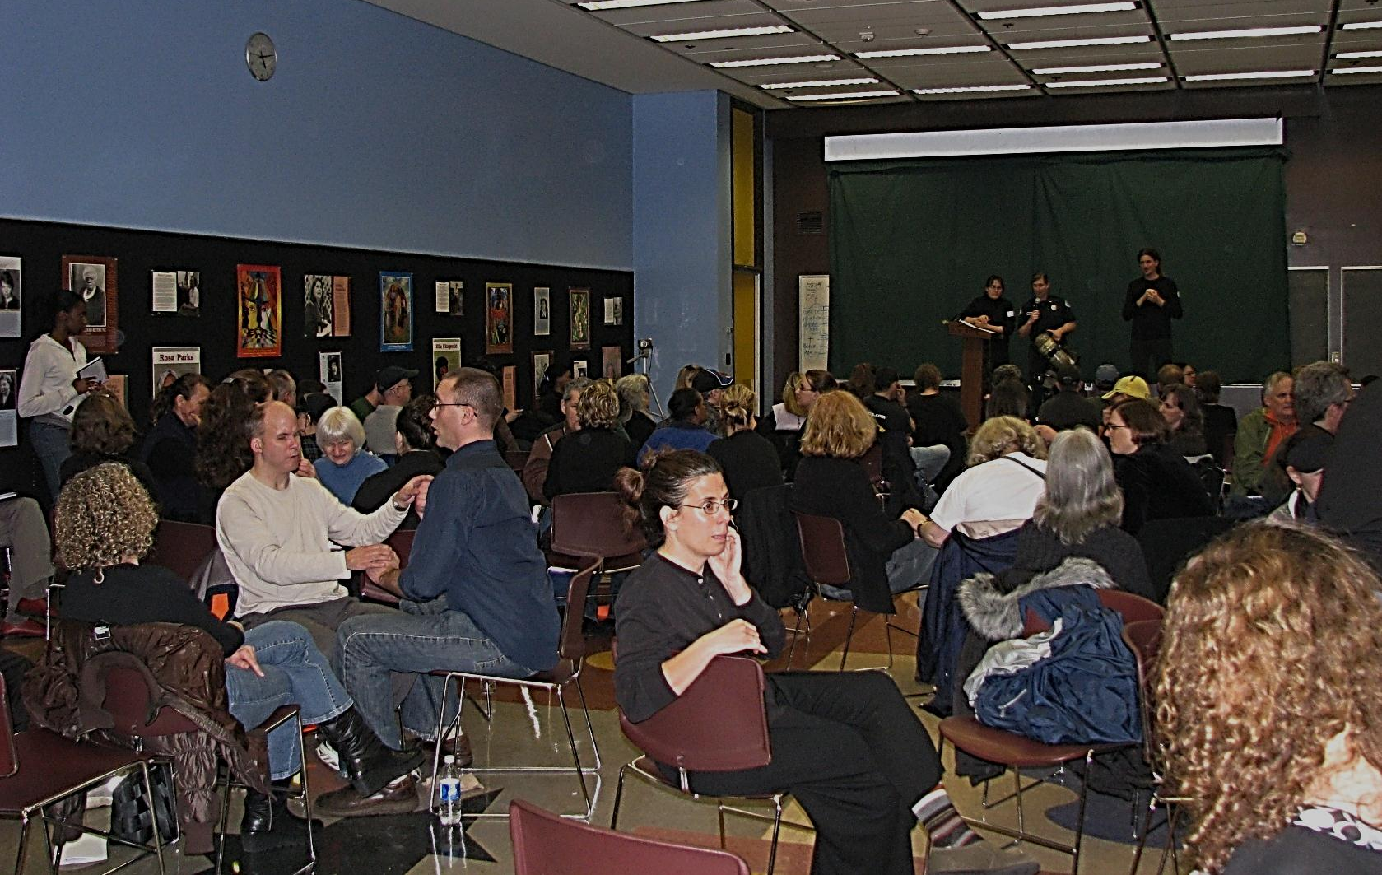
Conducting Business

Slide 31
Attending Camp-Retreats

Slide 32
Recreation

Slide 33
Autonomy & Choices
Autonomy is having information and other resources with which to make choices.
This includes
Social connections and activities (a peer group good communication),
Access to information and resources (interpreters, SSPs, equipment and transportation), and
Meaningful work.
These are not necessarily sequential.

Slide 34
JOBS

Slide 35
Jobs
Gainful employment does not just mean a job. There should be real opportunity.
DB people who enjoy working with machinery should be able to find employment doing that.

Slide 36
Jobs, cont.
DB people who have college degrees in a field of specialty should be able to find employment in that field.
DB people with administrative and leadership skills should similarly be able to find gainful employment in appropriate positions.

Slide 37
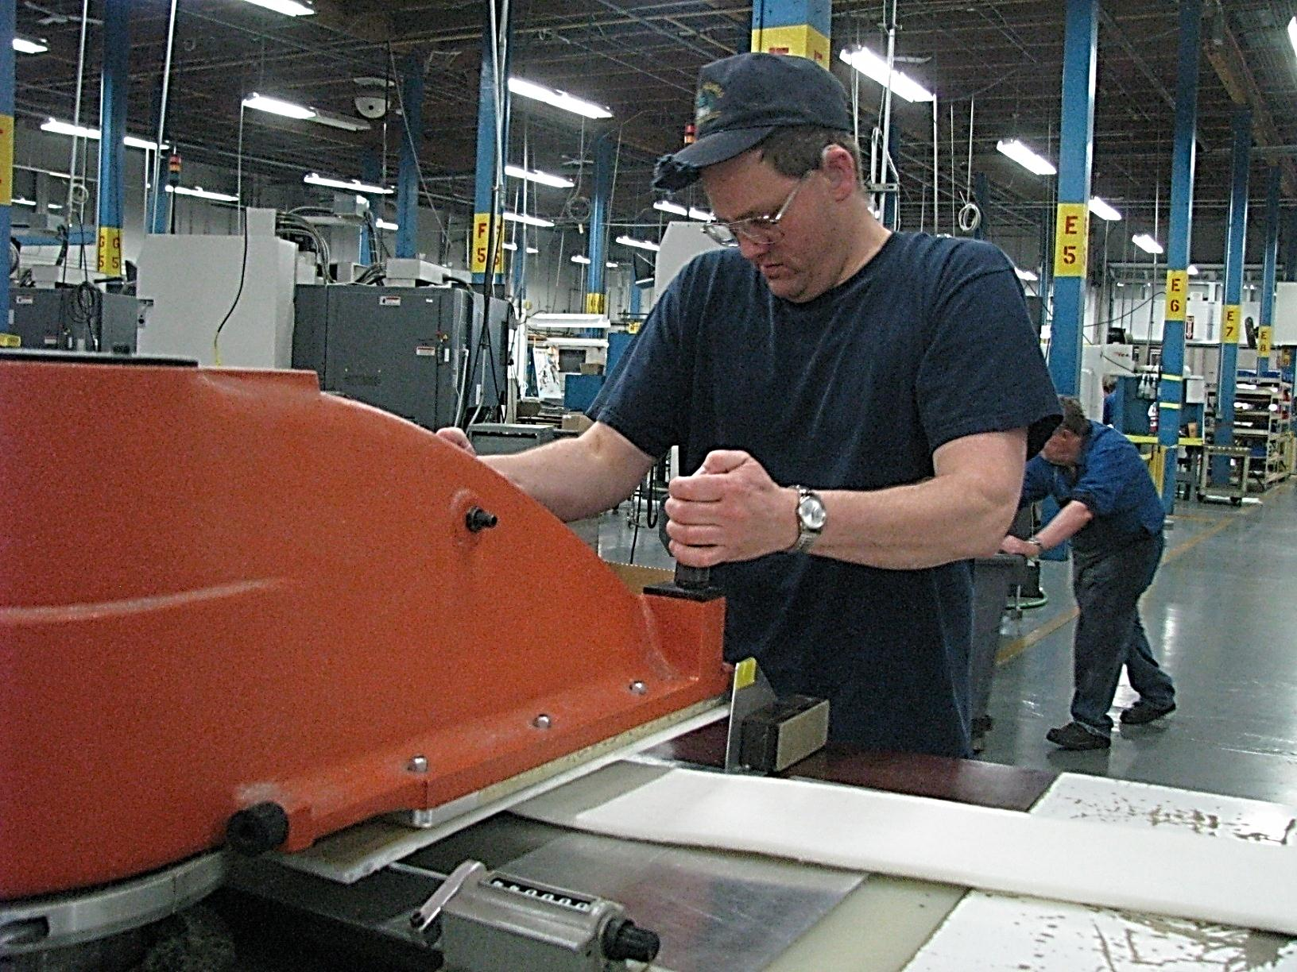
Jobs: Blue Collar

Slide 38
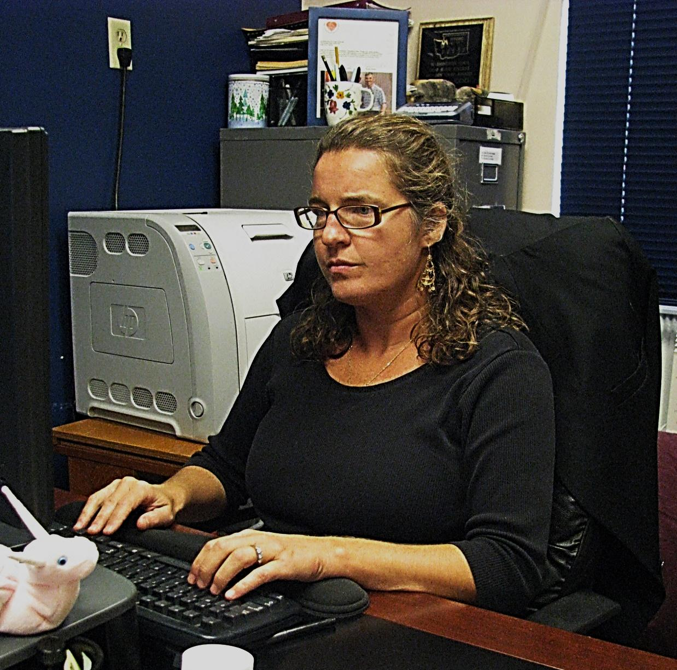
Jobs: Administrative

Slide 39
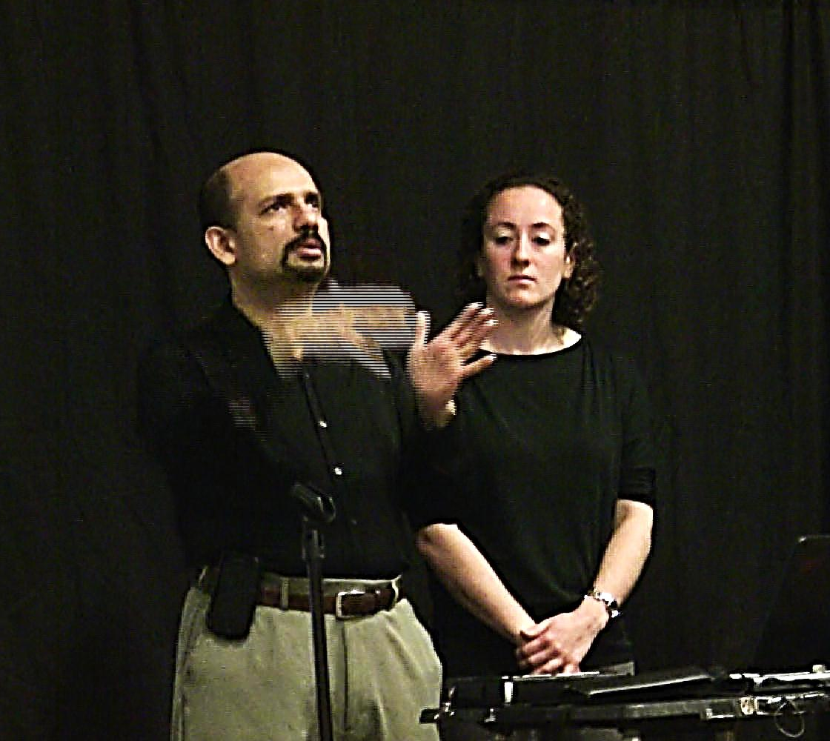
Jobs: Professional

Slide 40
By Fabric Artist aj granda

Slide 41
AUTONOMY & A SUPPORT SYSTEM

Slide 42
Today
While there are DB people with Ph.D. degrees, and some who are artists, teachers and administrators employed in their fields, these DB people are the exception.
Most DB people are employed in menial jobs, and depend on family members for help and support.
Some live alone; they have access to food and shelter but are extremely isolated.

Slide 43
Challenge
When a DB person is severely isolated, they may lack the knowledge and energy to change things.
No one can make these changes alone.
Hearing-Sighted people often feel overwhelmed and frustrated at trying to help and sometimes end up blaming the DB person.

Slide 44
Begin
There have been many positive changes in the last 30 years.
Start where you are. Keep the positive changes coming.
Respect what you hear from each DB person.
Work together.
Don’t give up.

