Slide 1
Boundaries: Yours, Mine and Ours
Chapter 4.2.2

Slide 2
Boundaries Overview
Boundaries are lines not to be crossed without permission.
Role boundaries are negotiated and explicit.
Once negotiated (as in established roles) they remain firm until re-negotiated.

Slide 3
BOUNDARIES AND THE ROLE OF SSP

Slide 4
SSP Role
SSPs provide the link to the environment in casual contexts (e.g. shopping, at community events, paying bills).
They provide visual-spatial-social information.
SSPs do not offer opinions, give advice or speak for the DB person.
They provide sighted-guidance.

Slide 5
Interpreter Role
Interpreters provide the link to formal environments (e.g. business meetings).
They relay what is said and needed visual-auditory context (e.g. who is talking).
Interpreters do not offer opinions, give advice or speak for the DB person.
They sometimes provide translations.

Slide 6
Multiple Roles
The configuration of professional roles and of the boundaries of the role(s) will vary somewhat by custom and by negotiation.
Interpreter-SSP
SSP-Interpreter, or
2 distinct jobs/roles

Slide 7
Boundaries & Role Definitions
The AADB and some jobs have interpreter-SSPs, (interpreters who also provide sighted guide and visual –spatial-social information).
Camps for DB people and some jobs have SSP-interpreters (SSPs who also provide light interpreting).
Professional DB people sometimes hire a person to serve in both roles.

Slide 8
AADB
The American Association of the Deaf-Blind (AADB) was originally a way for DB people to be in touch with one another through Braille newsletters and other communications. In 1975 DB people began meeting regularly at national gatherings, first under the name the National Association of the Deaf-Blind of America (NADBA), but after a few years this was changed to the AADB.

Slide 9
NADBA to AADB
In the 1970’s members first gathered in camps and then college campuses that were large enough to hold all the deaf-blind attendees and their support people.
Supporters included spouses, friends, counselors, a few interpreters, and a few ministers. They were called ‘volunteers’.

Slide 10
AADB Evolves & SSP Role Emerges
Throughout the 1980’s the AADB grew in members and organization under the capable leadership of Rod Macdonald.
Macdonald coined the term ‘SSP’ and the role began to emerge. Four categories of people attended the meetings: delegates, SSPs, family members and observers. ‘SSP’ was a working role.

Slide 11
Camp Retreats
By this time the meetings had moved to college campuses where the costs were still low, and space was plentiful
During this same time period, state and local agencies began sponsoring regional camp retreats. Some borrowed the label SSP for volunteers who came to support DB people.

Slide 12
SSP Role Evolves
Today the AADB continues to evolve and grow in sophistication, and with it, the demands put on its SSPs.
In 2011 SSPs at the AADB were expected to interpret much of the time.

Slide 13
SSP Role Evolves, cont.
The next slide shows the front dais where a platform interpreter and personal interpreters for Board members are working during the business part of the meeting.

Slide 14
AADB 2011

Slide 15
Meanwhile... Retreats & Local Organizations
Several states have camps or retreats for DB people. These gatherings vary in terms of scheduled activities, including workshops, social or recreational activities, meetings, sports-like recreation or simply times to chat.
These events too mix light interpreting with providing visual information.

Slide 16
Camp-Retreats
Interpreting announcements at the annual Seabeck Retreat.

Slide 17
Here too, the SSP does not ‘participate’ as such!
It may seem that in casual environments such as camp-retreats or while doing daily errands that the SSP is simply offering a ride, an elbow (as a guide) or being a companion.
In the next slide we see SSPs and DB people chatting and enjoying an outdoor meal.
But… these SSPs are on duty.

Slide 18
Seabeck Retreat 2011

Slide 19
Day to Day Access
However, DB people need access to informal environments beyond Camp Retreats. They have daily errands to run, from grocery shopping to getting a haircut to paying bills.
Beyond this, DB people have a right to access the wider community through walks in the park to attending community festivals.

Slide 20
Day to Day Access, cont.
In the next slide a DB woman is participating in a Walk-a-Thon fundraiser.

Slide 21
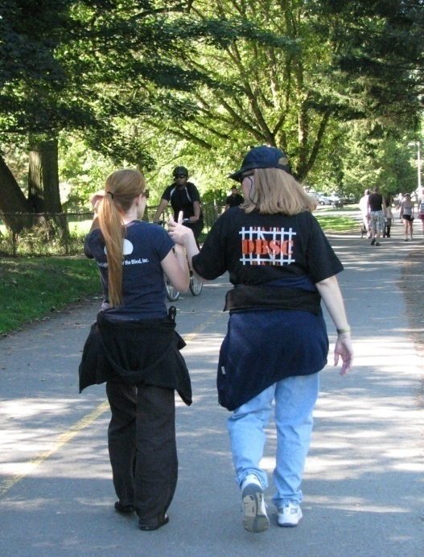

Slide 22
Information about Upcoming Events at the Park

Slide 23
The SSP is Working
It is the DB person’s walk. She decides how long to walk, when to do something different and so on, based on information given to her.
In the next slide, the DB woman has completed her errands and decided to take a break. The SSP describes the space, the customers, and other things of interest as well as what is offered to drink and eat.

Slide 24
A Break from Errands

Slide 25
Interpreters & SSPs as Part of a Team
As access is provided, DB people become more employable.
Interpreters provide interpretation during business/work meetings, while SSPs provide access to the informal environment.
In the following slide the DB woman uses a certified interpreter for the meeting part of her day and an SSP-provider for lunch with colleagues.

Slide 26
Sometimes the Roles are Separated
Interpreter (below right) for a meeting.
SSP for a lunch break with colleagues.

Slide 27
Emerging Profession
Today the SSP is a paid and trained worker – no longer friend, family member or other professional who comes to help as a volunteer.
The terms used vary somewhat in different cities, and many areas still struggle to find funding and a structure through which to pay for this service.
The future, however, is clear.

Slide 28
RELATIONSHIPS AND PERSONAL BOUNDARIES

Slide 29
A Personal Relationship
SSPs are in close physical proximity with the DB person, often touching.
Unlike interpreters, they work in informal environments.
This means the work is in many ways more personal than for other professionals and clients, e.g. interpreters.

Slide 30
The SSP is not a Buddy
Lines or boundaries can more easily become blurred.
Both the DB person and the SSP must remain clear that this is a working relationship, not a personal one.
Both the DB person and the SSP must remain clear that the SSP is working for the DB person (i.e. it is not an equal relationship).

Slide 31
Community?
These lines can become especially blurred when a DB person has little other social contact and little opportunity to make friends.
People who become SSPs are often caring people who enjoy and want to be helpful.
The problem with blurred lines arises when the expectations are not the same for both people.

Slide 32
NEGOTIATING BOUNDARIES, SOLVING PROBLEMS

Slide 33
Who Owns the Problem?
It is said over and over again that the SSP does what the DB person wants.
So if the SSP is uncomfortable, whose problem is it? It depends.
DB people have very few resources and sometimes are tempted to over-use an SSP.
When issues arise it is good to talk about them.

Slide 34
Common Issues
Common issues include:
Time (starting and stopping on time)
Hygiene (clean hands, no perfume, etc.)
Smoking (this is becoming less of an issue)
Dogs (guide dogs and pets) and their behavior
Children (the SSP is not a baby-sitter or responsible for children)
Work time vs. social time

Slide 35
What is the Problem?
First, identify ‘the problem’.
Often the problem is complex.
A problem may hook into old baggage or issues.
Use the scenarios to help you analyze the problems presented.

Slide 36
Who Owns the Problem
If the DB person will be late that is the DB person’s problem.
If the DB person will die from smoking, that is not the SSP’s problem.
If the activity goes over time and will make the SSP late then it is the SSP’s problem.
If the smoke of the cigarette is bothering the SSP, then yes, that is the SSP’s problem.

Slide 37
My Problem
When it is my problem, then I am the one who needs to address it.
If it is the SSP’s problem, the SSP should address it. How can it be solved without being aggressive about it?
If it is the DB person’s problem, then how can it be solved while taking responsibility?

Slide 38
Personal Boundaries
Your religion should guide you in your actions at home and at work, but it should not be a topic of discussion while you are working.
Touch should respect the SSP’s boundaries, but it should also respect touch as a major avenue of information for DB people.

Slide 39
THE DEAF-BLIND WAY & PERSONAL (PHYSICAL) BOUNDARIES

Slide 40
Boundaries & Culture
Dominant American culture and “the Deaf-Blind Way” are different, especially in pace, kinesics (the use of the body) and proxemics (the amount of space between people).
Some DB people are bi-cultural and separate how they interact depending on where they are and who they are with.
Other DB people prefer to follow the dominant culture virtually all the time.

Slide 41
Touch & The DB Way
In the next few slides are some DB people who are members of a DB Community who feel comfortable switching to “the Deaf-Blind Way” using 3-way communication and using touch to gain information about the environment.

Slide 42
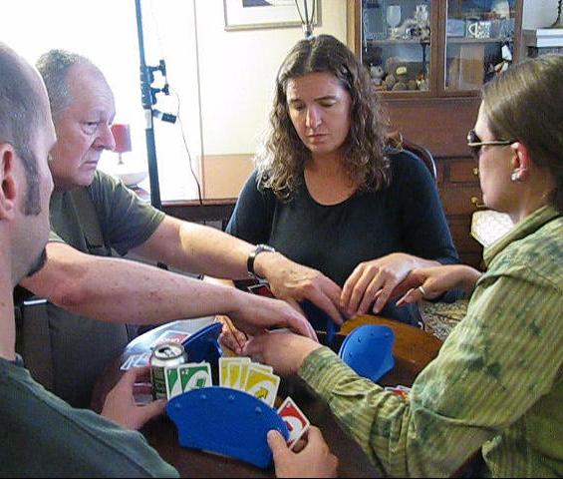
A Friendly Game

Slide 43
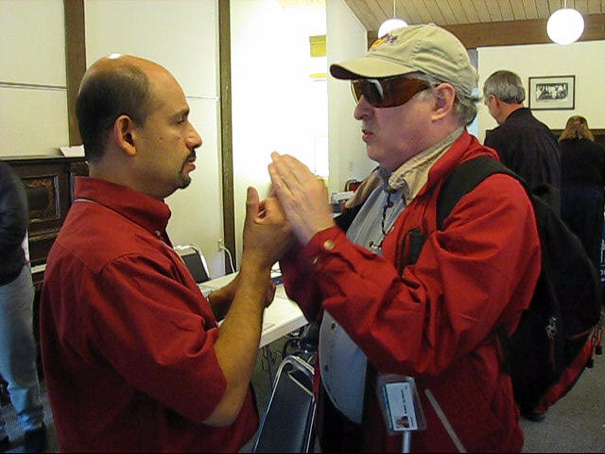
Two Men Discussing Technology

Slide 44
A Community Picnic

Slide 45
Touch & the DB Way
As you can see in the visuals with this curriculum, touch is not random.
Commonly, it is:
Hand to hand
Hand to shoulder or knee
Hugging
With permission, it can include the arms, head, sweater, hair-do, glasses, etc.

Slide 46
Touch, Culture & Personal Boundaries
Some DB people are bi-cultural and distinguish how they interact depending on where they are and who they are with.
Other DB people prefer to follow the dominant culture virtually all the time.
SSPs come from different family-cultural backgrounds; they will become bi-cultural as well if not already so.

Slide 47
SSP-DB RELATIONSHIPS

Slide 48
Relationship
SSP work is not a rigid set of behaviors.
The defined boundaries of the job will determine the way the SSP provides service.
The number of people who can communicate effectively with DB people is relatively small.
Thus, the same person is often an SSP at one time, an interpreter at another time, and a friend at yet another time.

Slide 49
Do Not Take Over
An SSP may feel that the quickest and most efficient way to accomplish something is to do it one’s self (i.e. take over and just do it).
This is not respectful:
It lessens the experience of the DB person.
The DB person gets less information.

Slide 50
Showing, not Telling
In the next two slides the DB man is shopping in a very crowded hardware store. Despite the awkwardness, the skilled SSP shows the DB man where the merchandise is (on the bottom shelf), informing him of other shelves as well as other objects in the way.
The SSP then stands and stays in touch with him (her left hand) while the DB man explores the merchandise on his own.

Slide 52
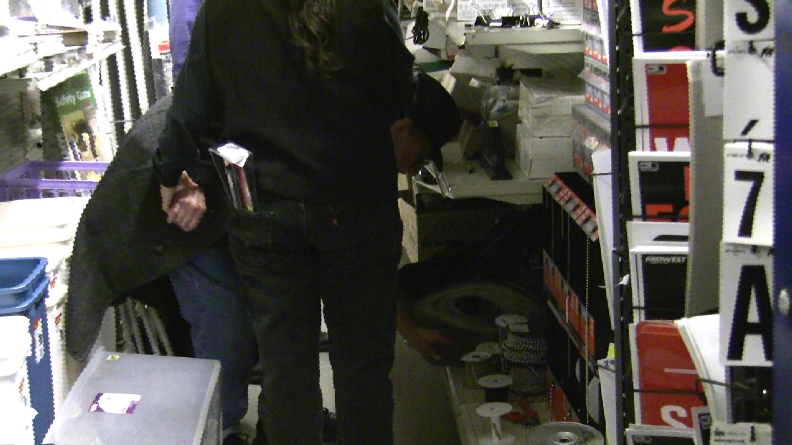

Slide 53
Be Realistic About Time
Being an SSP is being on DB time.
The goal is not to ‘get the task done’; the goal is for the DB person to do it.
The more you work together as a team, the more efficient you will become.

Slide 54
Seek Out a Match
When both the DB person and the SSP enjoy the same errands or types of participation in the community, the work will be more pleasant.
Just as interpreters tend to specialize in medical, classroom or other fields, SSPs will find they enjoy certain types of assignments more than others.

Slide 55
Burn Out
There are very few services in place for DB people and even when there are regular, paid SSP services, these are often not enough.
The most valuable way to contribute to a DB person or to the DB Community is to be in it for the long haul.
This means taking care of yourself, too.

Slide 56
Maintaining Boundaries and Review
It is good to be conscious about boundaries and to periodically review to make sure there has not been unintentional ‘drift’.
If you are feeling annoyed or angry, perhaps you have been ‘rescuing’ the DB person.

Slide 57
Maintaining Boundaries and Review, cont.
Perhaps you have become friends and would prefer this to be a more personal relationship rather than a professional relationship.

Slide 58
Complexity
Roles change over time within society.
Relationships change over time between people.
The idea of boundaries to a role is related to ethics and power.
The idea of boundaries between people is related to respect.

Slide 59
Conclusion
The work of SSPs are essential to a quality life for a DB person.
The role is defined within the agency, the community, and sometimes the event or situation.
Touch is an essential part of being deaf-blind.
Avoid feeling overly responsible for the decisions and actions of others.

