Slide 1
Selecting the Site and Accommodations for your Workshop / Training
Chapter Two:
Some Illustrations

Slide 2
Overview
This presentation includes information to help choose a site and make it ready for training.
It includes discussion of the room itself, light and acoustics, as well as
Arrangements to be made for amplification and interpreters,
All with a focus on good communication.

Slide 3
CHOOSING A SITE

Slide 4
Location
Choose a site that is easily and comfortably accessible to instructors and participants. This may mean near a bus line.
There should be good sidewalks, and preferably ample parking.

Slide 5
Location, cont.
You will also want nearby choices for the lab exercises (e.g. restaurants and shops that are willing to let you use their space for practice).
Some people prefer a familiar location (less stress finding it) while others prefer a site that will provide maximum exposure to the DB Community (training as public relations).
Notes:
Change title to: ‘Location, cont.’ ?

Slide 6
Location, cont.
Money is often a consideration and while space in outlying areas may cost less, it may not suit the criteria for transportation or proximity to lab sites.
The coordinator has a big job choosing the site and arranging the labs.
Notes:
Change title to: ‘Location, cont.’ ?

Slide 7
Building & Site
The building should have opportunities to practice guiding stairs, doors and access to the outdoors.
It should be close to sites for lab exercises.
Notes:
Note: the first bullet looks messy.

Slide 8
THE ROOM

Slide 9
DB Trainees and SSP Trainees
Some DB people will communicate tactually, some visually and some auditorily.
Training and the space should be modified to suit the communication.
SSPs will communicate visually (using Sign Language).

Slide 10
SSPs for HH-DB People
SSPs who are not fluent in Sign Language and who are taking training to work with hard-of-hearing DB people should nevertheless know basic tactual communication (fingerspelling, guiding signals and becoming comfortable with touch).

Slide 11
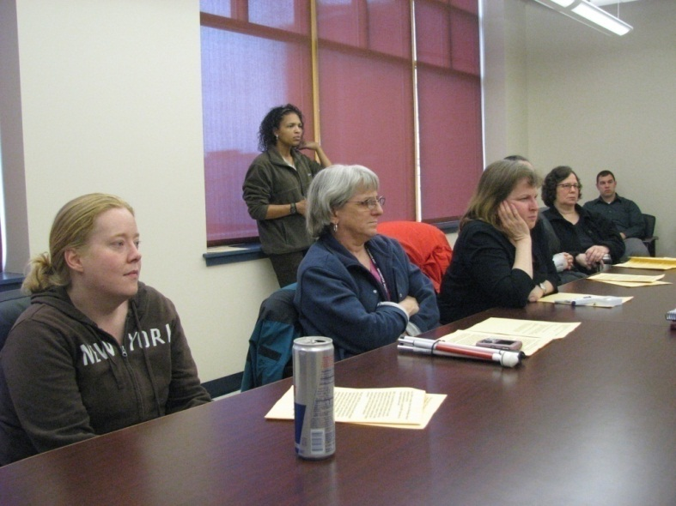
Space & Visuals
Classrooms, and board or conference rooms typically offer good lighting
Room to write, move around and do activities is helpful.
Notes:
Note: add period at end of first bullet?

Slide 12
Light & Wallpaper
Hotel rooms are often poorly lit and have patterned wallpaper, wall lighting or other decorative elements that distract rather than aid communication.

Slide 13
Lighting
Vision accommodation for participants with limited vision:
Bright overhead lighting (as in most college classrooms)
Reduced glare (see slides following)
Improved contrast (background, and clothing for instructor and interpreters)
Notes:
Note: add period points at end of three bullets?

Slide 14
Acoustics
Rooms with bare walls and bare floors often reflect sound and create a slight echo.
Just as with lighting, slight glare which may not bother people with normal vision will strain the eyes of those who have impaired vision, so too, slight echoes which will not bother those with normal hearing will strain the hearing of those with impaired hearing.

Slide 15
Windows
Windows should be covered.
Ordinarily the natural light is nice, but hard to arrange so no one has to look into them. Windows can also be a source of glare.

Slide 16
Avoiding Glare
Glare can come from shiny table tops, light colored walls, eye-level lights, and of course, windows.
Be creative. Solid, dark colored sheets can provide an inexpensive, temporary solution that is quite effective.
Don’t worry about the aesthetics; focus on strong lighting while reducing glare.

Slide 17
Draping or Tacking
Temporary covers for a backdrop can be pinned into bulletin boards, draped over movable chalk boards or racks.
In the next slide you see a small group with two DB people communicating visually.
The backdrops are temporary (sheets).
The instructor is wearing a cap to prevent overhead lighting causing eye strain.

Slide 18
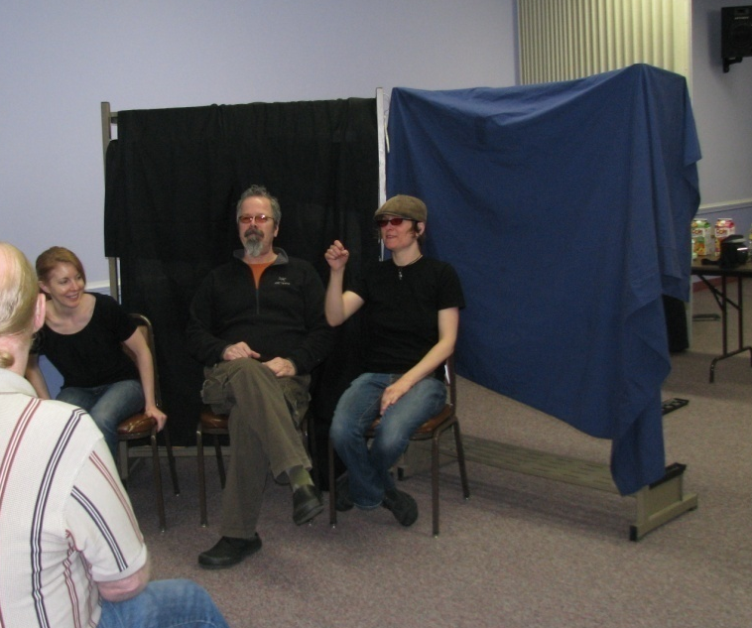

Slide 19
Size & Height
The wall covering should be high enough that the DB participants who are sitting down will see it behind the head of the instructor.
If this is not possible, speakers can be seated.

Slide 20
Drapes
The one shown below is not wide enough.
The instructor has very limited tunnel vision & is using a tactile interpreter but even this narrow backdrop helps reduce glare from the light walls behind.

Slide 21
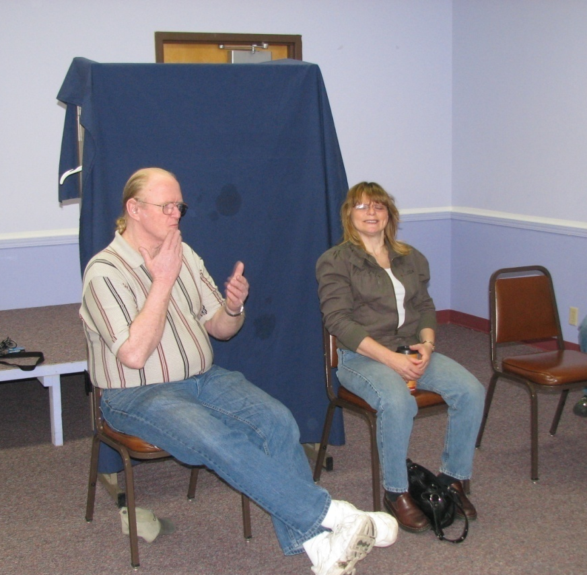

Slide 22
Drapes on Tables
Tables too, may have to be covered with solid, dark-colored cloths.
These gray tables are “non-glare” but are nonetheless tiring to the eyes of people with RP.
The drapes which reduce glare will also help to reduce echoes from hard surfaces for hard-of-hearing people.

Slide 23
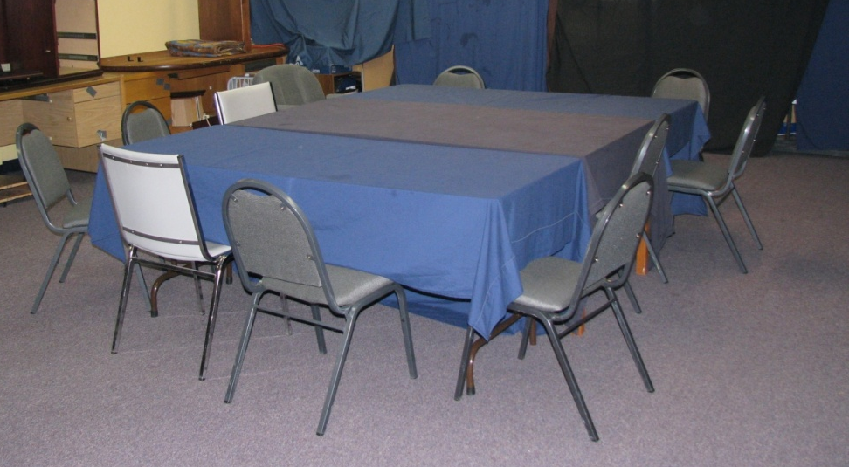

Slide 24
AMPLIFICATION

Slide 25
Amplification
Various Microphones
Large Groups

Slide 26
ARRANGING THE ROOM

Slide 27
SSPs: Chairs & Sight Lines
Hopefully you will have deaf participants in your SSP training. Chairs should be arranged in a semi-circle so all can see clearly.
The typical workshop arrangement (seated in rows) does not work for visual communication.

Slide 28
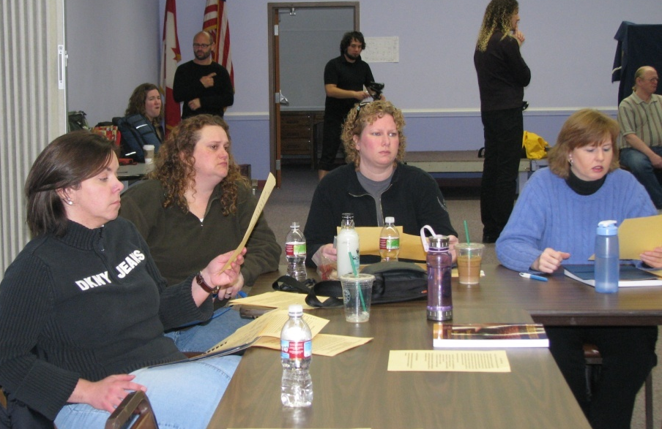

Slide 30
SSPs: Tables & Chairs
It’s good to have tables and chairs rather than classroom tablet-chairs. This way SSP trainees can write notes using the tables, eat a lunch under blindfold (for the experience and empathy) and all can be moved aside and stacked to make space for various exercises (e.g. communication & guiding).

Slide 31
COMMUNICATION

Slide 32
DB Instructors
Deaf-Blind Instructors will need their own interpreters.
If the instructors use tactile signing, the interpreter will copy the participants’ questions and comments.
In the next two slides the DB instructors lecture to trainees. The interpreters on their left are ready to copy/interpret comments of the trainees.

Slide 33
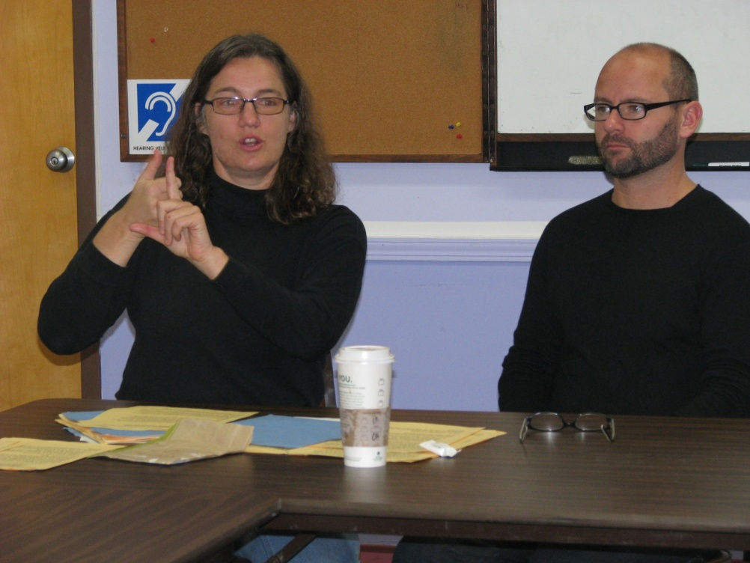

Slide 35
Communication and DB Participants
Some deaf-blind participants will read signs tactually.
Some deaf-blind participants will read signs visually using tunnel vision or close vision.
Some will listen auditorily with amplification.
Some are in transition and may use a combination of communication modes.

Slide 36
Platform - “Copy Interpreter”
It is more difficult for people with tunnel vision to look back and forth between instructor and other participants.
This is also true for deaf interpreters who are working with tactile DB people.
The solution is a ‘copy interpreter’ who stands next to the instructor.

Slide 37
‘Copy Interpreter’
The next slide shows a copy interpreter for a large group. The speaker (next to the podium) and interpreter are on a raised platform.
The copy interpreter is copying comments and questions from participants. You will notice that both are focused downward on the participant asking a question.

Slide 38
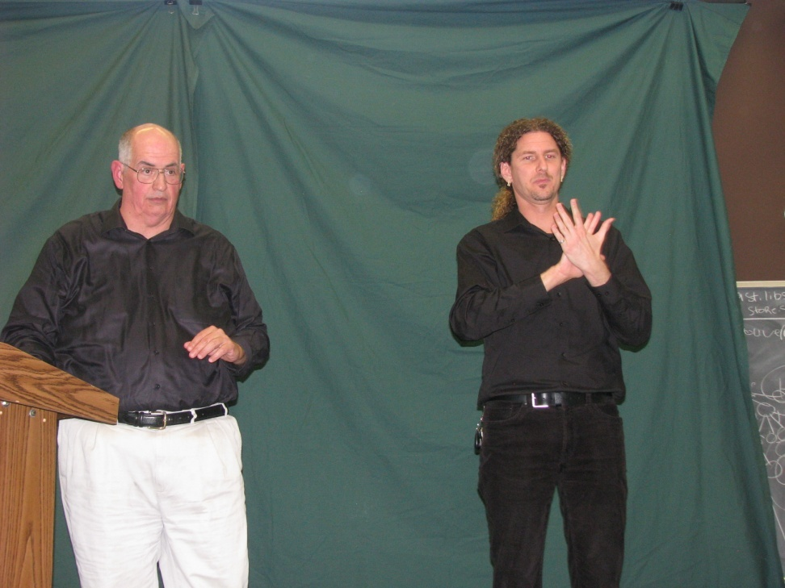

Slide 39
‘Copy Interpreter’
There should be a dark backdrop behind the copy interpreter and good front lighting.
In the next slide, the copy interpreter indicates yielding the turn back to the speaker (pointing). The copy interpreters’ hands are raised to stay within a small circle for people with very limited tunnel vision.

Slide 41
Close Vision Interpreters
Next is a picture of a small meeting with about 10 participants.
Below right, a deaf-blind woman uses a ‘close vision’ interpreter.
Notice the glare from the window light and the undraped tables – not good.

Slide 42
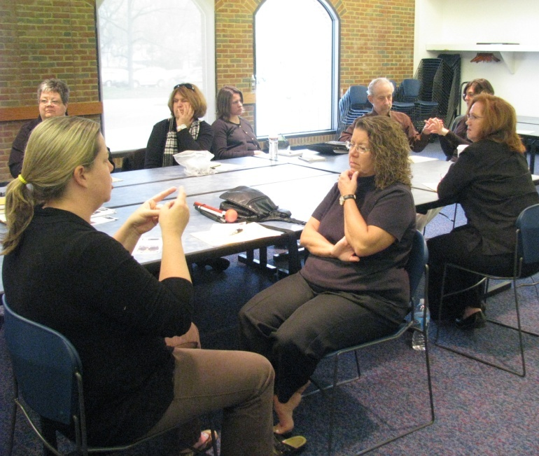

Slide 43
Voice Interpreter
The voice interpreter speaks into and FM microphone for hard-of-hearing DB participants.

Slide 44
Using an FM System
The FM microphone has an off/on switch in the device held by the voice interpreter.
The interpreter should be careful to
Make sure the antenna (wire) is unfolded
Hold the microphone at the best distance
Keep the microphone clear of clothing that will create additional rustling background sounds

Slide 45
Communication Checklist
Interpreters for the instructor (tactile, close vision or tunnel vision)
Platform or ‘Copy’ interpreters
Platform “voice” interpreters
Tactile interpreters
Close vision or “small group” interpreters
Amplification
Captioning

Slide 46
Interpreting and Time Lag
All interpreters need to be considered in turn taking.
The teacher will monitor the interpreters to be sure all are caught up and everyone has time to then look back to the speaker/teacher.
When there are layers of interpreters (e.g. DB participant to copy interpreter to tactile interpreter) this is especially important.

Slide 47
Breaks
Most people do not sit in meetings or classrooms all day. Breaks are both an opportunity to rest arms for interpreters and DB people, and for students a chance to both digest what they have been learning and to connect with one another.

Slide 48
LABS

Slide 49
Lab
Choose a site in which SSPs might typically work such as a store. Chain stores have many layers of management and it is difficult to get permission. Independent stores are often the most accommodating.
These “real” settings will not have the same accommodations for light and glare but the participants can practice their new skills.
Notes:
Note: add period on the last bullet?

Slide 50
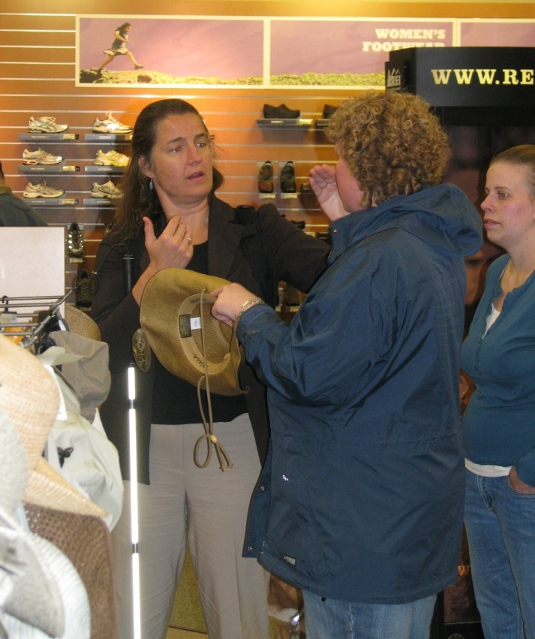

Slide 51
Outdoors
Conducting discussions outdoors is sometimes necessary due to space, but:
There might be glare (notice the windows here)
It will take time to arrange yourselves so that everyone can see/hear the discussion
Notes:
Note: period points on both bullets?

Slide 52
Outdoors, cont.
In the next slide the DB woman with tunnel vision on the left is watching the close vision interpreter angled to take advantage of the blue pillar as background.

Slide 53
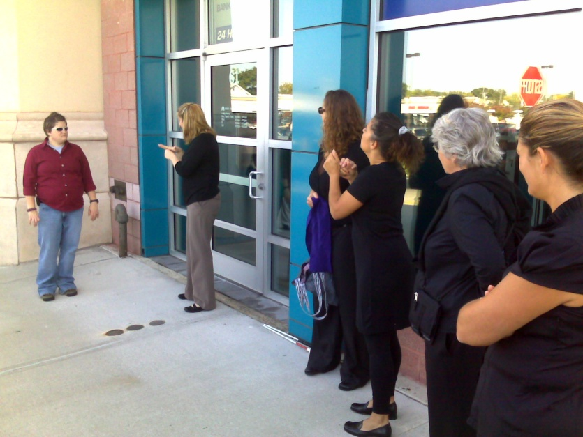

Slide 54
Acoustics
Acoustics will also likely be a problem outdoors (ambient noise such as traffic, and bare walls that bounce sound).
Deaf-blind participants who need to be near to listen may also need their own interpreter.

Slide 55
Acoustics, cont.
Wind both disperses the sound of speech, and creates noise, sometimes even blowing over the microphone itself.
DB people who do not need a microphone in a quiet environment may need one outdoors.

Slide 56
Additional Interpreters for Outdoors
If there is a lack of good backdrops or sight lines, additional interpreters may be needed for participants who would otherwise watch the speaker/platform interpreter directly.
In the next slide, each DB person had their own interpreter.

Slide 57
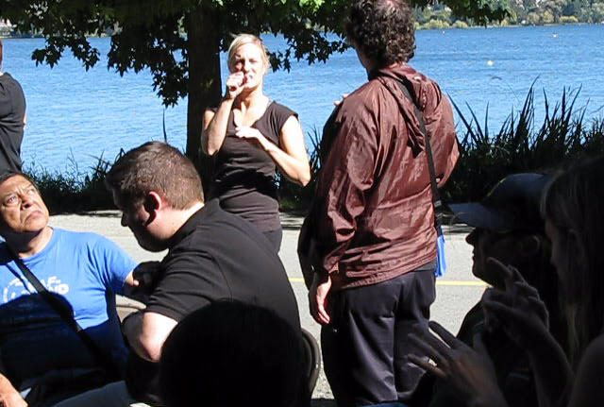

Slide 58
OTHER CONSIDERATIONS

Slide 59
Communication & Schema
Most DB people will have had some prior experience using SSPs, but most will not have had any formal training on the role or skills in using an SSP.
The concept of SSP as distinct from:
Helper,
Buddy,
Driver .. and so on, may have to be clarified.

Slide 60
Assertiveness
Many DB people are grateful for any assistance and may not have practice thinking about what they themselves would like or how an SSP can be most useful.
They may not think about requesting drapes on the tables or shades on the windows. They may feel afraid to ask.

Slide 61
Assertiveness & Accommodations
The power difference between people with good vision and hearing and people who are deaf-blind is significant. It is important that the system bolster the power of the DB person so they feel comfortable being assertive about their communication needs.

Slide 62
Privacy - Time - Safety
Private time and space for DB trainees to discuss issues with DB teachers, who understand the power dynamics, supports this assertiveness.
This means two separate spaces: one for DB trainees and one for SSP trainees.
The curriculum is divided into modules which instructors can stretch to suit the participants.

Slide 63
Grouping
Most experienced deaf-blind teachers we interviewed preferred one-on-one instruction even when the communication mode of several DB participants was similar because background information or schema may be significantly different.
Small groups can be more strain on the instructor.

Slide 64
BUT…
A few instructors prefer teaching in teams and doing additional planning so that DB participants can have the benefit of both a group experience, learning from one another, and one-on-one time with the instructors. (See interview with instructor aj granda.)

Slide 65
Conclusion
Arranging training for paired groups of SSP trainees and DB trainees takes a great deal of coordination.
Preparation includes gathering non-reflective solid-color drapes, identifying resources for FM systems, scouting the area for a good training site, lab sites and qualified interpreters.

Slide 66
Conclusion, cont.
It also includes getting permission to use these sites.
The important point is that all this preparation is essential to a successful session.
Notes:
Heading: Conclusion Cont. ?

Slide 67
Conclusion, cont.
It is often good to work in a team so no one person has to do it all.
The first time you arrange such a training it may feel overwhelming, but once you have organized your kit of materials and regular resources it will be no more trouble than any other training.

